Slide 1

Browser-Based DLP
&
GenAI security

Slide 2


What is HAPPENING?
בשקפים האלה, שאינם שקפים כלליים, נשמח לראות עיצוב שונה מהעיצוב של מצגת ההרמוני, אותה צבעוניות (הסגול) אבל עם משהו שמייחד את המוצר כתת קטגוריה. חשוב לנו שיהיה בו משהו שייחד את האנדפוינט מהמובייל- זה יכול להיות צבע או backround pattern לדוגמא
Ransomware
& Phishing
AI
Hybrid Workforce
Skill Crunch
Notes:
AI- AI has become increasingly important in today’s world, as it has the potential to revolutionize many industries, including Healthcare, Finance, Education, and more.
The use of AI has already improved efficiency, reduced costs, and increased accuracy in various fields. Cybercriminals may use AI to easily create new and sophisticated cyber attacks. On the other hand, the effectiveness and precision of threat detection and response could be greatly enhanced by AI capabilities
Elections Spotlight: Generative AI and Deep Fakes - Check Point Research
Hybrid- The ongoing hybrid work revolution is reshaping traditional meeting dynamics and office needs. Technology, particularly Generative AI, is enhancing both physical and virtual meeting spaces. In 2024, virtual meetings will become immersive, AI-powered experiences, transforming traditional meeting rooms into flexible, high-impact spaces. Hybrid Work requires specific cybersecurity capabilities, Highlighting the need for Cybersecurity products for Remote Workers and BYOD Policies
Skill Crunch- A shortage of professionals with the skills needed to protect organizations from cyber attacks continues to be a running theme throughout 2024. A greater investment in training or the use of Managed Services is expected to rise in 2024
The coming security talent crunch and what it means for IT (techbeacon.com)
Ransomware & Phishing: as always, Ransomware and phishing remain the 2 biggest concerns with a constant rise in both attack number and sophistication … (*add numbers*)
Ransomware Trends 2023 Report (cyberint.com)

Slide 3
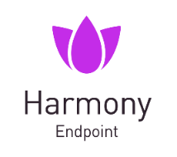
Harmony Endpoint Blocks all entry points
Incident Management
Research Intelligence
XDR & MDR
Monitoring & Incident Handling
Deployment & Policy Handling
Threat Hunting Automated Remediation
Forensic Report
MITRE Mapping
Remote Access VPN
Firewall
Application Control
Endpoint Compliance
EDR
Access Control
Threat Cloud
IOC Management
Threat Intelligence
Sandboxing & CDR
Threat Emulation
Threat Extraction
Anti-Ransomware
Behavioral Guard
Intel TDT
Anti-Bot
Anti-Malware
Anti-Exploit
Port Protection
Threat Prevention
Browser
Security
Zero-day Phishing
DLP (Data Loss Prevention)
GenAI Security
URL Filtering
Corporate Password Reuse
Safe Search
Data Protection
Posture Management
Full Disk Encryption
Media Encryption
Vulnerability Management
Patch Management
Inventory Management
Notes:
Now, as I just mentioned, consolidation is extremely important for our customers.
This is what we are offering to our customers as part of our one consolidated solution:
Access control – including remote access VPN.
Sandboxing and CDR – Including Threat Emulation and Extraction.
Web Protection – Including Zero-Phishing and DLP, this is a Hugh competitive advantage, as our competitors are completely ignoring this attack surface.
Posture Management – Including our newest capabilities of Vulnerability Management and Patch Management.
This is part of our cooperation with Ivanti.
Data Protection – Including Full Disc Encryption.
Unique approach of Prevention first – Including Anti Ransomware and our new integration with Intel TDT.
Threat Intelligence – Including Check Point Brain, ThreatCloud.
Advanced EDR capabilities – Threat Hunting and MITRE Mapping.
XDR - Including incident management and research intelligence.
Just think about how many different product and clients we can replace with our consolidate solution.
With Only one vendor, one client and one management console. This is a Hugh competitive advantage.

Slide 4



Data Loss Prevention - What is it?
Data Loss Prevention (DLP) is a set of tools and processes,
used to ensure that sensitive data is not:
Accessed by Unauthorized Users
Lost
Misused
Notes:
Solving these challenges might prove harder

Slide 5
GenAI Adoption
The use of Generative AI tools in businesses is increasingly growing.
While GenAI tools and apps accelerate the business,
it also might put its data and compliance data at risk:
New GenAI apps are introduced on a daily basis, and are not always trusted
Users’ prompts might contain sensitive business data
New regulations demand more visibility and control

Slide 6
Conventional Solutions are not Enough
Conventional DLP solutions are based on keywords and patterns, while sensitive data is sometimes unstructured.
Understanding the context of the data is essential for determining if it is confidential
To enable safe use of GenAI apps, you need to discover and assess the risk of using it, prevent data loss though apps, and ensure visibility to meet regulations.
Notes:
Solving these challenges might prove harder

Slide 7

Data Loss is a Significant Concern for Organizations World-Wide
$4.35 M Is the Global average Data Breach Cost in 2023
38% of IT Professionals worry about Mobility & BYOD policies
94% of companies that experience a severe Data Loss Accident Never Recovered
Notes:
The above causes these pain points / challenges for organizations
Protecting against sophisticated attacks- attackers always work to find the next hole in the fenc. with AI on their side, attacjers are quicker and deadlier. here‘s an example of an attack originated from a surprising USB device
Covering all attack surface- not having full coverage creates holes in your net when you actually need a waterproof cover. But covering all is difficult
Managing multiple security solutions-many solutions means gaps between solutions, in addition , your security team is berdined by operating different platforms- waste time and cant see the full pic

Slide 8



Challenges in Protecting the Organization
Data Loss
Financial Risk
Reputation
Intellectual Property
Customer Data
Employee Data
Ransom Demand
Legal Cost
Brand Reputation
Customer Trust
Notes:
The above causes these pain points / challenges for organizations
Protecting against sophisticated attacks- attackers always work to find the next hole in the fenc. with AI on their side, attacjers are quicker and deadlier. here‘s an example of an attack originated from a surprising USB device
Covering all attack surface- not having full coverage creates holes in your net when you actually need a waterproof cover. But covering all is difficult
Managing multiple security solutions-many solutions means gaps between solutions, in addition , your security team is berdined by operating different platforms- waste time and cant see the full pic

Slide 9

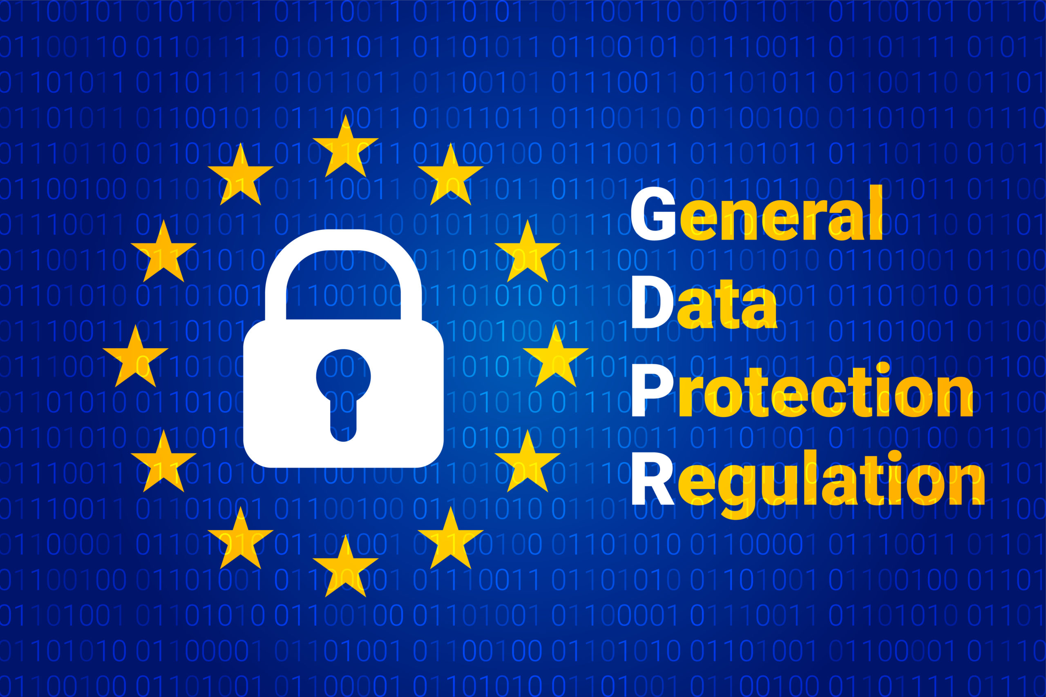
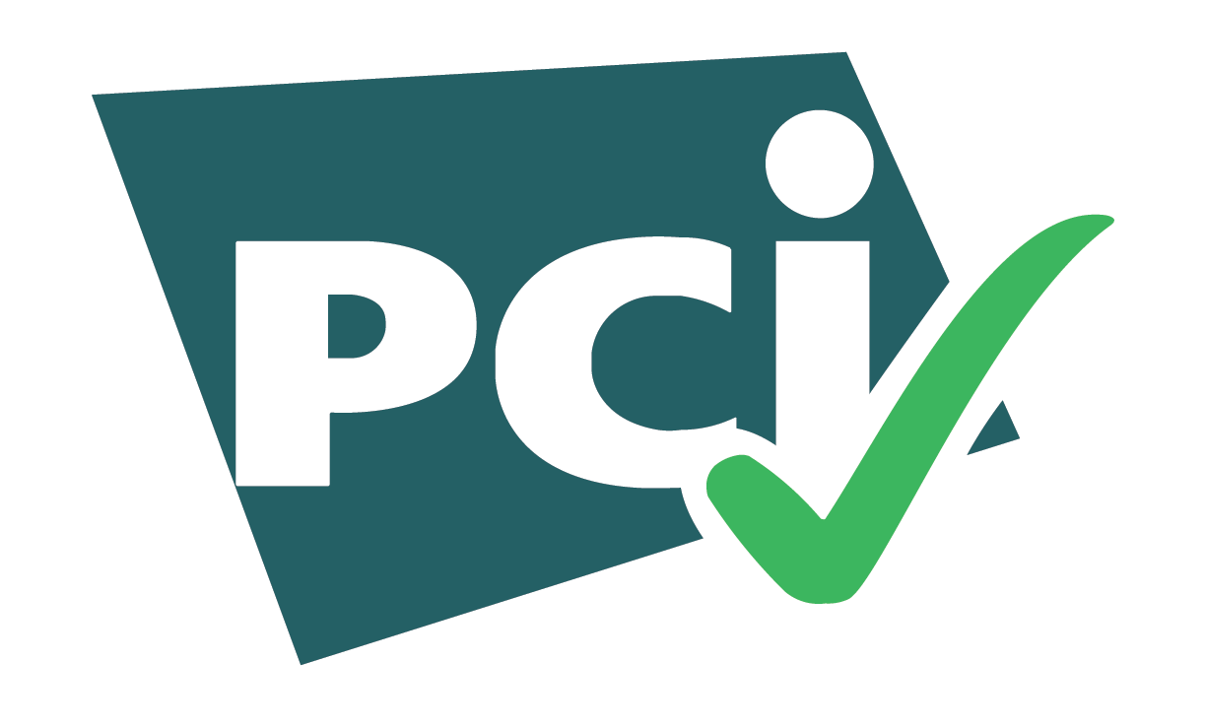


Regulation Need

Slide 10



How can we Improve it?
Safeguarding your valuable information with ease through our browser-based DLP & GenAI security:
Simple
Powerful
Tailored for modern needs

Slide 11
Browser-Based DLP & GenAI Main Capabilities
DLP & GenAI
Safe Use of GenAI Platforms
AI Based Classification, to allow restrictions on unstructured data
App Inventory for usage tracking
Risk Insights based on end users' behavior
Policy based upload scanning
File upload will only be permitted if it meets policy restrictions
GenAI Security
Upload Files Scanning
Multiple Data Types Restrictions
Multiple options to data type setting, including 700+ predefined data types, custom data types, and data type grouping
Policy based download scanning
File download will only be permitted if it meets policy restrictions
Data Type based Policies
Download Files Scanning
Clipboard Control
Clipboard restrictions
Copy-Paste restrictions
Print Restrictions

Slide 12
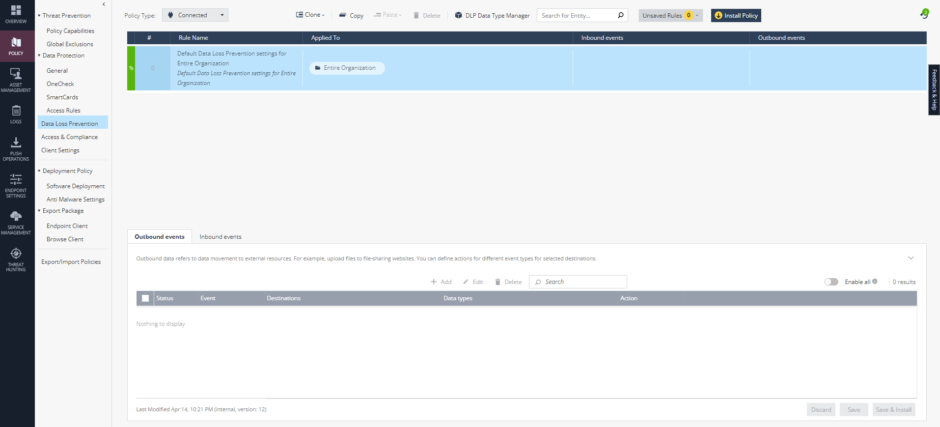
DLP Policy
Access
Data Type Manager
Set Policy
Based on your Company needs

Slide 13
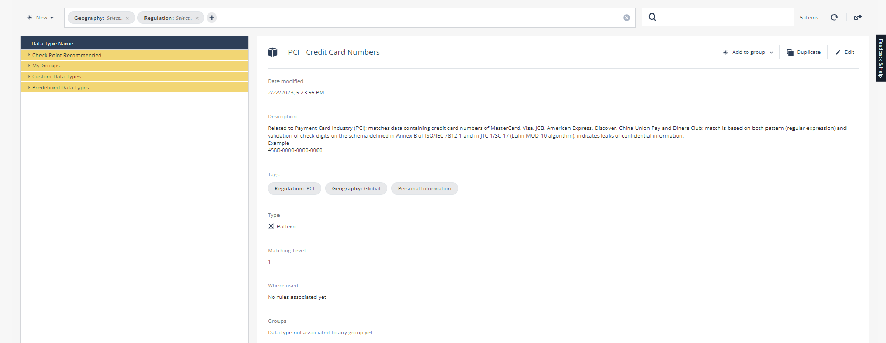
DLP Data Type Manager
Check Point recommended data types
Add to one of your defined groups
Create your custom date types
700+ pre-defined data types
Choose your preferred threshold

Slide 14
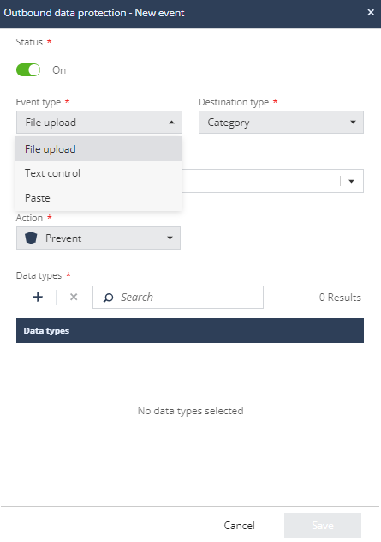
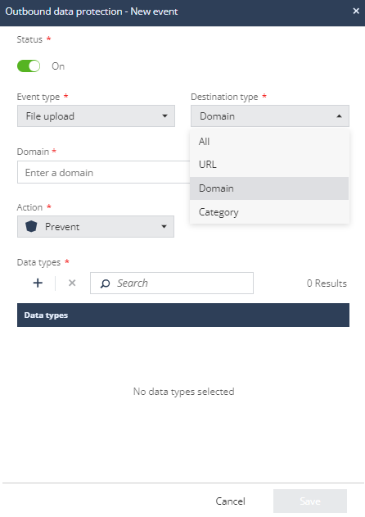
Download & Upload Scanning
Set your policy to On\OFF, per rule
Set your protected domains

Slide 15
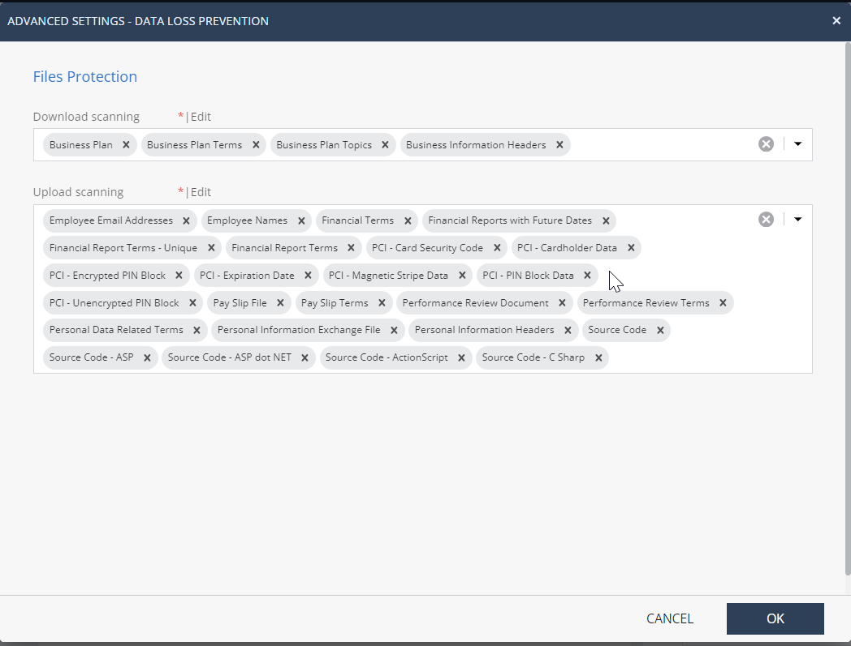
Pre-Defined Data Types
Choose from over 700 pre-defined data types, per rule

Slide 16
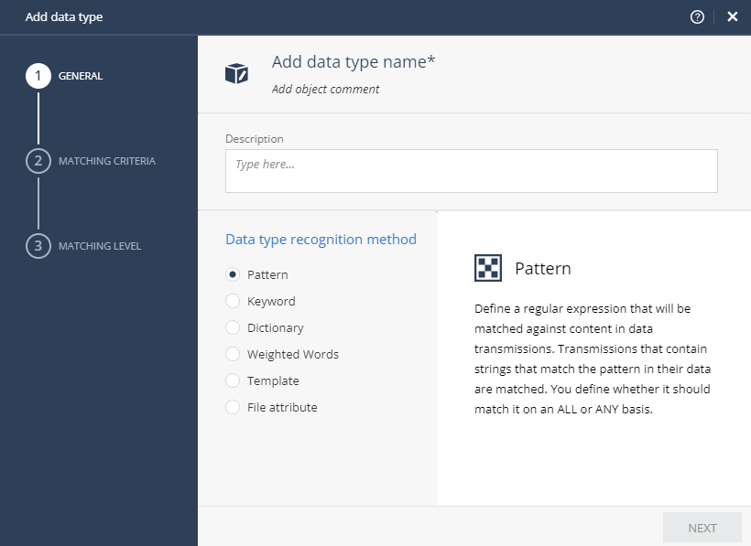
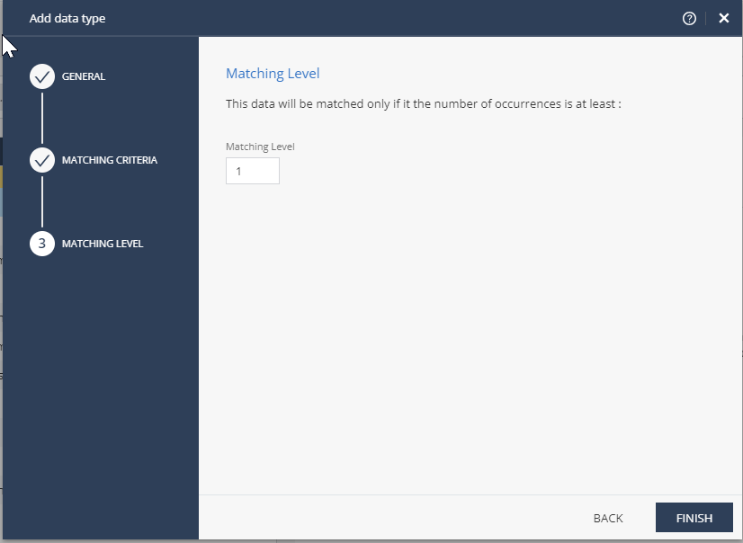
Custom Data Types
Choose the matching level for enforcement
Choose data type recognition method

Slide 17
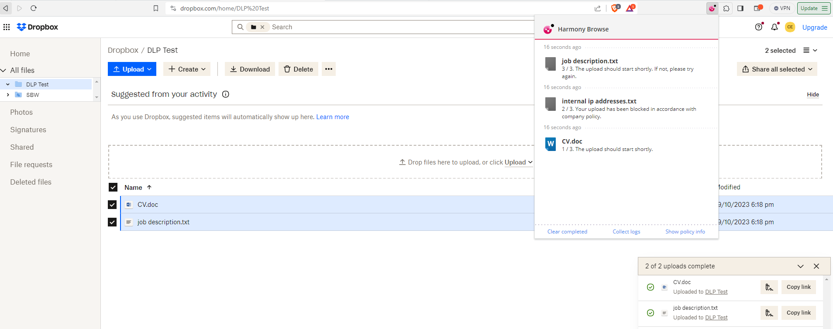
End User Experience
User tries to upload 3 files:
2 files are uploaded successfully
1 files is blocked by DLP in accordance with company policy

Slide 18
Get Insights and Assess Risk of
GenAI Usage
Uncover GenAI usage, including shadow services
Discover if your data is being used to train GenAI tools
See prompts containing sensitive data
Uncover data lineage of information copied into prompts
Monitor risky activity at the app and session level, and prioritize it using a risk score

Slide 19
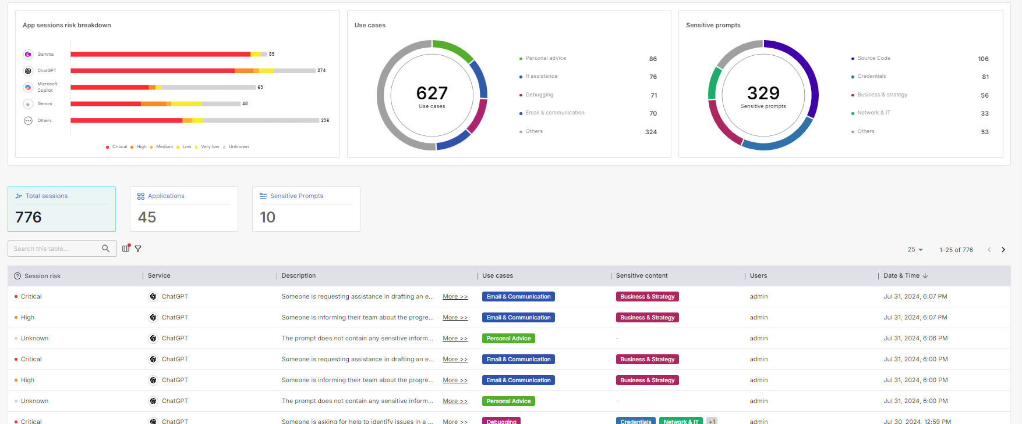
What it looks like?

Slide 20
Map the risks your organization was exposed to due to GenAI usage

Slide 21
Discover what are the common use cases for GenAI tools in your organization

Slide 22
Discover which sensitive prompts were shared in GenAI engines

Slide 23
Drill-down through all sessions to learn more about its risks

Slide 24


Unified Agent Endpoint Security & DLP & GenAI
Safeguard your Data
While Maintaining Productivity
Comply with Regulation & Policies
While Ensuring Seamless User-Experience
Gain Visibility into Data Mobility
With On-Demand Logs & Reports
Complete Consolidation
All from the same Security Platform
TCO

Slide 25

Harmony Endpoint
The Only Endpoint Security Solution You Need
Provides comprehensive market-leading security
  Complete endpoint security
  Prevention-first approach
  Automation & AI for increased accuracy
Reduced TCO
  Easy to deploy and operate
  Consolidated Solution
  Single management for all OSs
  Simplify your security operations
Notes:
To Summaries
Harmony endpoint is the only solution you need:
It provides comprehensive security, including complete endpoint security, Prevention-first approach, Automation & AI for increased accuracy.
It also, Reduces your TCO, by being easy to deploy and operate ,a single management for all Oss, and by simplifying your security operations.
If you want to learn more, schedule a demo, or a POC, the next slide is for you.

Slide 26
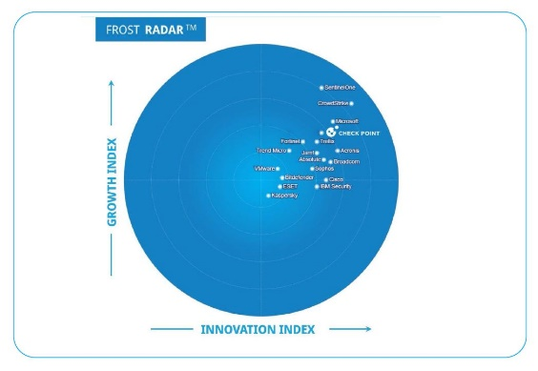
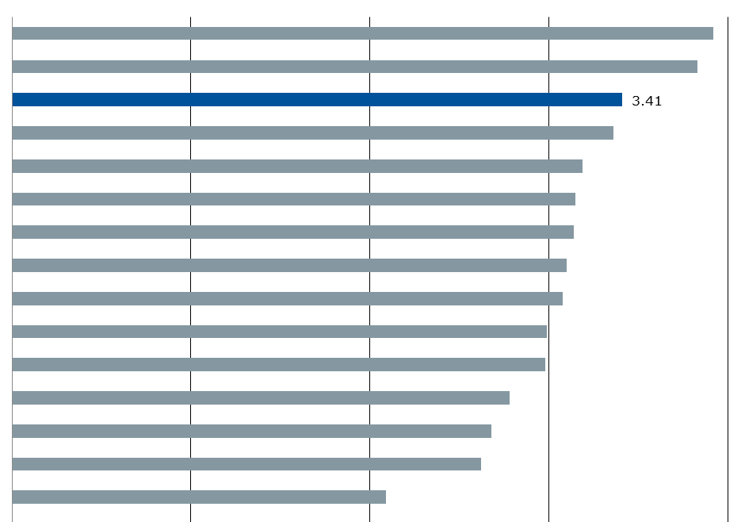
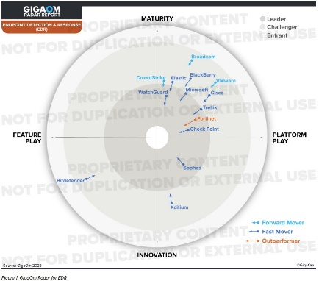
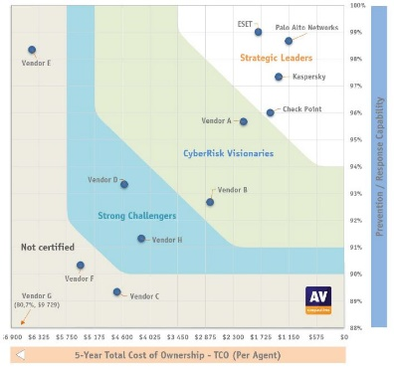





A Leading Endpoint Solution
Leader
Visionary
Leader & Fast Mover
Strategic Leader
Frost Radar for Global Endpoint Security Market, 2023
Magic Quadrant,
Endpoint Security Platforms, 2023
GigaOm Radar: Endpoint Detection and Response (EDR) report, 2023
AV-Comparatives EPR Test, 2023
“Check Point’s Harmony Endpoint
is a comprehensive solution unifying Prevention, Detection,
and Response”
“Check Point’s flagship EPP product
generally suits organizations
prioritizing ease of use,
and pursuing security
vendor consolidation”
“Comprehensive and consolidated approach, which spans a wide range of use cases, and includes powerful investigation and operational features, API-based integration, and a unified management interface”
100% Passive Response
100% Active Response
0 workflow delays
0% False Positive
Notes:
If you want to start a 1:1 demo, you can just scan this QR.

Slide 27
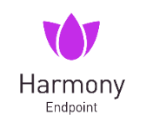




How Would You Like Your Endpoint Security Served?
On the Rocks
Shaken, not Stirred
Make it a Double
It’s 5 O'clock Somewhere
Endpoint Security
Endpoint Security + MDR
Endpoint Security + MDR
+ Global Services
Harmony Endpoint + MSSP Platform
EPP
EDR
XDR
Posture Management
Browser Security
DLP
Sandboxing and CDR
Investigation, Response, Remediation
Incident Response
Monitoring 24x7x365
Threat Hunting Services
Implementation
Policy & Settings
Provisioning
Preparation & Training
Deployment
Harmony Endpoint
Implementation
Settings
Provisioning
Preparation/ training
Deployment
+
+
Security Provided
by Check Point
Security Provided
and Managed
by Check Point
Security and Operations Provided and Managed
by Check Point
Security Provided
by Check Point
Managed by MSSP
[Internal Use] for Check Point employees​
Notes:
We have now launched multiple services which augments our technology to deliver MDR, Deployment and MSSP offering.
Needless to mention that HEP is modular and allow each organization to deploy and implement the solutions gradually (click)

Slide 28



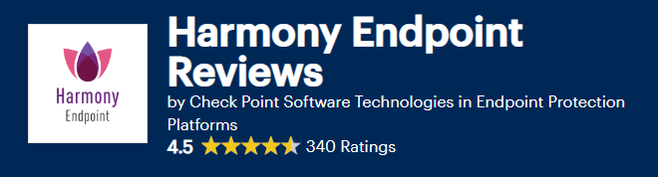
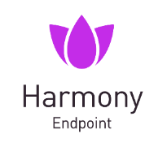



Recommended by Customers
Harmony Endpoint is Complete Package for Security
Harmony is easy to deploy,
manage, and implement
Simplify unified management of a large number of devices, giving flexibility and security for each department
Notes:
And this is the part i’m the most proud of.
What customers are thinking about us.
By the way- you can use Gartner peer insight by yourself, to read customers’ review on Harmony Endpoint.

Slide 29

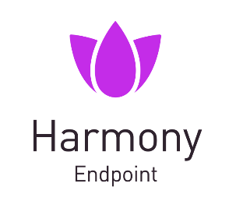



Visit Our Webpage for the Next Steps
Get a 1:1 demo
with a Security Expert
Start a free
Harmony Endpoint trial
Watch the
product tour video
Notes:
To learn more, I would encourage you all to visit our web site, to participate in our CPX tech tables and to evaluate HEP.
Our Harmony specialist are here to help and assist as needed (click)

Slide 30


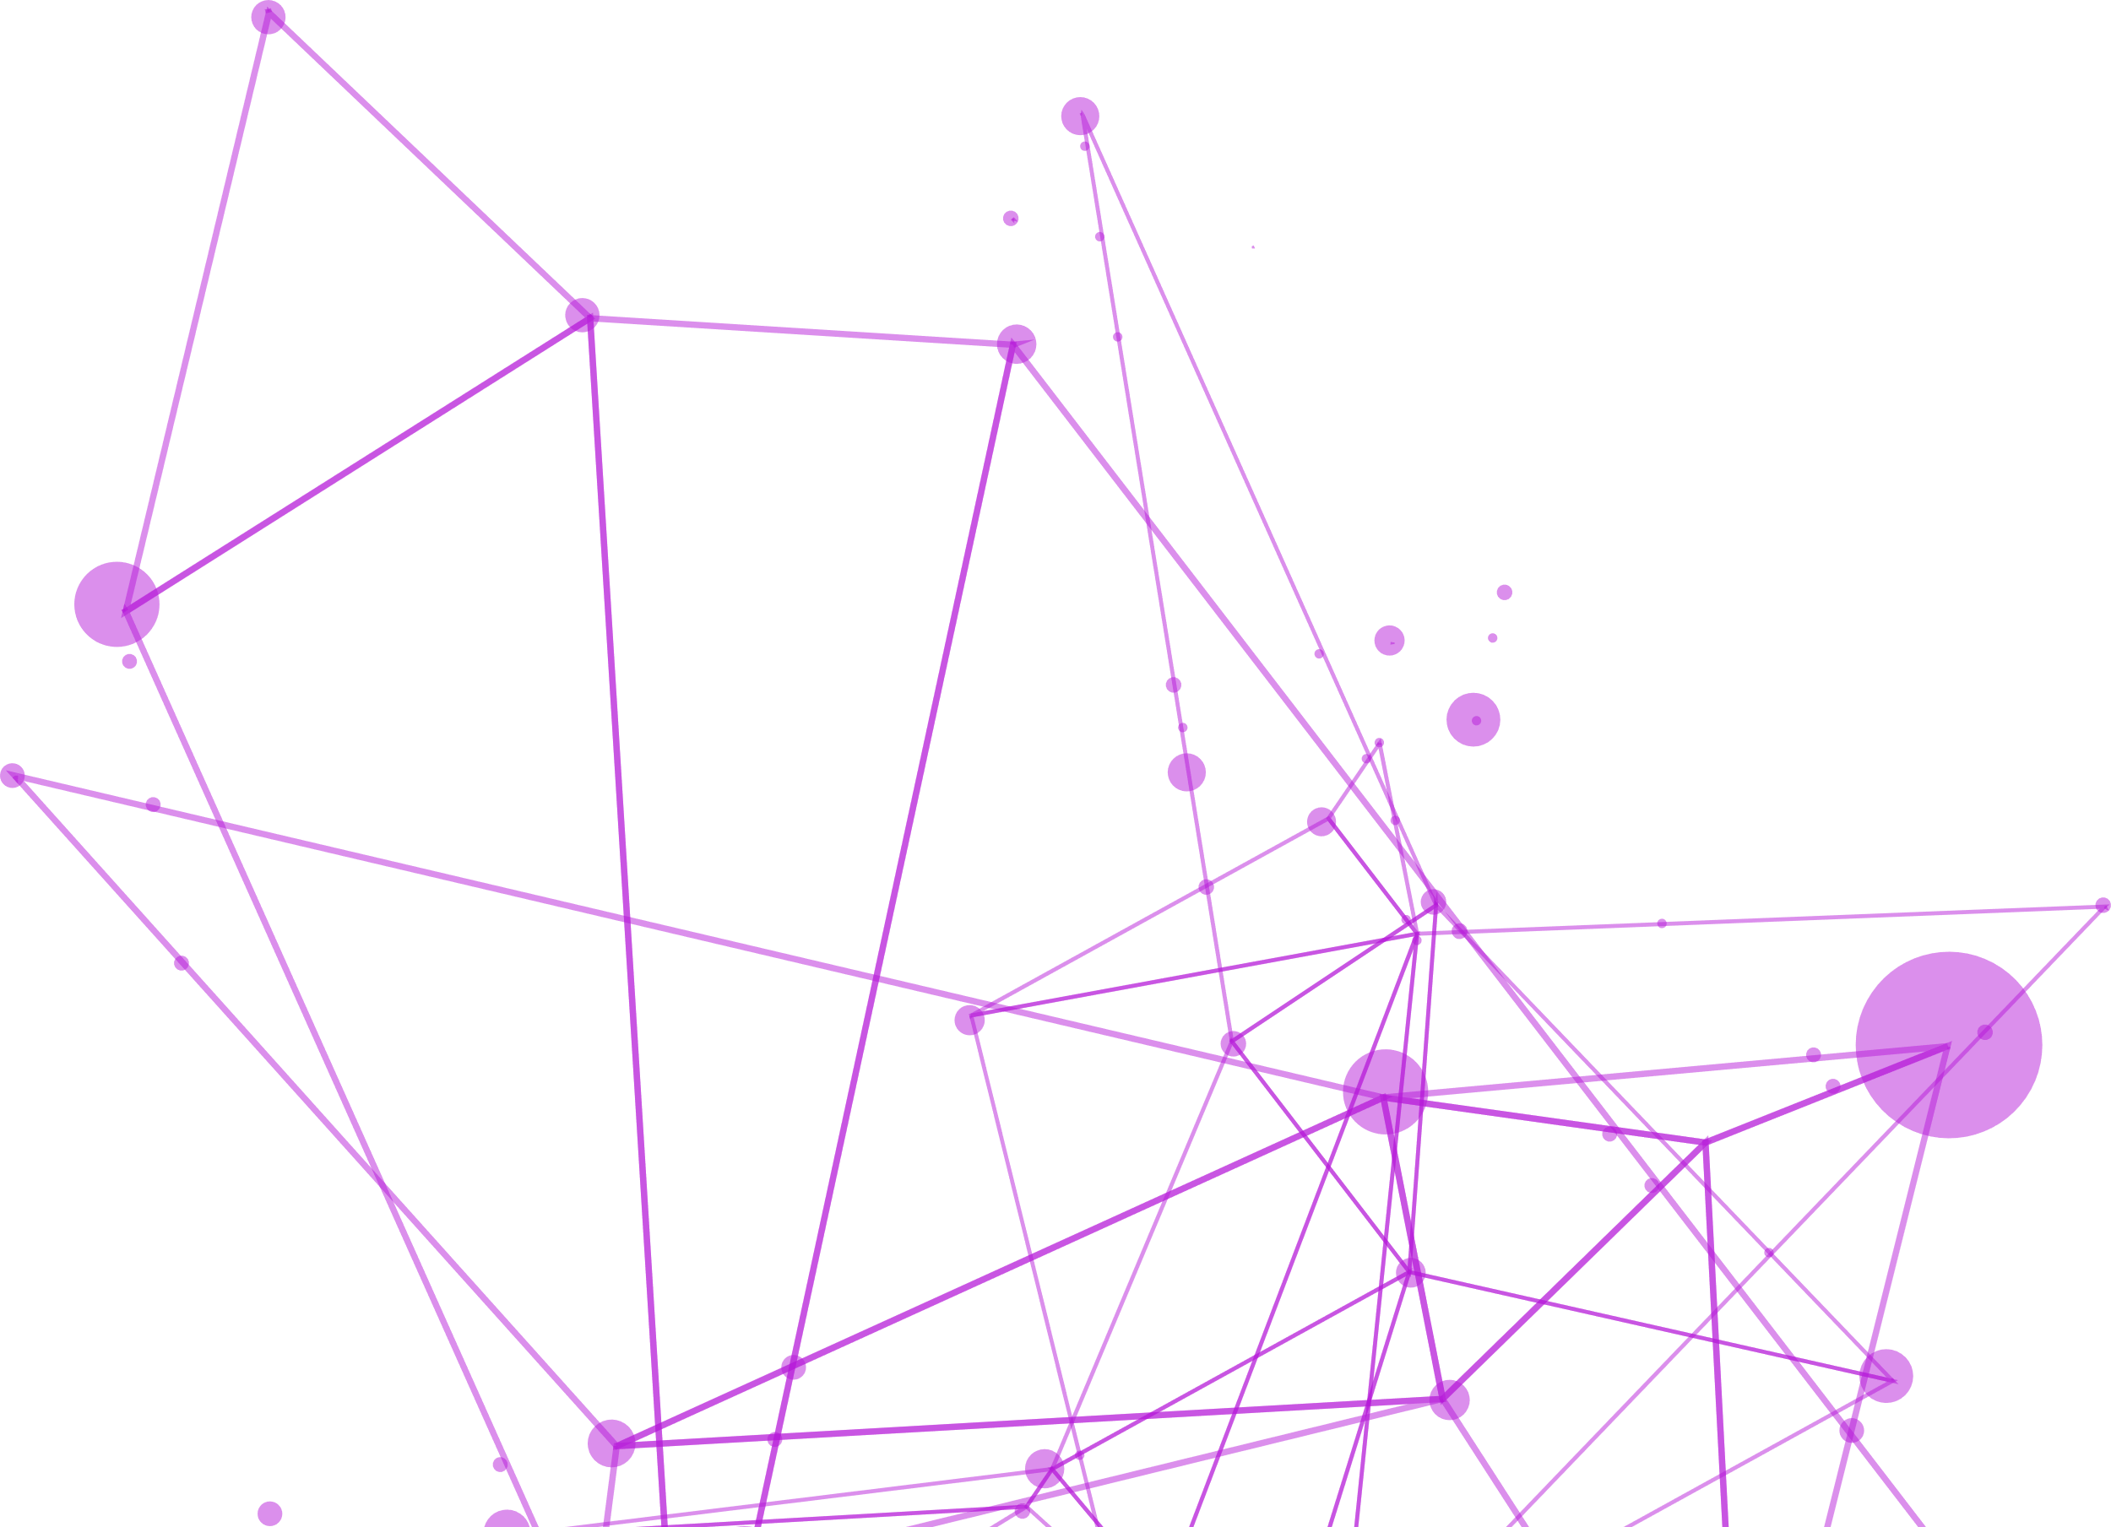

THANK YOU
Notes:
So, what can you do to protect your organization?
Scan the barcode to our webpage and choose how to start- watch our product video, register for a demo, or just jump in and start a free trial.

