Slide 1

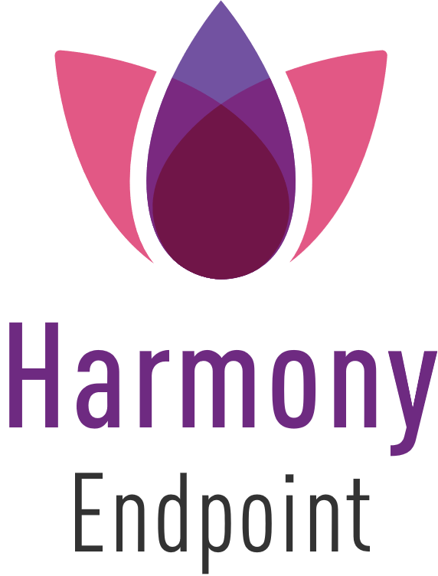

Posture
management
Notes:
Hi
My name is Bar Yassure, and a Product Manager handling Harmony Endpoint.
Today we want to talk about endpoint security and how Harmony Endpoint can reduce the attack surface, using automated vulnerability assessment & patch management.

Slide 2








Endpoints Have Never Been More Vulnerable
Complex Environments
USER ERROR
BOT ATTACKS
PHISHING
DATA THEFT
emails
MALWARE
Remote / Hybrid Work
No longer protected on-premise
WEB-BASED
ATTACKS
Sophisticated Attacks
FILELESS
ATTACKS
Blurred borders
Between personal & organization use
RANSOMWARE
ZERO-DAY
EXPLOITS
Notes:
Lets start with the need.
Our customers are facing many challenges.
First – Organization are running complex environments, including wide range of third party applications, different Operating systems, workstation, VDI, Servers and more…
Also - The move to remote and hybrid workforce means, that employees are no longer protected by on premise measures such as gateways
Additionally – Based on our Check Point Research Group, we are aware to the YoY increase in number of attacks and the level of sophistication.
And Of course - don’t forget the human factor- the use of BYOD, and flexible work hours has blurred the borders between personal and organizational use of endpoint devices.
While there is no doubt about the need for endpoint security, there is not wonder why the market is growing 25% YoY.
The question is – How can we address real challenges??

Slide 3

Security Vulnerability – What is it?
Security Vulnerability is a Operating System, or, Application
code flaw through which attackers can directly gain unauthorized access to a system or network.
Once inside, the attacker can leverage authorizations and privileges to compromise systems and assets.
Ranger Locker ransomware gang demanded ransom from Belgian police using CVE-2022-27511 related to
Citrix Server’s Application Delivery
Management (ADM)
Notes:
So, what is a security Vulnerability?
Security Vulnerability is a Operating System, or, Application code flaw
Attackers can use it in order to start the attack.

Slide 4



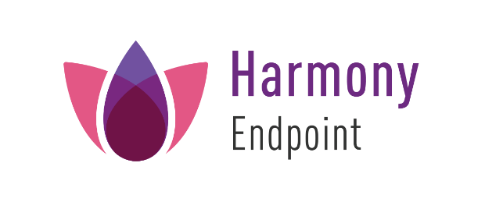
Vulnerabilities are The Entry Point
There are 203,157 Known CVEs,
while 58% are with
high or critical severity
National Vulnerability Database
50% of vulnerabilities
exploited occur within
2-4 weeks of a patch being released
The average time for an enterprise
to response to critical vulnerability
is 120 days
Notes:
Based on our Check Point Research group, Vulnerabilities are the usually the entry point.
The number of new CVEs in on a rise, same as the severity level.
The interesting part is - While 50% of attackers will exploit new CVE within 2-4 weeks, while the average time for an enterprise to patch vulnerability is 120 days.
Security Gap?

Slide 5
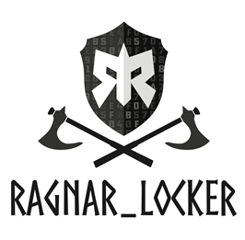


This is not just a Theoretical Risk
Ranger Locker ransomware gang demanded ransom from Belgian police using CVE-2022-27511 related to
Citrix Server’s Application Delivery
Management (ADM)
Notes:
And this is not just a theoretical risk.
Just 1 example, Ranger Locker ransomware gang used new vulnerability to attack the Belgian Police.
Of course, there are many more examples out there.

Slide 6

What is The Challenge?
Multiple Versions
Multiple Applications
Multiple OSs
Ranger Locker ransomwar gang demanded ransom from Belgian police using CVE-2022-27511 related to
Citrix Server’s Application Delivery
Management (ADM)
No Visibility
Time Consuming
Notes:
So, what is the challenge?
10% of business now have more than 200 applications across the organization, with no visibility to vulnerabilities.
Just try to imagine the wide range of installed versions and the time consuming process to patch each vulnerability.

Slide 7
How can we Improve it?
Smart Automated process
Can reduce the attack surface &
Improve operation efficiency
Save Time
Save Money
Minimize Risk
Notes:
So, how can we improve it?
We believe we can improve it with Automated process
Than can reduce the attack surface,
While improving operational efficiency.
The basic idea is – save time, save money, and of course, minimize the risk .

Slide 8
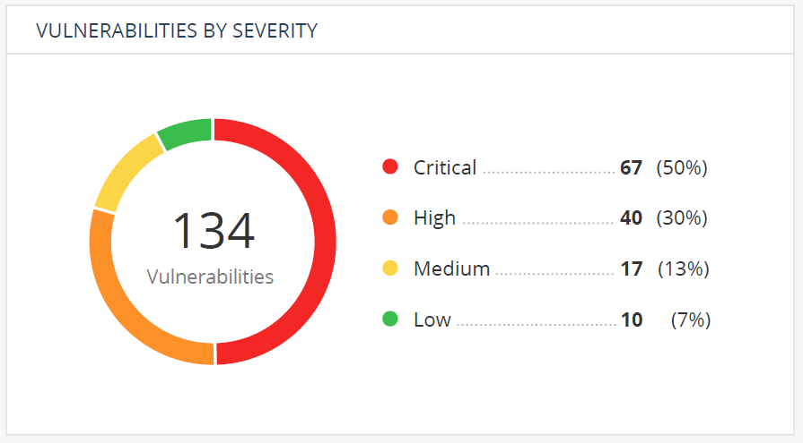
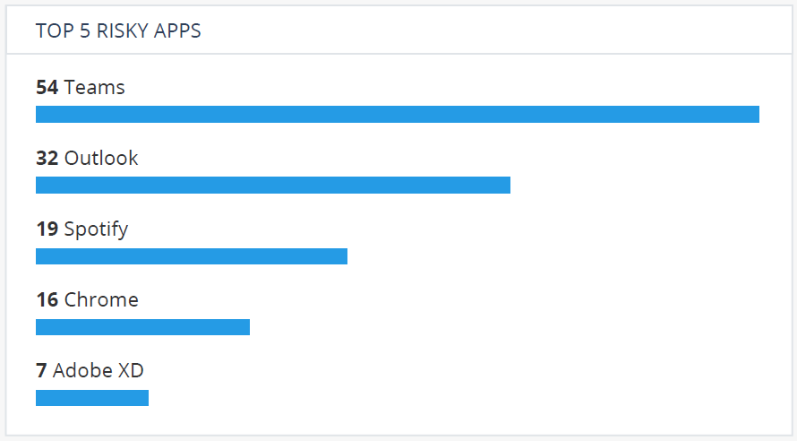

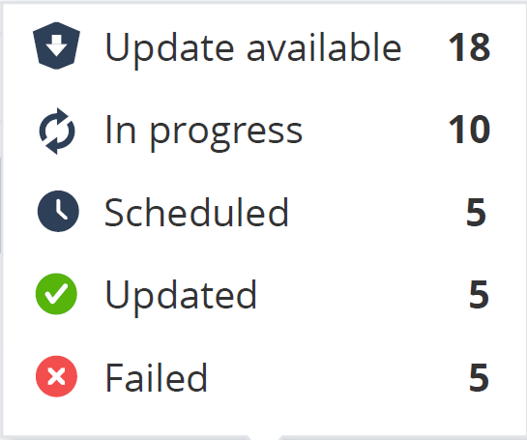
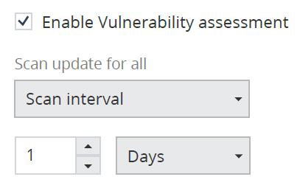
Posture Management Life-Cycle?
Scan
Prioritize
Improve
Patch
Notes:
Lastly, this is our approach to Posture Management.
First – We Automatically scan all devices for new vulnerabilities, with the same client and zero impact on performance.
Priorities – We want to make sure our customers are focusing on what really matters, so we assign risk score to each machine / user / application, based on its impact or criticality.
Patch – Our customers can choose if they want to patch vulnerabilities Automatically or Manually.
Lastly - Improve by checking if the selected policy & timeline needs improvements.

Slide 9
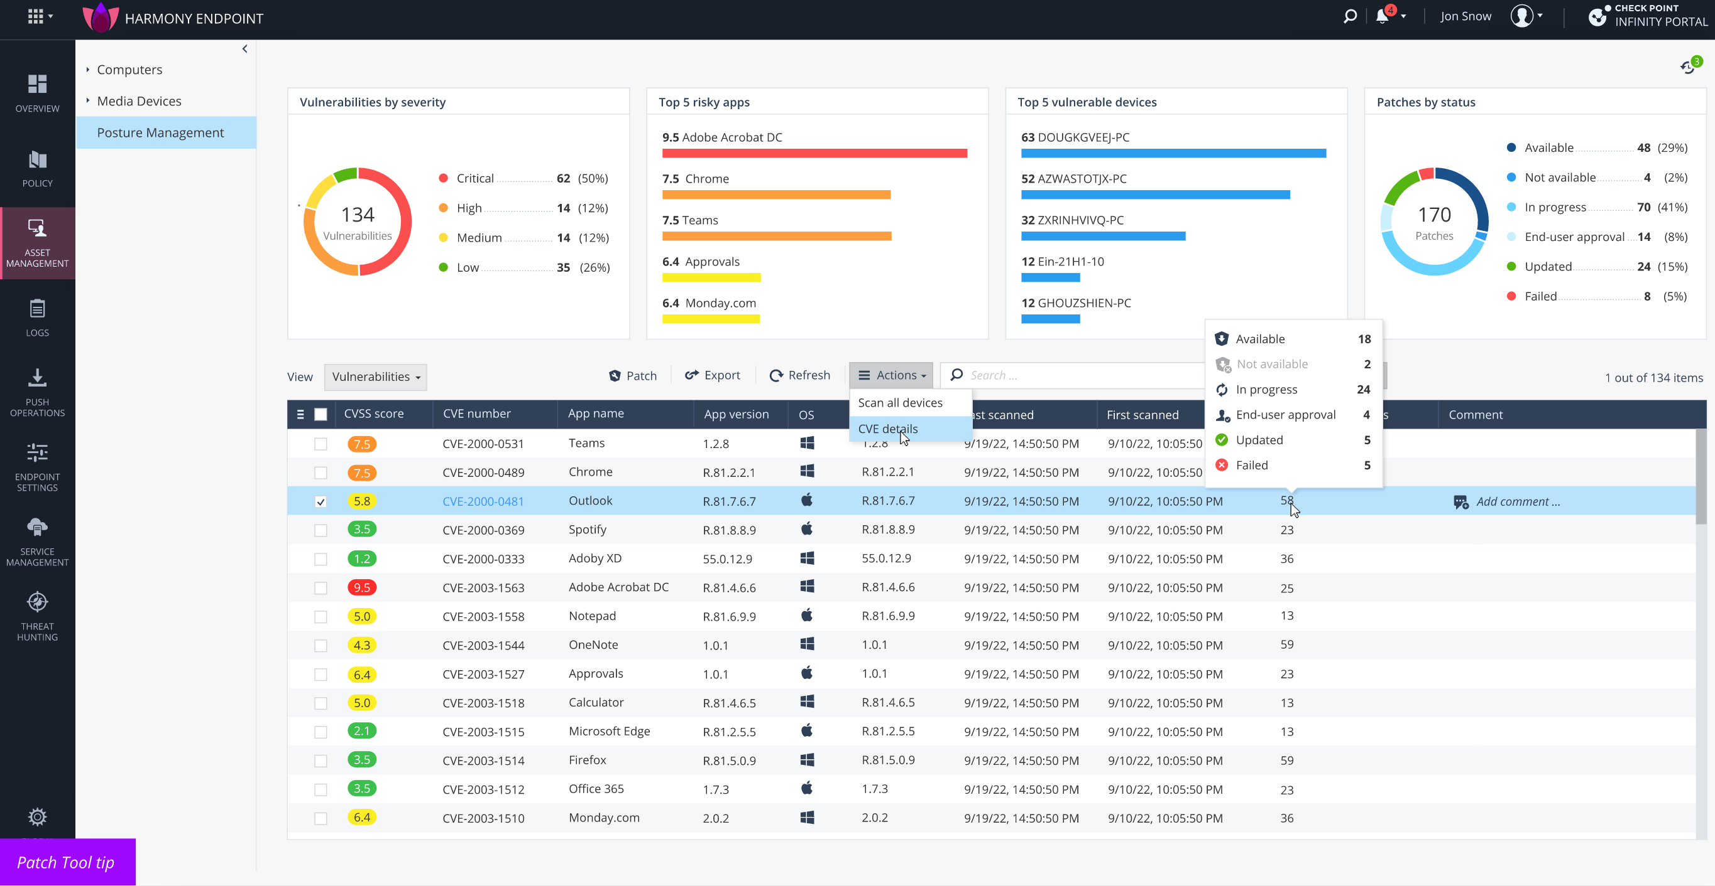
Posture Management
Focus on
the most Vulnerable Application / Machines
Get Live
Patching Status
Focus on
the most Critical Vulnerabilities
Easily Run Patches
View all
Vulnerabilities within the organization
Sort by
CVSS Score
Notes:
And this is how it looks like.

Slide 10
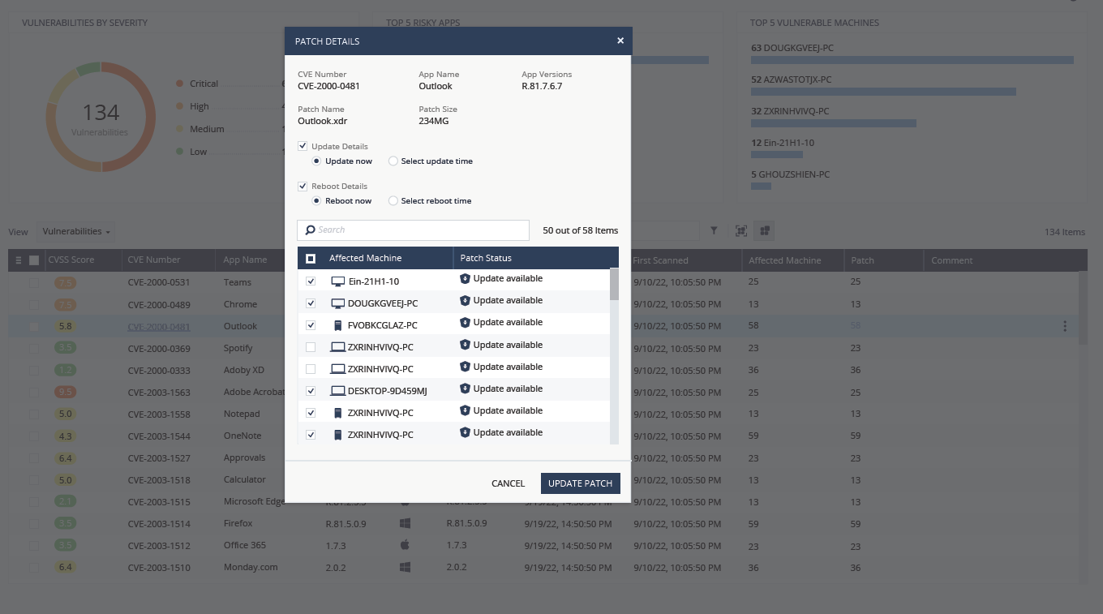
Posture Management
Choose the Machines you wish to Patch

Slide 11
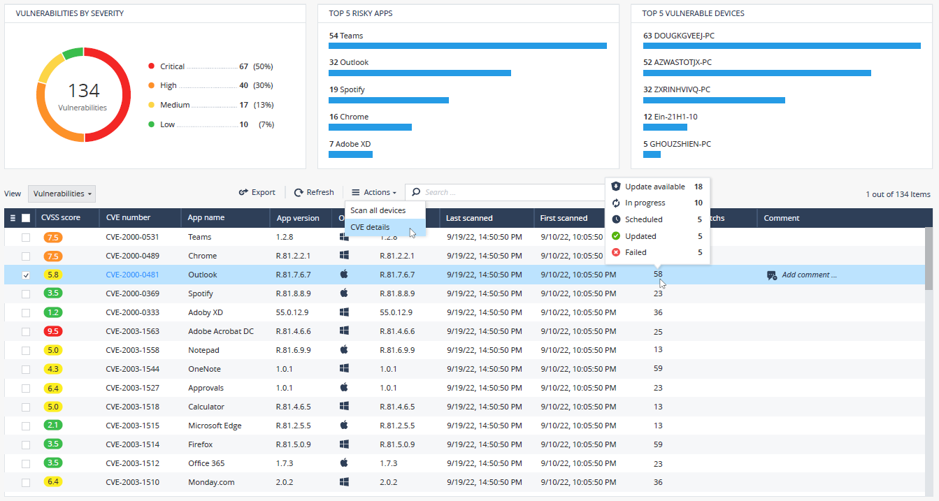
Posture Management
Get Live
Patching Status

Slide 12
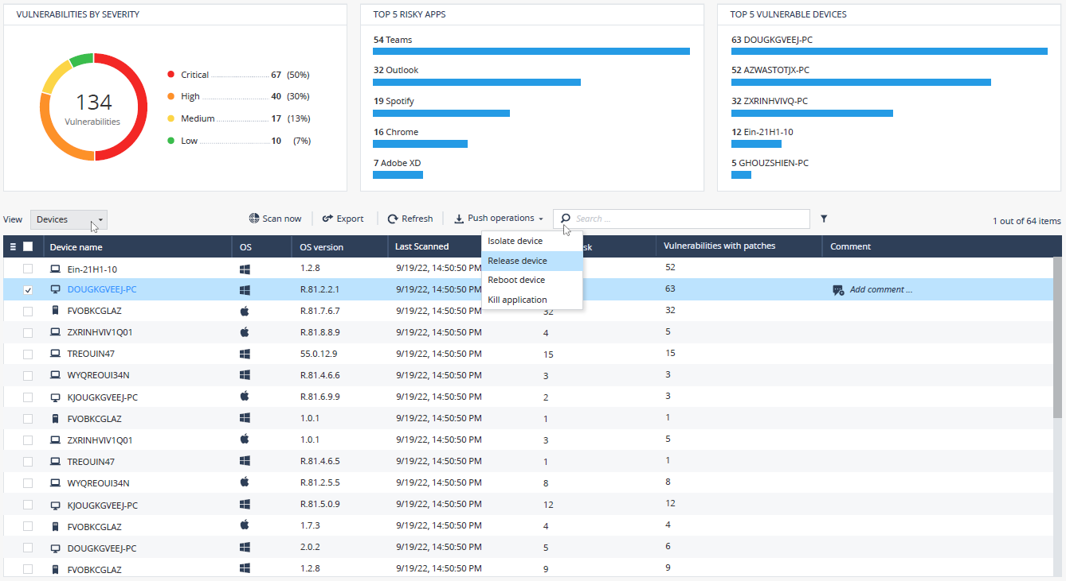
Posture Management
Use
Push Operations to Remediate risks
Switch to
Device-Oriented View

Slide 13
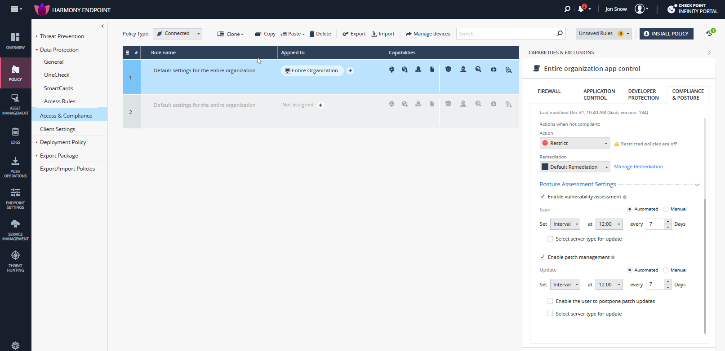
Posture Management
Use Policy to
Automate the
Vulnerability Scanning
Process
Use Policy to
Automate the
Vulnerability Patching
Process

Slide 14



Main Benefits
Fully Automated process – From initial scan to patch
Smart Prioritization
By Severity, Apps, Machines, Identity, Risk-Based Prioritization
Consolidate Solution
Endpoint security & Posture Management tool
TCO
Real-time Patch Management & Validation
For Microsoft & 3rd party
Improved Endpoint Compliance & Application Control

Slide 15

Endpoint Security & Posture Management in One Product
Improved security
  Reduce the attack surface dramatically
  Automatically scan & patch vulnerabilities
  Prioritized risks, focus on the most risky gaps
Reduced TCO
  Improve Operational Efficiency
  Single Client & Management Console
  Cost Effective solution
  Save time & money using a consolidated solution
  Automate & Simplify your security operations

Slide 16
Main Benefits – Consolidated Solution
Enrich Application Control & Compliance Policy with Vulnerabilities data
Performance at peak
No additional client is needed
Vulnerabilities data as part of Threat Hunting
Find the root-cause of an event
Use Vulnerabilities data for Detection & Response
Set the right responses to remediate risks
Get Relevant Alerts & Reports
Automated Alerts & Reports based on your needs

Slide 17
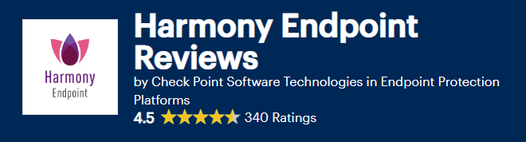
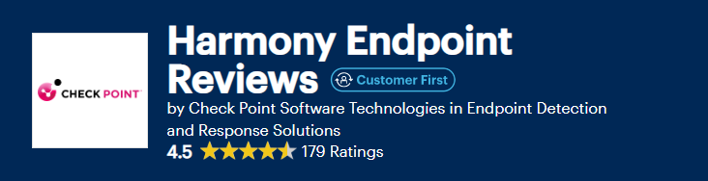

Recommended by Customers
Harmony Endpoint is Complete Package for Security
Harmony is easy to deploy,
manage, and implement
Simplify unified management of a large number of devices, giving flexibility and security for each department
Notes:
And this is the part i’m the most proud of.
What customers are thinking about us.
By the way- you can use Gartner peer insight by yourself, to read customers’ review on Harmony Endpoint.

Slide 18


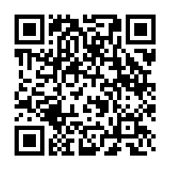


Visit Our Webpage for the Next Steps
Trouble scanning?
https://www.checkpoint.com/products/advanced-endpoint-protection/
Get a 1:1 demo
with a Security Expert
Start a free
Harmony Endpoint trial
Watch the
product tour video
Notes:
If you want to start a 1:1 demo, you can just scan this QR.

Slide 19


Thank you!

