Slide 1
CheckMates- Quantum Gateway and Microsoft Defender for Endpoint
Deep Dive into New Integrations with Infinity XDR/XPR and Playblocks
Yael Cinamon | Product Manager
May 2024
Notes:
Quantum Gateway and Microsoft Defender for Endpoint –Deep Dive into New Integrations with Infinity XDR/XPR and Playblocks

Slide 2
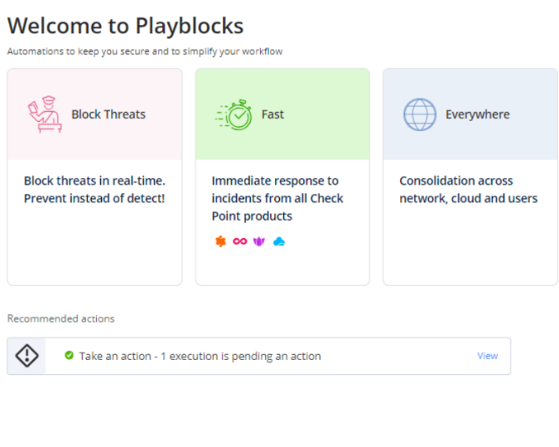













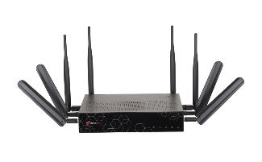
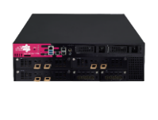




Infinity: Prevention-First Security Operations
Extend the reach of siloed security solutions to stop attacks across your enterprise, with automation and collaboration of products, people, and processes
Automation and
response platform
Collaborative threat prevention through intelligent AI correlation
24/7 SOC Service,
365 Days
Microsoft Defender for Endpoint
Notes:
Check Point launched Playblocks in October 2023 as the newest part of the Infinity Prevention-First Security Operations & AI tools and services.
Playblocks extends the reach of siloed security solutions to stop attacks across your enterprise, with automation and collaboration of products, people and processes.

Slide 3

Security Automation & Response
Collaborative Security In Action

Slide 4










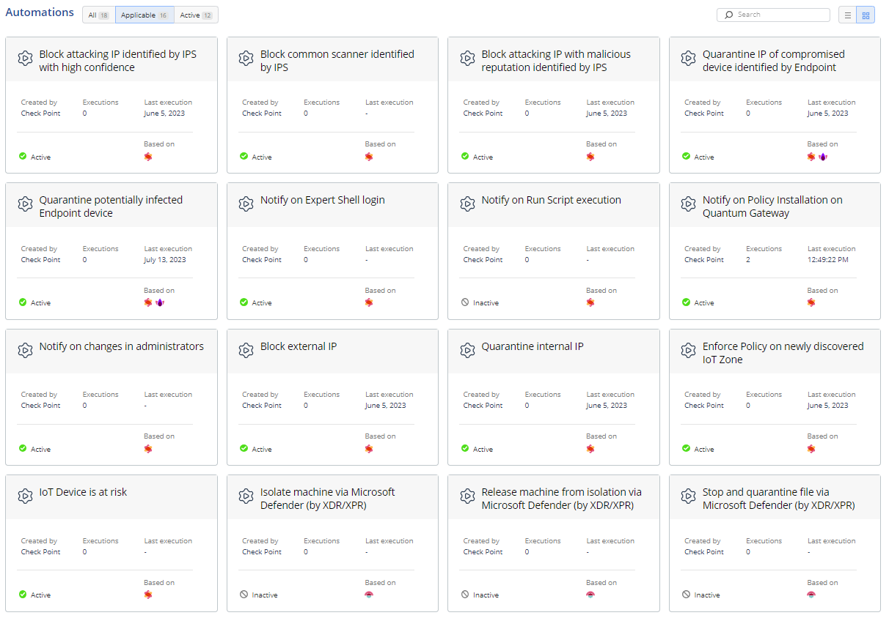


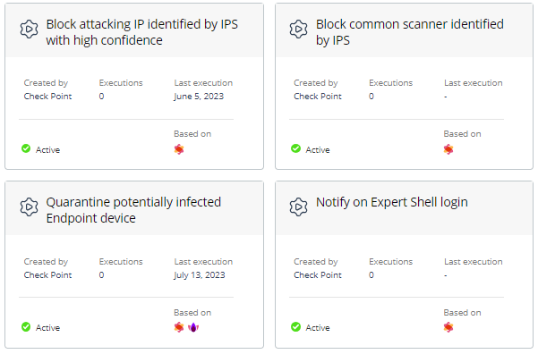

released in 2024
Endpoint
Network
Infinity Playblocks
COLLABORATIVE SECURITY
IN ACTION
Email
Mobile
SaaS
Applications
OT
Public Cloud
Workloads
NEW
50+
Out of the box Playbooks
Notes:
We've also introduced Playblocks, offering dozens of pre-configured prevention playbooks for a wide range of automated security responses.

Slide 5









Automated, Collaborative Security Across the Enterprise
When an enforcement point identifies a potential security threat, it triggers preventative actions across the entire security infrastructure and alerts security teams.
Endpoint
Network
Email
Mobile
SaaS
Applications
OT
Public Cloud
Workloads

Slide 6





Collaboration Powers the Best Prevention
Any security product can trigger Playblocks to carry out automated preventative actions
Collaboration between security products prevents attack from spreading across environment
Automatic Check Point integration:
Notes:
Collaborative Prevention
Prevention playbooks are triggered to contain the threat and prevent future attacks
Fastest Time to Prevention
Out-of-the-box playbooks include the ability to automatically block an IP across all enforcement points, notifying admins of policy installations on gateways, isolating hosts etc. these Playbooks provide attack prevention across the entire security environment includes actions like is, initiating kill processes
Reduce operational overhead by eliminating need to manually update policies and rules

Slide 7

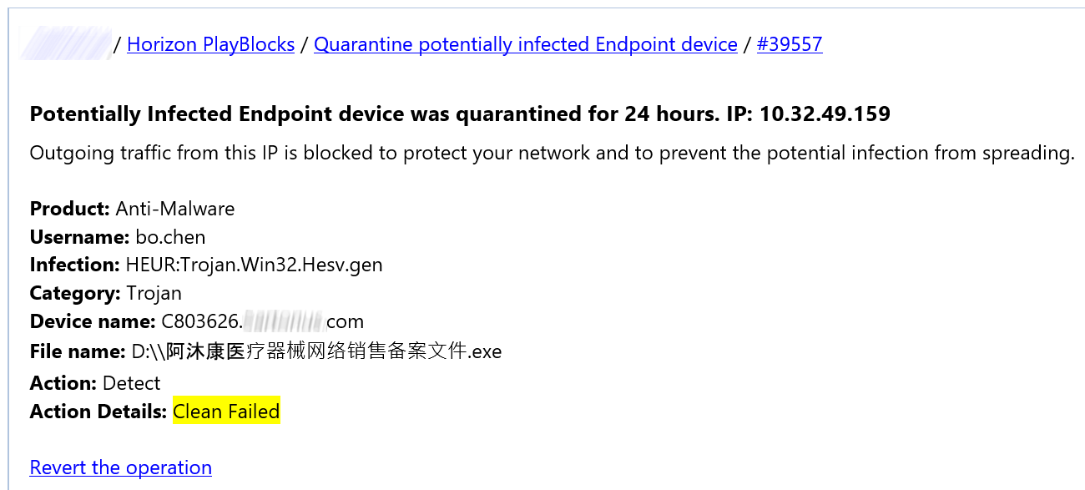





Collaboration Optimizes Operations
Leverage existing IT workflows to keep
your teams updated
Notes:
Collaborative Prevention
Prevention playbooks are triggered to contain the threat and prevent future attacks
Fastest Time to Prevention
Out-of-the-box playbooks include the ability to automatically block an IP across all enforcement points, notifying admins of policy installations on gateways, isolating hosts etc. these Playbooks provide attack prevention across the entire security environment includes actions like is, initiating kill processes
Reduce operational overhead by eliminating need to manually update policies and rules
Collaborative Prevention
Prevention playbooks are triggered to contain the threat and prevent future attacks
Attack prevention across the entire security environment includes actions like isolating hosts, initiating kill processes and notifying admins
Playblocks automatically integrates with Check Point products
Fastest Time to Prevention
Reduce operational overhead by eliminating need to manually update policies and rules
Out-of-the-box playbooks include the ability to automatically block an IP across all enforcement points, notifying admins of policy installations on gateways, quarantining files etc.

Slide 8
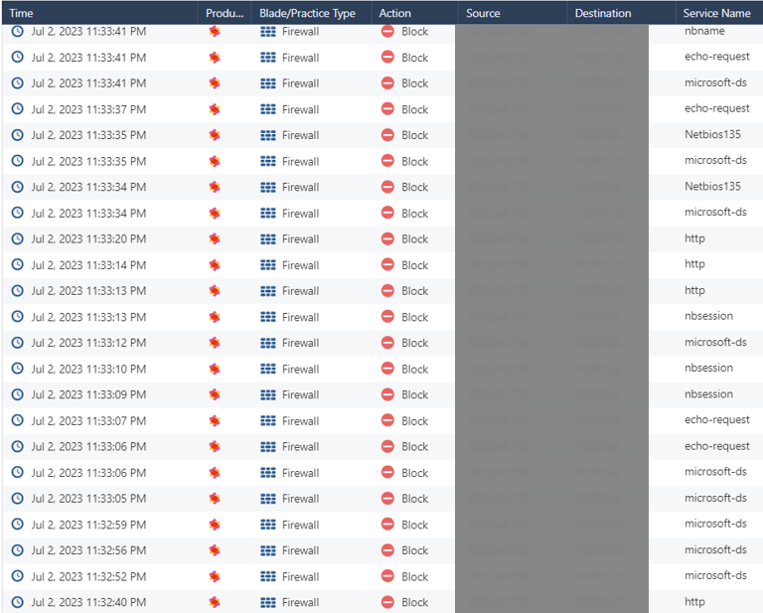

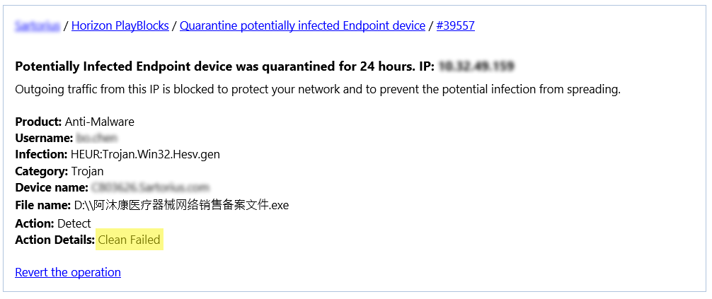
Stop Lateral Movement
Pharma – 14,000 users
Chinese Trojan detected on endpoint
Endpoint solution unable to mitigate device
Trojan neutralized
Lateral movement prevented
No interruption to productivity
or security workflow
Organization remained safe
and informed
  Infected device automatically quarantined
  Prevented outbound traffic
  Team notified on Slack
Playblocks blocked outgoing traffic
to 5 other devices on Gateway
Notes:
Chinese Trojan infection detected by Endpoint security
Endpoint solution unable to mitigate
the device
PLAYBLOCKS
Endpoint security
triggered Playblocks:
Automatically
quarantined the infected device, preventing outbound traffic
Notified administrator
and SOC team on Slack
<<CLICK>>
FURTHER INVESTIGATION BY SOC TEAM
Further investigation uncovered outgoing traffic from device
to 5 other devices blocked on the Gateway by Playblocks
PLAYBLOCKS ACHIEVED
Trojan attack neutralized
Immediate prevention of lateral movement
Organization remained safe and informed
No interruption to productivity
No additional security overhead

Slide 9
Infinity Playblocks & MS Defender Demo

Slide 10


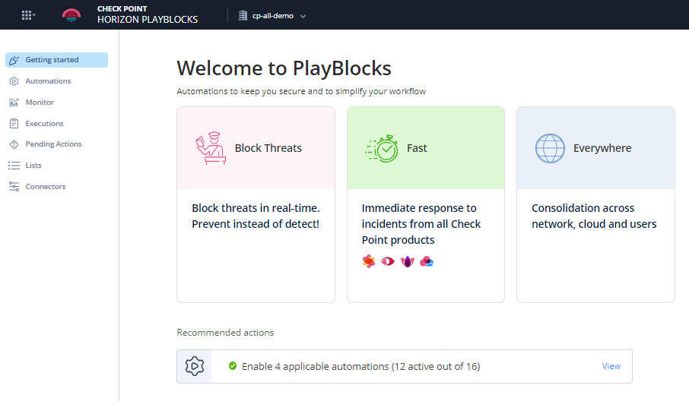
Playblocks is Available Today
+50 out-of-the-box Playbooks
2-minute deployment
Available as cloud service
Included in Infinity XDR/XPR

Slide 11


YOU NEED AN XDR SOLUTION THAT FOCUSES ON PREVENTION
Notes:
We at Check Point actually believe it’s about time to get proactive and give the needed protection your organization deserves.

Slide 12
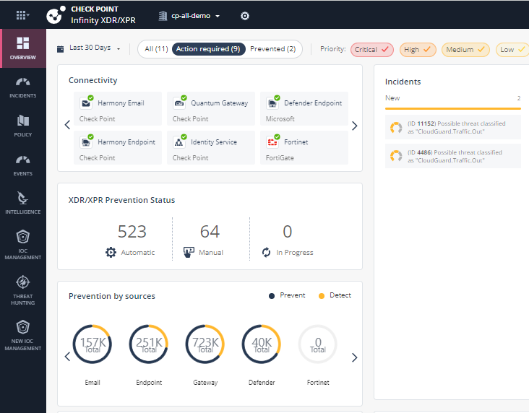
Infinity: Prevention-First Security Operations
Comprehensive threat prevention
across your entire estate through collaborative, intelligent AI correlation
Automation and
response platform
Collaborative threat prevention through intelligent AI correlation
24/7 SOC Service,
365 Days
Microsoft Defender for Endpoint
Notes:
Prevention-First Security Operations & Unified Management Suite
SOC operations tools and services

Slide 13




Fast Onboarding,
As a Cloud Service
Automatic Prevention Responses
Infinity XDR/XPR
Automatically prevent attacks from spreading through intelligent
AI correlation
AI Based Correlations
Simple Investigation Experience
Notes:
The XPR product, launched last year, prevents attacks from spreading through AI correlation, using collaborative efforts across our product range.

Slide 14
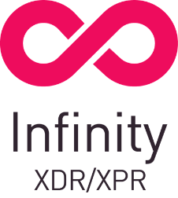
XDR/XPR addresses cyber complexity with the 3Cs of Best Security
C
C
C
COMPREHENSIVE
THREAT PREVENTION
INTELLIGENT
CORRELATIONS
CONSOLIDATED
ANALYTICS
Automatic attack prevention across the entire security estate
Powered by AI and
Threat intelligence Correlating Check Point
& Third-Party Events
Improve posture through visibility to attack behavior, context and damage
Notes:
XPR is the most accurate product to demonstrate how Check Point provides the best security for its customer through these 3C’s- COMPREHENSIVE threat prevention, intelligent CORRELATIONS and CONSOLIDATED analytics

Slide 15

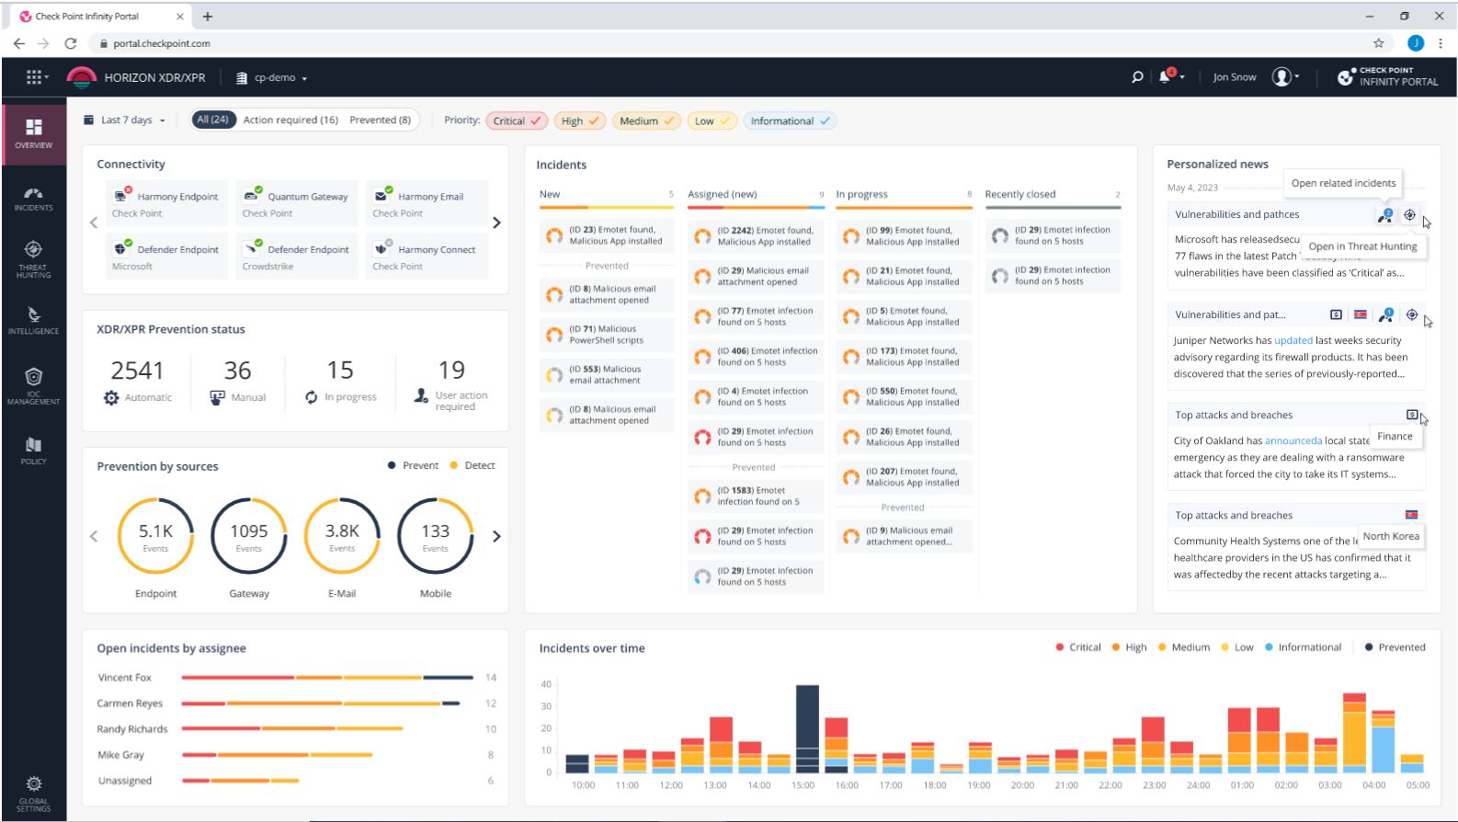
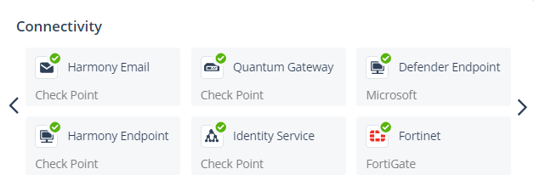
Events
C
Comprehensive Threat Prevention
XDR/XPR takes immediate, comprehensive prevention actions across all parts of the security estate
XDR/XPR integration to Endpoint, Network, Cloud, Mobile and more
Personalized new feed powered by CP<r>
XDR/XPR Prevention status and by connected sources
Notes:
On the XPR welcoming page, we get an overview of its current status; we can see that both Check Point’s products and 3rd party data sources can be incorporated into XPR. As a prevention-first solution, the prevention status will always be reflected so you will always be aware of what and how much has been done in terms of prevention and auto-response, and of course all that is waiting for your manual response and handling.

Slide 16
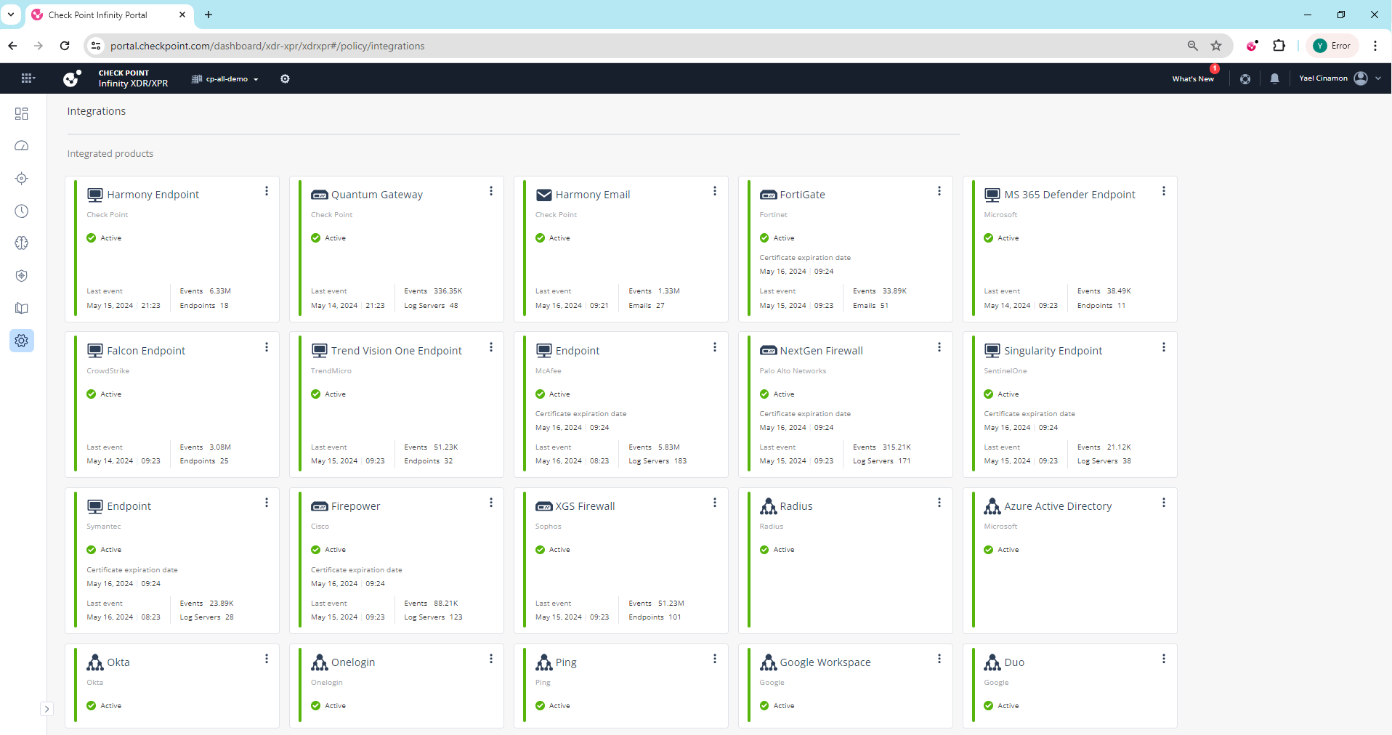
Events
C
Comprehensive Threat Prevention
20+ integrations with Check Point and third-party solutions
Notes:
On the XPR welcoming page, we get an overview of its current status; we can see that both Check Point’s products and 3rd party data sources can be incorporated into XPR. As a prevention-first solution, the prevention status will always be reflected so you will always be aware of what and how much has been done in terms of prevention and auto-response, and of course all that is waiting for your manual response and handling.

Slide 17






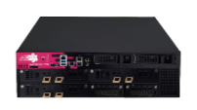





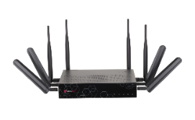

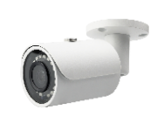

C
Intelligent Event Correlation
XDR/XPR determines advanced attacks from millions of events to high
confidence incident story
Threat Cloud
Intelligence
Anomalous
Behavior
Engine
Microsoft Defender
AI-Based
Microsoft Defender for Endpoint
Threat
Intelligence
Feeds
Microsoft
Entra ID
Notes:
Since 100% prevention is not realistic, we ensured XPR provides cross-product detection, and correlated detection even when connected to single data source. By running behavioral analytics and machine learning models based on all the data XPR collects, we can not only review the insights from all security solutions in a single pane of glass, but to also improve our detection by merging it all together, connecting the dots across the entire attack flow, across all products.

Slide 18





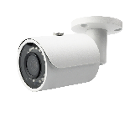
C
Comprehensive Threat Prevention
XDR/XPR takes immediate, comprehensive prevention actions across all parts of the security estate
PREVENTION
Microsoft Defender
Microsoft Defender for Endpoint
Microsoft
Entra ID
Notes:
XPR incidents not only detect advanced attacks, but those always attached with preventive actions and recommendations to improve your security posture. Relying on our powerful ThreatCloud, XPR works on top of all Check Point’s products, which are already built with prevention in mind, as a second layer of prevention.

Slide 19
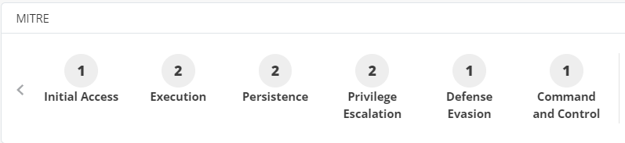
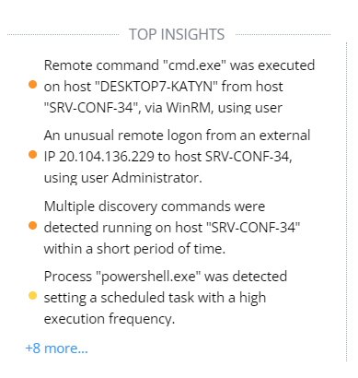
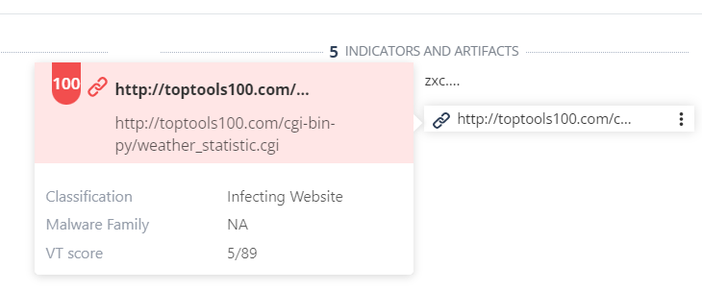
C
Consolidated Analytics
XDR/XPR improves posture through visibility to attack behavior,
context and damage
Understand the
Attack chain using
MITRE mapping
Visibility to all
compromised entities
Notes:
XPR Incidents are fully mapped to MITRE, so the user can review all the tactics that were detected in the attack, all the assets involved in the needed context and all malicious indicators of compromise with intelligence enrichment on each.

Slide 20
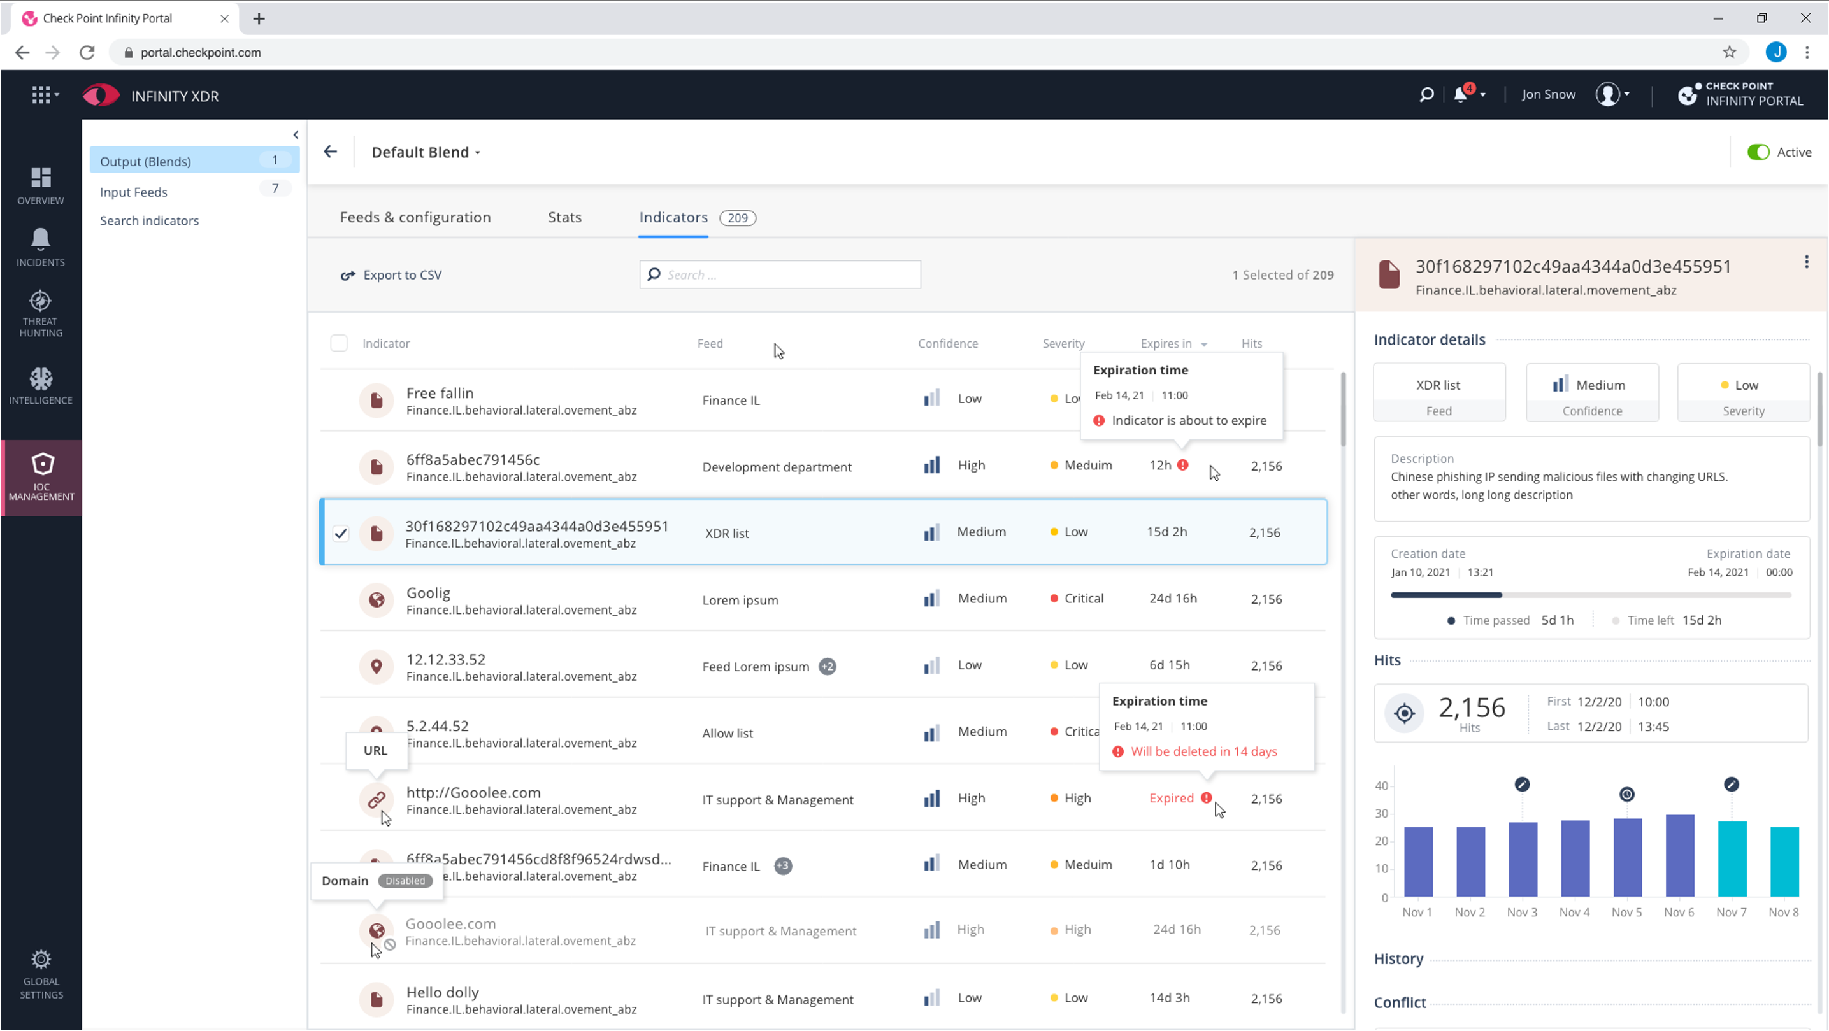

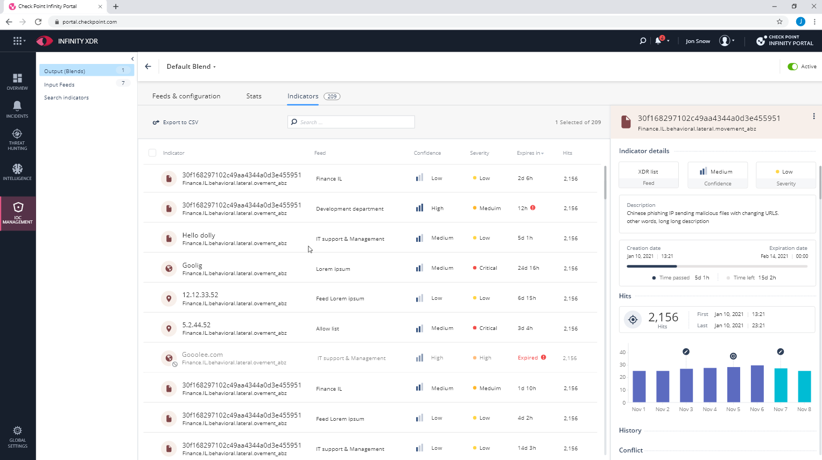
Events
C
Immediate Prevention of the Attack
IOC Management and enforcement across the entire IT environment
Ingestion of external third-party feeds
Quick responses to block/allow IOCs globally or per source
Single pane of glass to all IOCs from all sources – Network, Endpoint, Cloud, Email, and more
Part of Infinity XDR/XPR
Multi-tenant ready for MSSPs
Notes:
The IOC management feature is just one of the examples of how XPR delivers the promise for comprehensive prevention. The feature enables you to define custom enforcement of IOCs in all connected products to the XPR. Indicators involved in XDR incidents will be automatically added to this list, but since many of our customers also using Police feeds, open sources or purchased sources to be notified on malicious indicators- the user also can connect those to the IOC management using an API. This allows automatic enforcement on all connected products to the XPR.

Slide 21
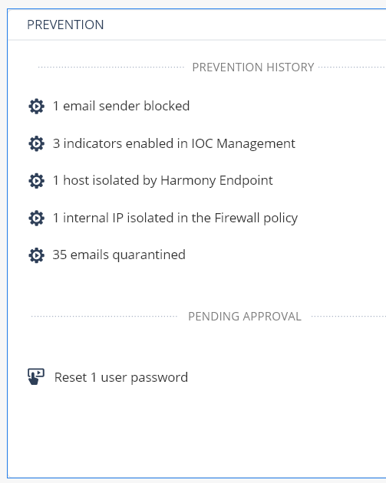
C
Immediate Prevention of the Attack
Automatic Response Playbooks across the entire organization
Auto Mitigation and Response
Isolate compromised endpoint
Block malicious indicators
Quarantine email
Endpoint Forensics analysis
Terminate a process
Force password change
Notes:
This great detection leads us directly to our automated response in XPR; since we are viewing and investigating incidents from all products, we are able to amutoate our responses across those products as well- Mitigate threats at the earliest stage possible and stop any further damage. Significantly reducing the amount of time needed to investigate and manage incidents in your network.

Slide 22








The Challenge:
Security and Data Silos
Notes:
I want to start by reviewing the XPR idea through a known tale about the blind men and the elephant. The story is about six blind men that felt different parts of an elephant, trying to guess what the object in front of them is. One felt the elephant’s thin ear and thought it was a fan, the other felt its thick strong leg and thought it for a tree, the third felt the elephant’s hard stomach, and compared it to a brick wall and so on. Each had a different understanding of what is the object in front of them, based on their own siloed experiences.

Slide 23
The Goal:
Bringing it all Together
Notes:
If they had dared to connect all their insights together, they actually would able to connect the dots and discover the bigger picture, the elephant.
This demonstrate beautifully the XPR capability to automatically connect the dots across the entire attack flow

Slide 24
Example - A bank in Europe
Endpoints communicate with unfamiliar domains
Process is Signed
by Microsoft,
runs on Endpoint
User
logs-into
3 devices
Anti Virus on Endpoint
was disabled
Teams process Changed Registry
Network Traffic to unfamiliar domains
Notes:
Take a look on these low severity Endpoint and GW logs detected on the environment of one of our financial customers in Europe.
None of these signals by themselves are interesting or suspicious enough to capture the analysts’ attention.

Slide 25



Endpoint and Gateway Detections Correlated Into XDR/XPR Incident
CORRELATION
DETECTION
High Severity Breach
Is Active on 3 Endpoints
Compromised 1 User
COMPREHENSIVE
PREVENTION
Isolated Infected endpoints
Blocked Malicious URLs
Removed Reset Password for user
Processes from devices
Bank, EMEA
Notes:
Only by correlating the network traffic to Endpoint processes, XPR was able to expose this high severity breach reaching the Command & Control stage that was found active in 3 machines. All needed responses happened automatically- XPR isolated the machines, blocked the malicious URLs, terminated the processes on all devices and restored windows defender policy. The incident was resolved at once.

Slide 26
Infinity XDR/XPR & MS Defender Demo

Slide 27



















20
New XDR/XPR Sources
Coming in 2024
Endpoint
Gateways
Email & Collaboration
Network
Microsoft Defender for Endpoint
Palo Alto Networks
SentinelOne
Fortigate
Sohpos
CrowdStrike
Trend Micro
Symantec
Notes:
Additionally, we're expanding our XPR solution to support more sources and third-party integrations.

Slide 28
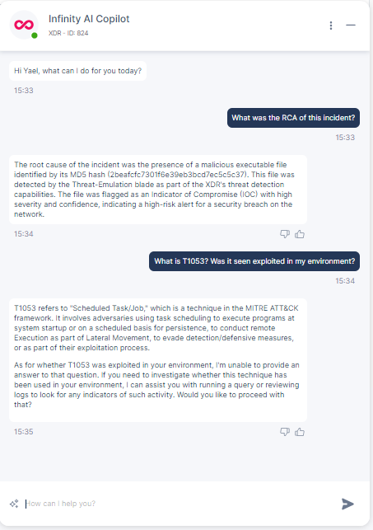
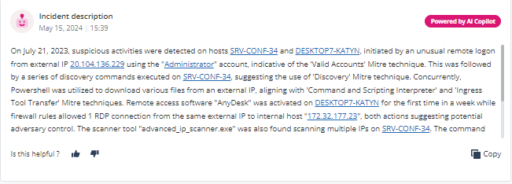
Infinity
AI Copilot
Now available in public preview for XDR/XPR customers
Notes:
A comprehensive Copilot chatbot for SOC research tailored to specific incidents, equipped with the following tools:
Capability to answer questions based on:
XDR/XPR incident data and its supporting insight(s) forensics information
MITRE
CP<R>
Check Point administrative guides and documentation, including SecureKnowledge
File.net
Natural language Threat Hunting
Supports querying of logs in human language
Currently limited to EDR logs; H2 plans to incorporate logs from additional data sources that are already supported in XDR/XPR
Actions:
XDR/XPR operational actions (for example: change incident status, add comment, etc.)
Future plans include response actions that are already supported via XDR/XPR (example: quarantine file, isolate machine, etc.)

Slide 29
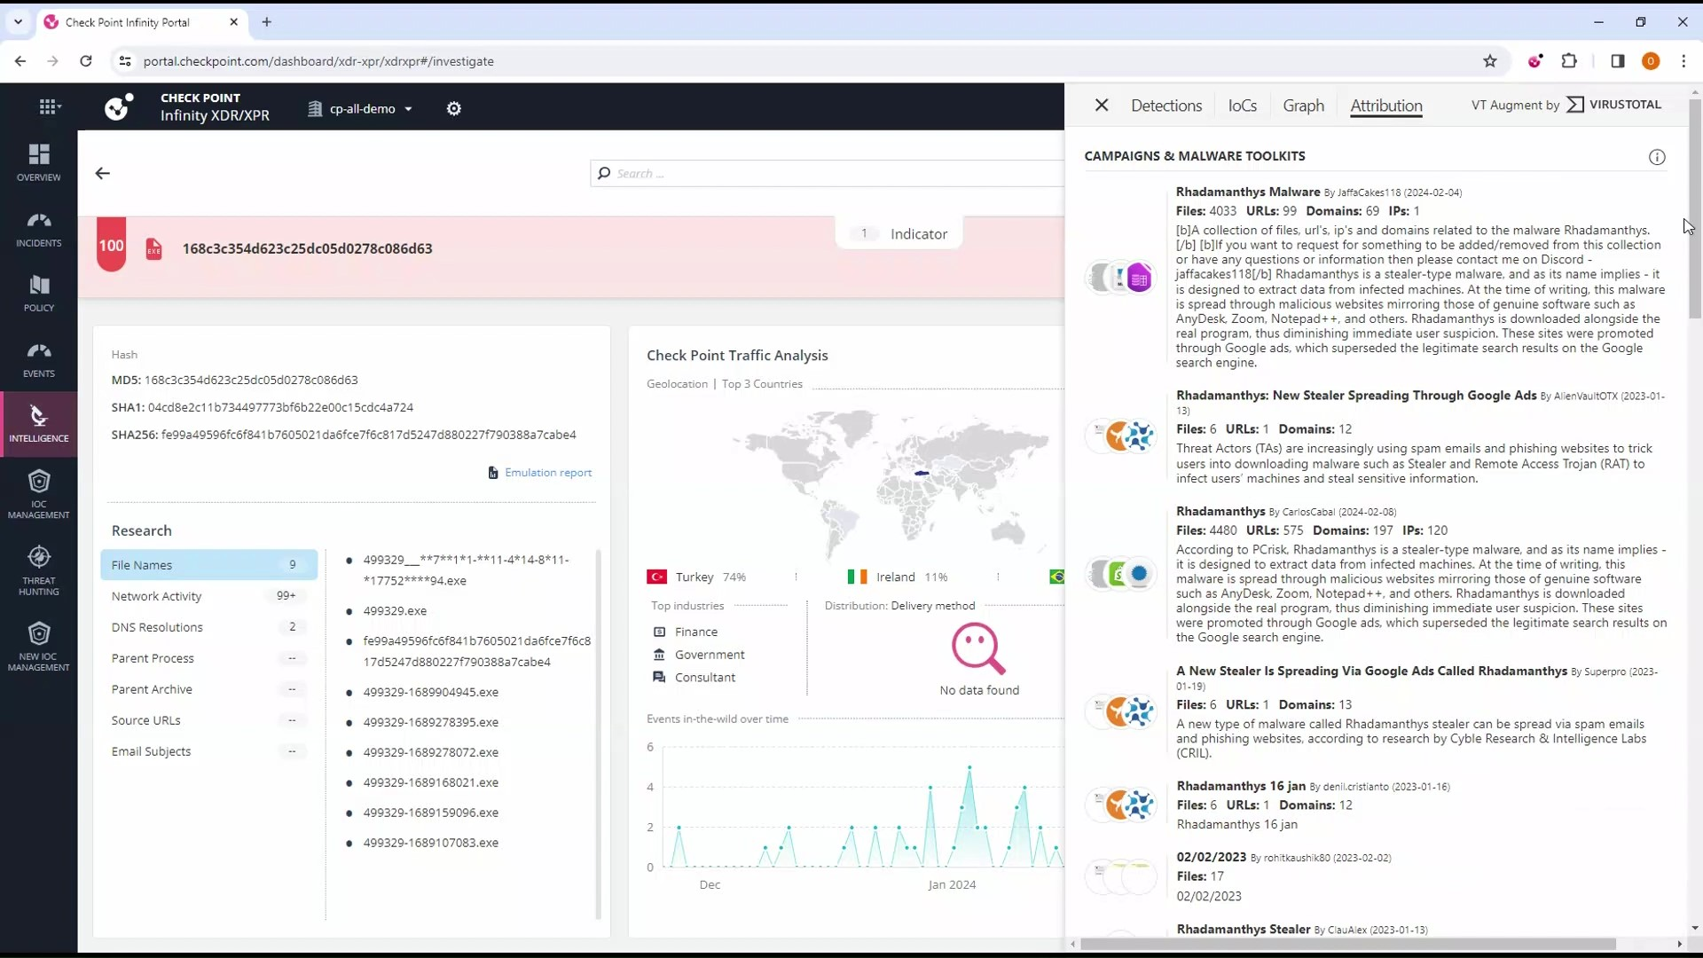
VirusTotal
Integration
Comprehensive investigation
Notes:
A comprehensive Copilot chatbot for SOC research tailored to specific incidents, equipped with the following tools:
Capability to answer questions based on:
XDR/XPR incident data and its supporting insight(s) forensics information
MITRE
CP<R>
Check Point administrative guides and documentation, including SecureKnowledge
File.net
Natural language Threat Hunting
Supports querying of logs in human language
Currently limited to EDR logs; H2 plans to incorporate logs from additional data sources that are already supported in XDR/XPR
Actions:
XDR/XPR operational actions (for example: change incident status, add comment, etc.)
Future plans include response actions that are already supported via XDR/XPR (example: quarantine file, isolate machine, etc.)

Slide 30
Thank You!

