Slide 1
Horizon – Prevention First Approach for Security Operations
Yael Cinamon | Horizon XDR/XPR & Playblocks Product Manager
March 2023

Slide 2
Agenda
XDR business overview
Horizon XDR/XPR overview
Customer testimonials
Demo
Product roadmap

Slide 3





Horizon
NEW

Slide 4
Cyberattacks become more sophisticated and costly
38%
increase
1150
Gen V
attacks
in global weekly cyber attacks (YoY)
attacks per week on every organization
at nation
state scale
Security Teams Struggle to shutdown attacks
Endless alerts, false positives
277 days to contain an attack
Multiple tools in siloes
Narrow view of the attack
Cyber skills shortage

Slide 5







Current SOC Affairs:
It’s all about detection and reducing alert queue
Everybody talks about offering better detection and reducing the alert queue for analysts on endpoint and beyond

Slide 6
We need prevention-first security
Notes:
Automate the lifecycle of creating prevention controls
Prevention at the product level - Prevention across all enforcement points
Prevent attacks from spreading – contain the attacks by Isolate hosts, quarantine files, block emails
Future proof prevention best practices - Horizon will take care of enabling security controls, installing a patch, or enabling IPS

Slide 7

YOU NEED A COMPREHENSIVE SOLUTION THAT WILL PREVENT ATTACKS EVERYWHERE
Notes:
Check Point’s groundbreaking foray into the world of security operations

Slide 8





Horizon: Prevention first security operations
Managed Prevention and Response
24/7 SOC Service
Full Threat Management | Incident Response | Elite Experts
HORIZON MDR/MPR
HORIZON XDR/XPR
Extended Prevention & Response
Incident Prevention | Hunting
HORIZON
EVENTS
Unified Data Platform
Troubleshoot | Investigate | Reports | Retention | SIEM Connectors
Third-party security solutions
Notes:
Prevention-first extended detection and response solution, that provide comprehensive security for SOC teams, by correlatining the data

Slide 9
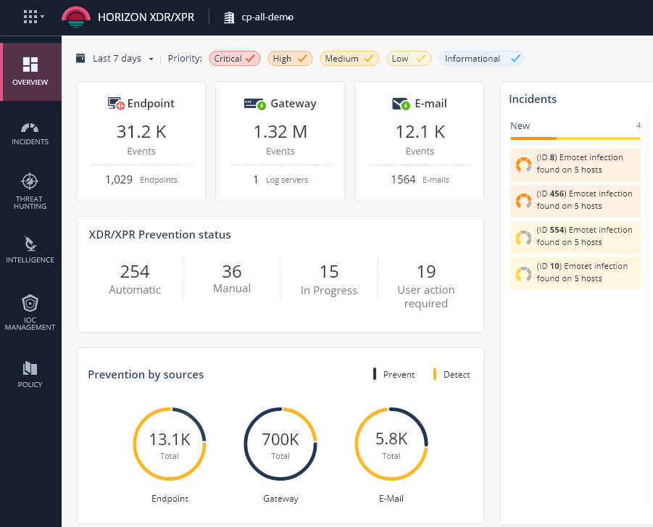









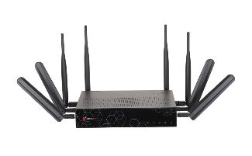
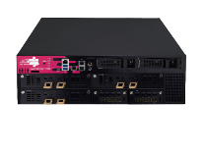




Horizon XDR/XPR
Automatically prevent attacks from spreading through intelligent AI correlation of billions of security events across Network, Cloud, Users and Devices
Microsoft Defender

Slide 10





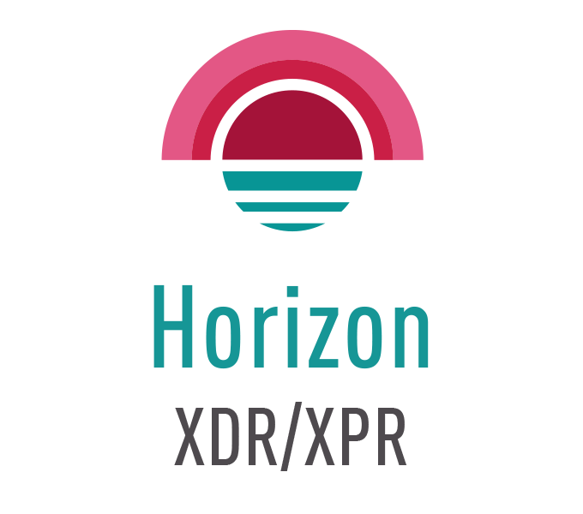
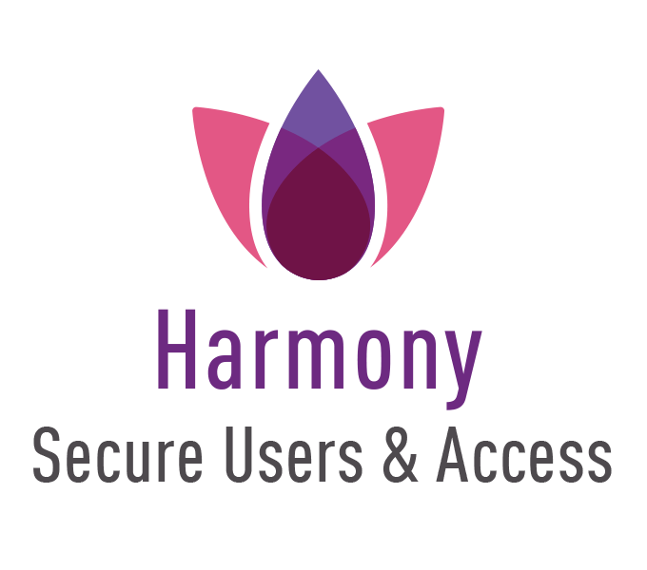



HORIZON XDR/XPR- Enabling prevention-first for everyone
Prevent, detect, investigate, and respond to attacks across your entire environment
Prevent
Detect
Cloud
Network
Email
Respond
Endpoint
Mobile
AI
technology
Big data
threat
intelligence
IoT
Investigate
Third-party security solutions
Notes:
Even when naming the solution, XDR/XPR- we wanted to make sure we add the P to emphasize the prevention capability on the product which is the key. So, relying on our powerful ThreatCloud, XPR works on top of all Check Point’s products, which are already built with prevention in mind, as a second layer of prevention.
XPR also uses innovated AI-Based technology for rapid detection, vast investigation capabilities and automated responses across all your security products, offering complete native coverage.

Slide 11
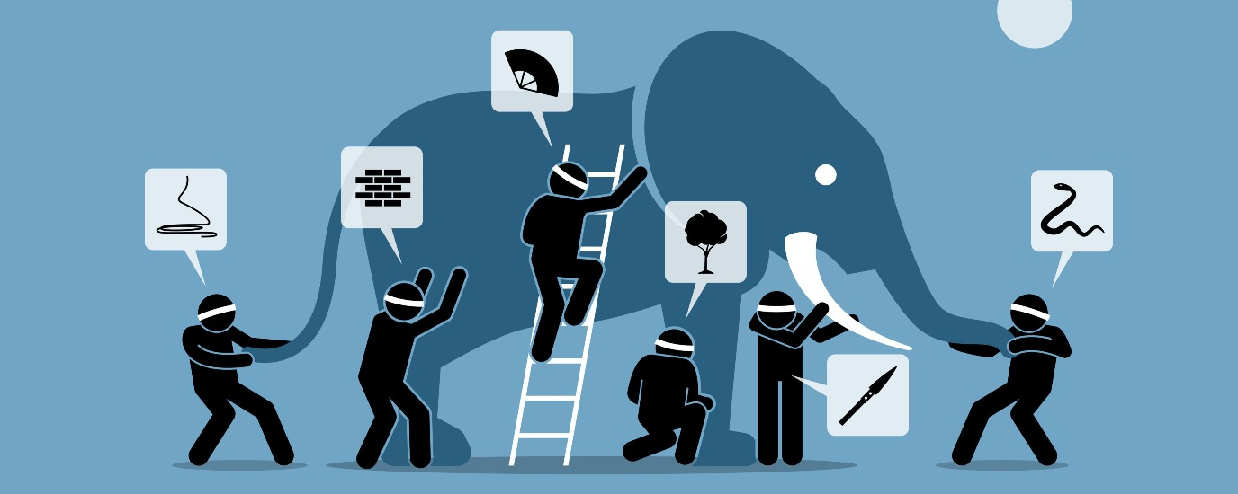

THE CHALLENGE: TOO MANY DATA FRAGMENTS
Notes:
A tale on the Elephant and 6 blind man.
Once upon a time, there lived six blind men in a village. One day the villagers told them, “Hey, there is an elephant in the village today.”
They had no idea what an elephant is. They decided, “Even though we would not be able to see it, let us go and feel it anyway.” All of them went where the elephant was. Everyone of them touched the elephant.
“Hey, the elephant is a pillar,” said the first man who touched his leg.
“Oh, no! it is like a rope,” said the second man who touched the tail.
“Oh, no! it is like a thick branch of a tree,” said the third man who touched the trunk of the elephant.
“It is like a big hand fan” said the fourth man who touched the ear of the elephant.
“It is like a huge wall,” said the fifth man who touched the belly of the elephant.
“It is like a solid pipe,” Said the sixth man who touched the tusk of the elephant.
Endless alerts, many false positives
Multiple detection tools in siloes
Lack of context
Skillset shortage

Slide 12
THE GOAL: BUILDING THE PIECES TOGETHER
TO SEE THE BROADER PICTURE

Slide 13






HORIZON XPR - EXAMPLE - A BANK IN EUROPE
Teams process Changed Registry
Anti Virus on Endpoint was disabled
Process is Signed by Microsoft,
runs on Endpoint
Network Traffic to unfamiliar domains
Endpoints communicate with unfamiliar domains
User
logs-into
3 devices
Notes:
A tale on the Elephant and 6 blind man.
Once upon a time, there lived six blind men in a village. One day the villagers told them, “Hey, there is an elephant in the village today.”
They had no idea what an elephant is. They decided, “Even though we would not be able to see it, let us go and feel it anyway.” All of them went where the elephant was. Everyone of them touched the elephant.
“Hey, the elephant is a pillar,” said the first man who touched his leg.
“Oh, no! it is like a rope,” said the second man who touched the tail.
“Oh, no! it is like a thick branch of a tree,” said the third man who touched the trunk of the elephant.
“It is like a big hand fan” said the fourth man who touched the ear of the elephant.
“It is like a huge wall,” said the fifth man who touched the belly of the elephant.
“It is like a solid pipe,” Said the sixth man who touched the tusk of the elephant.
Endless alerts, many false positives
Multiple detection tools in siloes
Lack of context
Skillset shortage

Slide 14

Horizon XPR/XDR
Comprehensive threat prevention across your entire estate through collaborative, intelligent AI correlation
DETECTION
High Severity Breach
Is active on 3 Endpoints
Compromised 1 User
COMPREHENSICE
PREVENTION
Isolated Infected endpoints
Blocked Malicious URLs
Removed Processes from devices
Reset Password for user
Notes:
A tale on the Elephant and 6 blind man.
Once upon a time, there lived six blind men in a village. One day the villagers told them, “Hey, there is an elephant in the village today.”
They had no idea what an elephant is. They decided, “Even though we would not be able to see it, let us go and feel it anyway.” All of them went where the elephant was. Everyone of them touched the elephant.
“Hey, the elephant is a pillar,” said the first man who touched his leg.
“Oh, no! it is like a rope,” said the second man who touched the tail.
“Oh, no! it is like a thick branch of a tree,” said the third man who touched the trunk of the elephant.
“It is like a big hand fan” said the fourth man who touched the ear of the elephant.
“It is like a huge wall,” said the fifth man who touched the belly of the elephant.
“It is like a solid pipe,” Said the sixth man who touched the tusk of the elephant.
Endless alerts, many false positives
Multiple detection tools in siloes
Lack of context
Skillset shortage

Slide 15

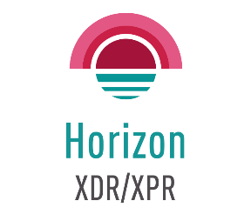
Comprehensive threat prevention across your entire estate through collaborative, intelligent AI correlation
INTELLIGENT
CORRELATIONS
COMPREHENSIVE
THREAT PREVENTION
CONSOLIDATED
ANALYTICS
Powered by AI and Threat intelligence Correlating Check Point & 3rd Party Events
Automatic attack prevention across the entire security estate
Improve posture through visibility to
attack behavior, context and damage
Notes:
Immediately prevent attacks from spreading
Accurate threat prevention providing the last line of defense; integrations with Check Point and 3rd party security solutions.
Rich intelligence for accurate detection & prevention
AI prevention, powered by correlation across the broadest range of threat intelligence including Check Point Research & ThreatCloud
Simplified analytics
Understand what’s happening in the corporate environment and where an attack is within the kill chain.

Slide 16
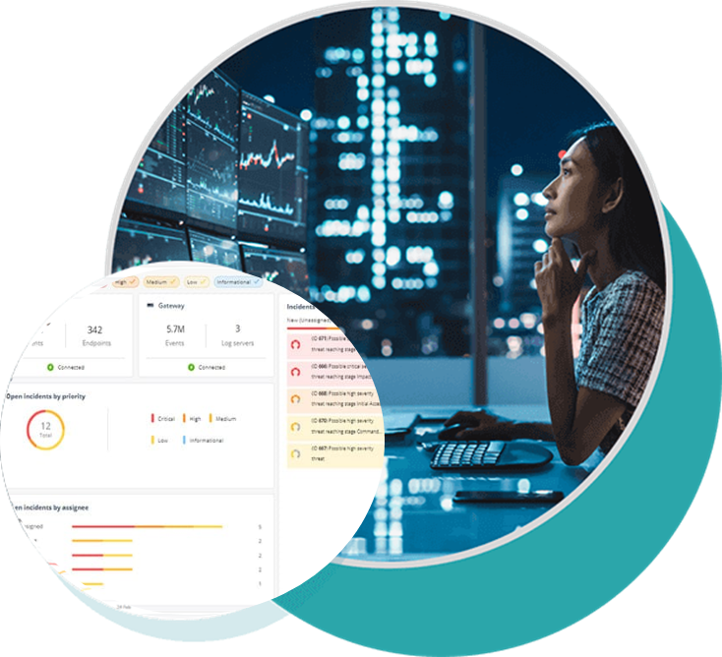
HORIZON XDR/XPR unique value
Prevention-first XDR/XPR - Unlike other XDRs, Horizon XPR is built from the ground up as a prevention first solution across all products
Complete native coverage for network, cloud, endpoint, mobile, and email – One data lake to all data sources
Total costs of ownership
Significant added-value for network-only customers
Exclusive CP<R> intelligence with attack statistics from ThreatCloud - our global network of sensors

Slide 17

Customers Recommend Horizon XPR
“Horizon XPR detected threats- automatic response were
very effective and saved time”
Manufacture Company, EMEA
“Horizon XPR stopped an incident, and preemptively prevented additional attacks on our organization”
Government, EMEA
“The Behavior insights of Horizon XPR brought a unique value that we didn’t have before”
Retail Company NA
“The incidents data were very reassuring and accurate.”
Universal Bank, EMEA
Notes:
Government- Andora
Manufacture Company- Thrace Plastics Greece
Retail Company- Clarks
Universal Bank- Ukgasbank

Slide 18
Horizon xdr/xpr
DEMO
Notes:
Prevention- first detection & response solution. Let’s see how it provides these capabilities to any CP products and beyond

Slide 19
HORIZON XDR/XPR main capabilities
Detection & prevention across network, endpoint, email, (mobile, cloud – soon)
Behavioral Analytics (UEBA) & AI-based detection
Incident management
MITRE mapping
Threat Hunting
Intelligence investigation tool
Custom IOC Management
Custom rules
Integration with 3rd party security products & logs
Integration with MDR/MPR, 3rd party SIEM, SOAR

Slide 20
HORIZON XDR/XPR WITH ANALYSTS’
EXPERIENCE IN MIND
Prevention shift-left
More data sources
Personalized news feed
New correlations
Investigation board
More prevention responses
XPR Community
Improving SOC experience
Gamification

Slide 21
SUMMARY
Prevention-first XDR
Broadest native coverage, also supporting 3rd party data sources and responses
Easy to buy, easy to onboard, easy to use
Fun, unique vision to improve analysts' day job

Slide 22
Thank You

