Slide 1

https inspection
Tips and Tricks
Micki Boland
Cybersecurity Architect and Evangelist
1 JUN 2023

Slide 2
Tips and Tricks Agenda
https inspection (TLS/TLS)
  mission objectives
  GRC, regulatory and legal interactions
  alternatives
https inspection use cases
  Outbound / egress
  Inbound / ingress
  Surgical start with small scope
Considerations, best practices and resources (Threat Prevention Guide)
Notes:
https://sc1.checkpoint.com/documents/R81/WebAdminGuides/EN/CP_R81_ThreatPrevention_AdminGuide/Topics-TPG/Using_Threat_Prevention_with_HTTPS_Traffic.htm?Highlight=TLS

Slide 3
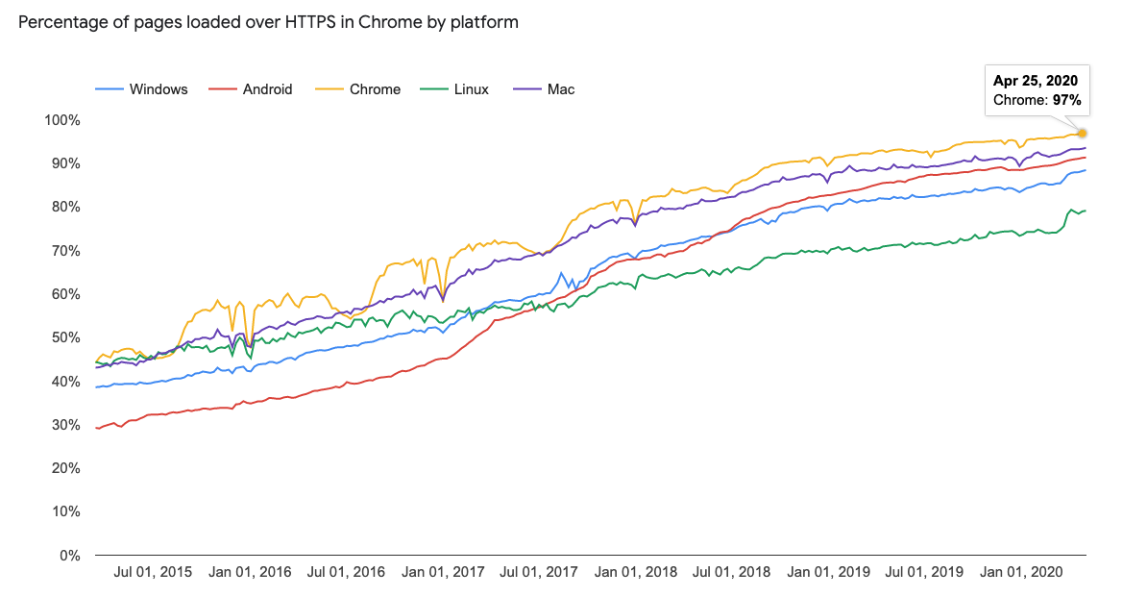
Encrypted Web in Numbers in 2021 > 90%
Notes:
50% of application layer attacks are encrypted
HTTPS attacks increased 20% year over year
Mobile applications still use http
https://webtribunal.net/blog/TLS-stats/
Mac 96%
Windows 94%
Linux 90%

Slide 4
TLS Inspection Overview & Background
HTTPS ratio of internet traffic is constantly growing
HTTPS Internet traffic uses the TLS(TLS) protocol and is encrypted to give data privacy and integrity
HTTP/2 is TLS based

Slide 5

TLS Inspection Overview & Background
By enabling HTTPS Inspection, the Security Gateway will inspect the encrypted parts of the HTTPS traffic.
The inspection will be performed by all the software blades that support HTTPS Inspection:
  Application Control
  URL Filtering
  IPS
  Data Loss Prevention (DLP)
  Anti-Virus
  Anti-Bot
  Threat Emulation
  Content Awareness

Slide 6
TLS Inspection – what we need to mind
Performance impact
Administrative overhead
Potential traffic complications, false positive / negative
Know your Regulatory and Legal and GRC requirements
Layer 8 human layer
Separation of duties – limiting access to unencrypted logging
Use cases by what to inspect!
Notes:
What to Inspect
It is highly recommended to inspect HTTPS traffic from desktop browsers (Outbound HTTPS Inspection).
Users may choose to bypass certain categories due to privacy considerations.
Non-browser HTTPS applications tend to trust their own root CA store and not to trust the certificate generated by the Security Gateway (examples: Google Drive, DropBox).
In addition, non-browser HTTPS applications may use non-standard SSL and therefore cannot be inspected by the Security Gateway.
These limitations are not specific to Check Point.
It is possible to bypass these connections by Server IP address (when available), Client IP address (if there are few clients using these applications), or user identity.
In cases the server uses standard SSL, bypass according to Category/URL can also be used.
This is the recommended order for HTTPS Inspection Policy (Top Down):
IP-based Bypass rules with no site/category defined
For more information, see sk163595.
Bypass rules with site/category defined
For more information, see sk165094.
Inspect rules
Inspection of sites with a multi-category certificate
HTTPS Inspection bypass decisions are based on the server's certificate and client request.
It is important to note that there are servers that issue a single certificate for several domains from different categories (Search Engines / Portals, Media Sharing, etc.).
For example, see the Google certificate below:

Slide 7
Alternatives
Does not require httpsi or can work together with httpsi
Categorize HTTPS Websites via Certificate Checking
  Categorize HTTPS websites in the advanced settings for Application Control & URL Filtering found under the “Manage & Settings” tab.
  The HTTP communication is TLS encrypted, the associated certificate is transferred in clear-text and can be read by the gateway. Cert will identify the website via Common Name (CN). In the case of Facebook, the CN is listed as *.facebook.com
Categorize HTTPS Websites via SNI - the very first Client Hello using TLS shows the server that the client is specifically requesting, under the Server Name Indication (SNI) extension.
  SNI is verified against the Subject Alternative Name of the host, which appears in the certificate. After the identity of the host is known and verified, the site is categorized, and it is determined whether the connection should be inspected or not.
XDR
Application Security (AppSec)
Notes:
The "Categorize HTTPS websites" feature (in combination with URL Filtering) lets you categorize HTTPS sites without having to enable HTTPS Inspection.
When HTTPS Inspection is enabled, it also allows categorization for connections that are bypassed according the HTTPS Inspection rule base.

Slide 8
TLS Inspection – How It Works
The Security Gateway uses certificates and becomes an intermediary between the client and the secure web site.
TLS Certificate
Server Certificate
TLS Client Hello
TLS Client Hello
Get Certificate
gw.myorg.com
CA running on the Gateway

Slide 9
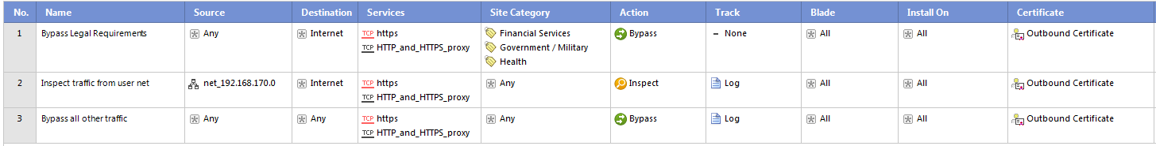
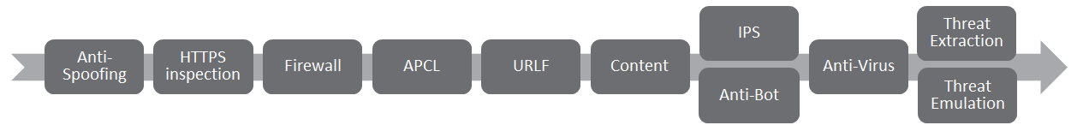
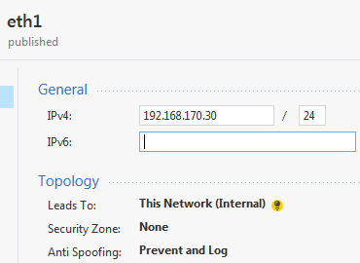
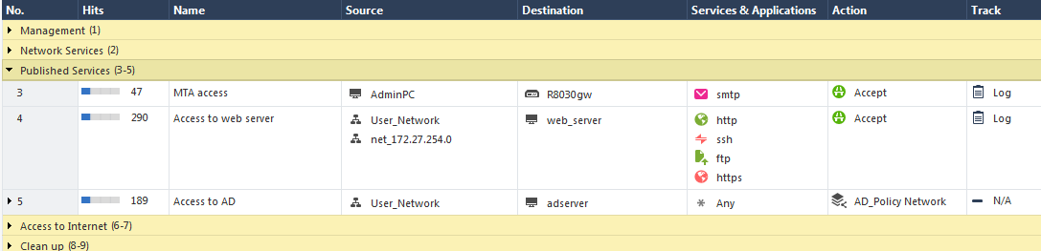
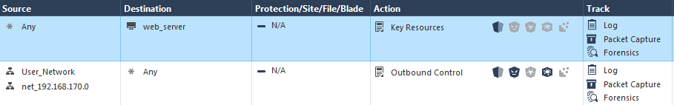
Understanding Policies Matching
Gateway Topology

Slide 10
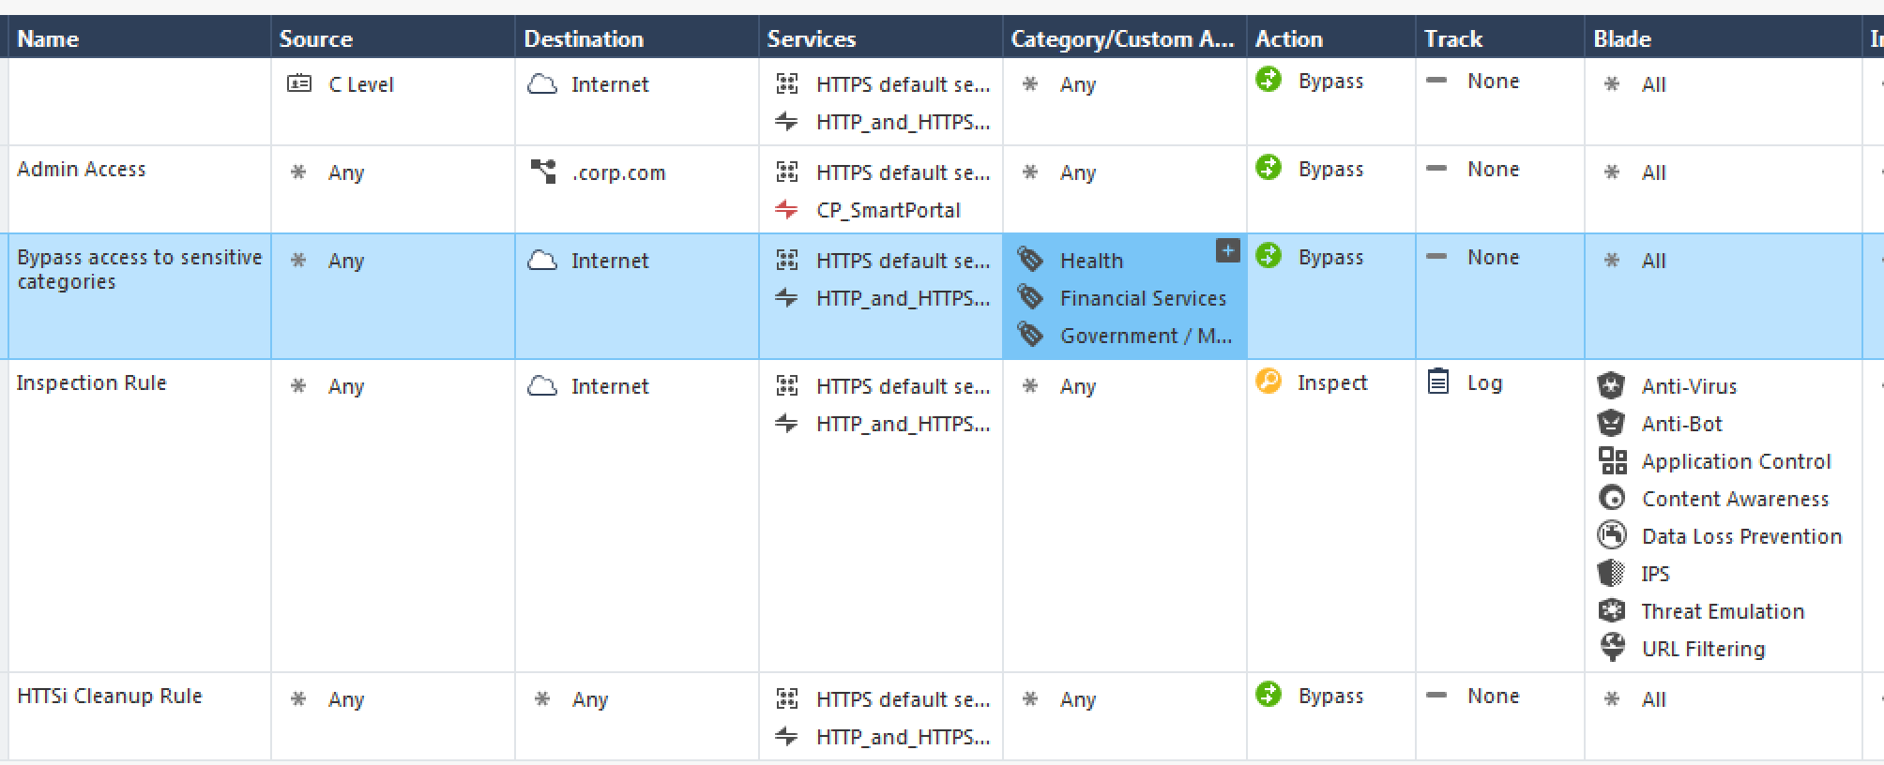
Inspection Rule Base Example
Notes:
Services in the HTTPS Inspection rules
In the HTTPS Inspection rule, in the Services column, we recommend to keep the default service object "HTTPS default services".
If it is necessary to add other services, consult Check Point Support.
Always select specific service objects in the 'Services' column.
If you remove all services from this column, the Security Gateway starts to inspect all TCP traffic. As a result, CPU load increases.
To allow bypass without impact on user experience or privacy, it is necessary to determine the site's category without performing TLS decryption.
To accomplish this, the site’s category is resolved according to the SAN (Subject Alternative Name) or CN (Common Name) fields of server's certificate, and the SNI (Server Name Indication) TLS extension sent by the client.
When the SNI extension isn’t provided by the client, users should take into account that connections to servers that present the same server certificate may be matched to the same category.

Slide 11
USE CASES Outbound
inbound

Slide 12
Use Cases
Outbound HTTPS Inspection protects internal users from malicious attacks coming from the Internet on connections originated from inside the organization.
Inbound HTTPS Inspection protects internal servers (for example, data centers and web servers) from malicious attacks coming from the Internet.

Slide 13
Outbound TLS Inspection

Slide 14
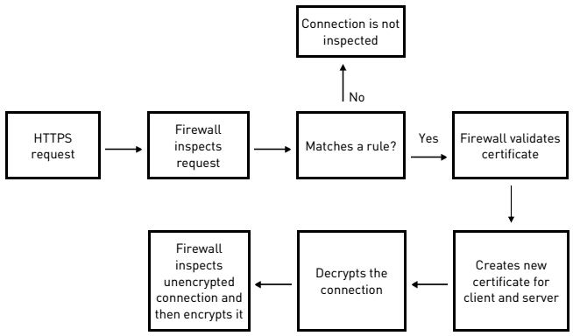
Outbound TLS Inspection – How It Works
Notes:
Outbound HTTPS Inspection protects internal users and perimeter servers from malicious attacks coming from the Internet on connections originated from inside the organization.
Outbound connections are HTTPS connections that start from an internal client and connect to the Internet.
The Security Gateway compares the HTTPS request to the HTTPS Inspection Rule Base.
If the request does not match a rule, the packet is not decrypted.
If the request matches an inspection rule, the Security Gateway makes sure that the certificate from the server (in the Internet) is valid.
The Security Gateway creates a new certificate, and presents it to the client, when the client creates an HTTPS connection to the gateway.
There are two HTTPS connections, one to the internal client and one to the server.
It can then decrypt and inspect the packets according to the Security Gateway and other Rule Bases.
The packets are encrypted again and sent to the destination.
Flow on Security Gateway:
Intercept the request.
Establish a secure connection with the requested server and validate its certificate using a separate probing connection.
Make an inspection or bypass decision based on the rule matched using information gathered from the original connection and server certificate.
When a decision to inspect is made, establish a secure connection with the requested server.
Create a new TLS certificate for the communication between the Security Gateway and the client, send the client the new certificate and continue the TLS negotiation with it.
Using the two TLS connections:
Decrypt the encrypted data received.
Inspect the clear text content for all blades set in the Policy.
Inspect the traffic coming from the web site into the organization.
Encrypt the data again to keep client privacy as the data travels to the destination web server resource.

Slide 15



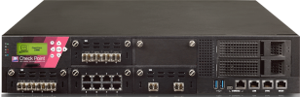
TLS Connection
TLS Connection
Client
Hello
TLS Server
TLS Client
Security Gateway
Offices
Internet
HTTPS Interception: Outbound

Slide 16

Re-Encrypt
Inspect
Decrypt
TLS Server
TLS Client
Security Gateway
Offices
Internet
HTTPS Interception: Outbound

Slide 17
TLS Inspection – How It Works
User accessing «https://www.cloudstorage.com»
Subject: www.cloudstorage.com
Valid from: 01/09/2016
Issuer: gw.MyOrg.com
Signature: zYxZx
Subject: www.cloudstorage.com
Valid from: 01/09/2016
Issuer: Verisign
Signature: xxYxY
https://www.cloudstorage.com
TLS Certificate
Server Certificate
TLS Client Hello
TLS Client Hello
Get Certificate
gw.myorg.com
CA running on the Gateway
Generate Certificate “on the fly”

Slide 18
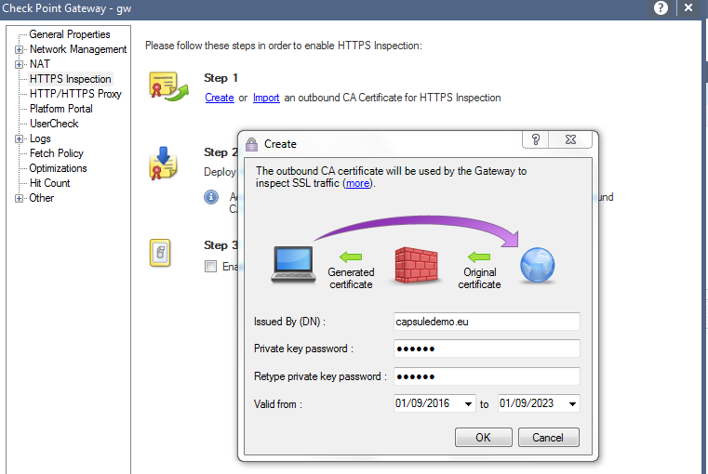
Configuring Outbound HTTPS Inspection
Generate the CA on the Security Gateway
  You will get prompted to define a FQDN for the CA, a password to protect the private key and a validity time frame.
Notes:
Make sure to remember the password that is protecting the private key! You will need it when you import the root certificate on computers that will generate the HTTPS traffic that will get inspected.

Slide 19
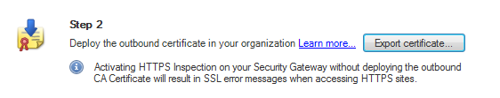
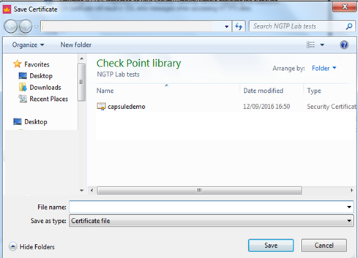

Configuring Outbound HTTPS Inspection
Export the Root Certificate of the Gateway CA
Enable the HTTPS Inspection
Notes:
When exporting the root certificate you save it on a place from where you can deploy it to the computers, that will generate the traffic that will traverse the security gateway with HTTPS Inspection enabled.
To make the PC trust the gateway CA certificate:
Export the CA certificate from the SmartDashboard (on the HTTPS Inspection window of the Security Gateway, or on the HTTPS Inspection > Gateways pane).
Install the certificate on the user's PC:
Manually put the certificate file in the user's PC. Click the file and follow the wizard instructions to add the certificate to the trusted root certificates repository on client machines.
Use GPO or group policy to distribute the certificate to a large group of users. See the documentation for more details.

Slide 20
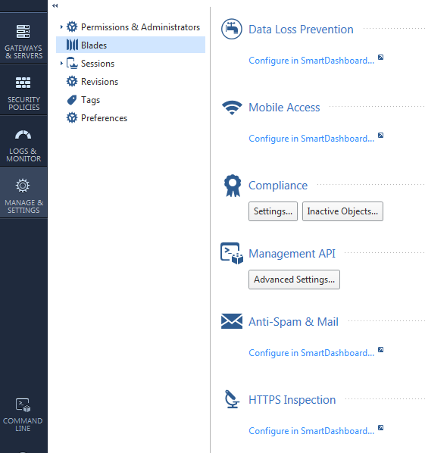
Configure Outbound HTTPS Inspection
Configure the HTTPS Inspection rules using the SmartDashboard
Click here to start the SmartDashboard

Slide 21
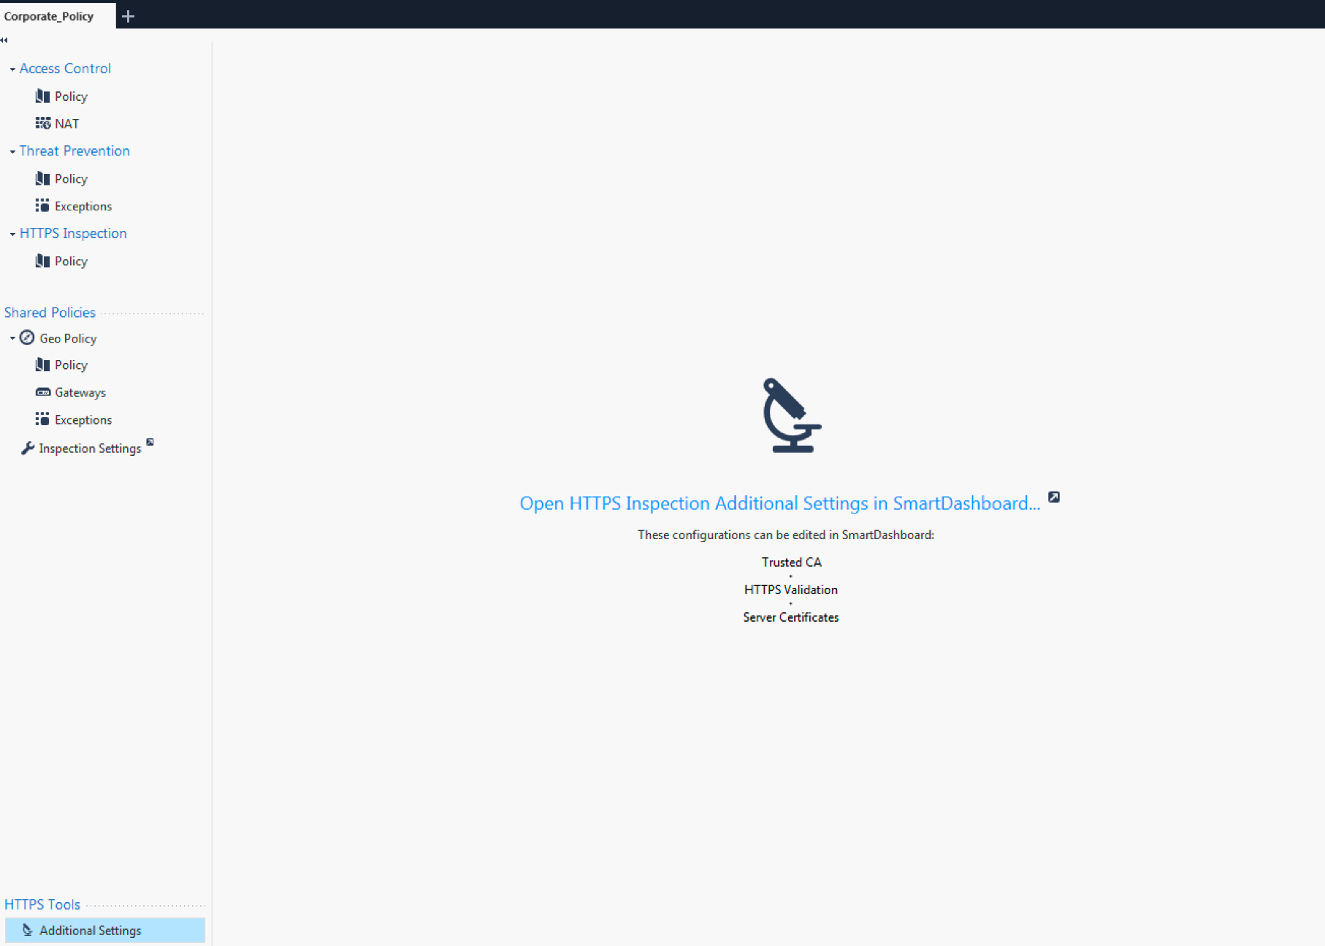
Configure Outbound HTTPS Inspection R80.40

Slide 22
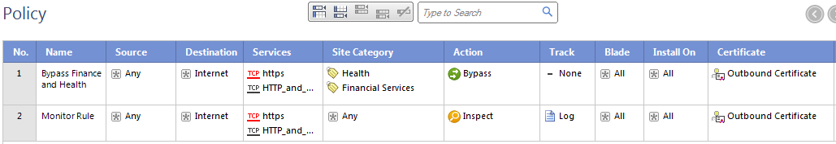
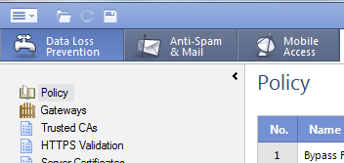
Configure Outbound HTTPS Inspection
Example rule base for monitoring
Create the rule base and save the changes
Close the SmartDashboard and install the policy.
Notes:
Keep in mind that in Europe you must configure a rule to bypass HTTPS Inspection for sites that belong to Financial Services or Health category. There is a law enforcing this.

Slide 23

Bypassing Update Services
Note that by default “well known update services” are excluded from HTTPS Inspection.
The list of update services is documented at sk98655:
    Check Point updates
    Microsoft updates
    VMware updates
    Mozilla updates
    Java updates
    Adobe updates
Notes:
Updatable objects sk131852
Starting from R80.20, updateable objects are supported for the Access Rule Base (the main rule base).
Starting from R80.40, updateable objects are supported for the HTTPSi and TP Rule Bases.
Starting from R81, updateable objects are supported for the NAT Rule Base.
Keep in mind that the above list refers to the canonical name of the update services. The actual domain URL may change over time. These changes are reflected in the application control database.
Since R80.40, an Updatable Object was introduced to ease the process of bypassing such applications.
Remember to keep your APCL and URLF database updated!

Slide 24
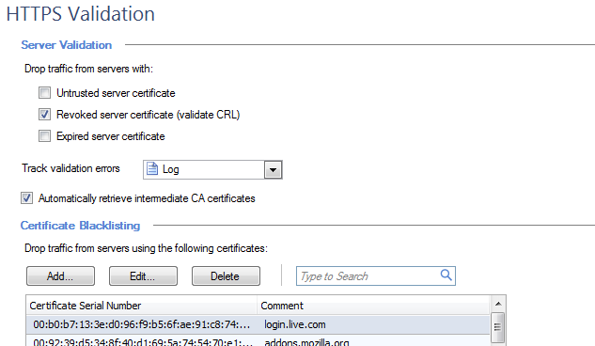
HTTPS Inspection Validation Settings
By default HTTPS traffic is dropped only from sources where the certificate has been revoked
Drop traffic from untrusted sites
Drop traffic from sites with an expired certificate
Notes:
Be careful in changing this default setting.
Services like Microsoft Office 365 work with many sites that use certificates signed by CA’s, that are not imported in the default root certificate storage of the security gateway and the management server.
Best Practices: Internet connection
Show / Hide this section
Make sure the Security Gateway is connected to the Internet, either directly or through a proxy.
Proxy can be defined in the Security Gateway properties, or in the Global Properties.
If there is no Internet connection, then CRL fetch and intermediate CA fetch will fail (this will be logged).
The inspection will take place; however, URL-based or Category-based bypassing will not work.
Note: The CRL verifications are performed in the background asynchronously while matching the security policy (this mimics the behavior of the major web browsers).
Untrusted certificates and lack of CRLs can be configured as reasons to drop the connection:
Note: Checking the box "Log connections of clients that have not installed the CA certificate" will log connections of clients that have not installed the CA certificate, however it will also log other cases of dropped connections.
We recommend to clear this box.

Slide 25
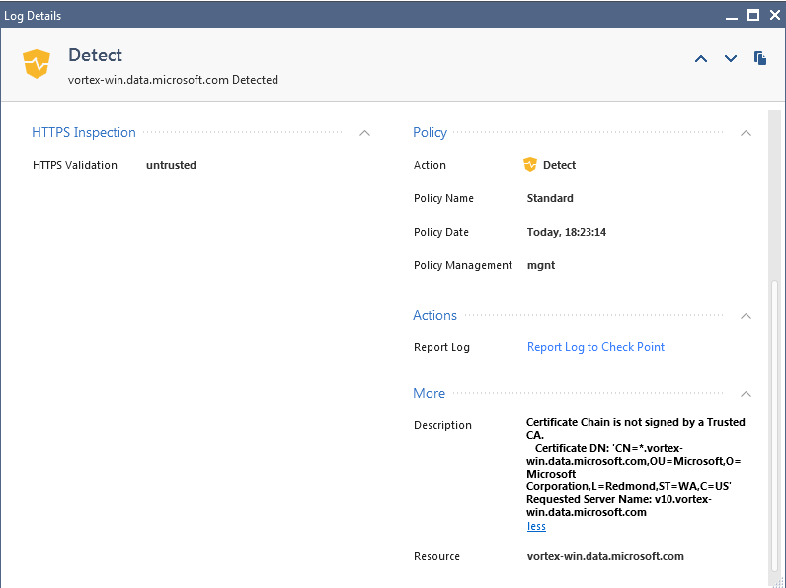
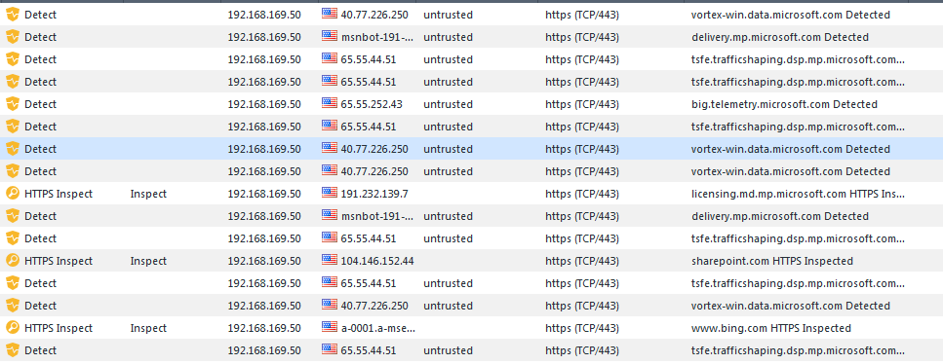
HTTPS Inspection Validation Settings
Trusted Certificate Authorities
You may want to observe your outbound network traffic and look for certificate “untrusted” log messages.

Slide 26
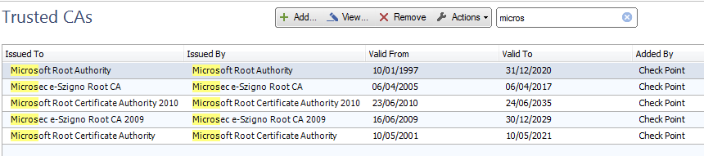
HTTPS Inspection Validation Settings
Trusted Certificate Authorities
Default list of Trusted Root Certificate Authorities
  Example: Microsoft

Slide 27
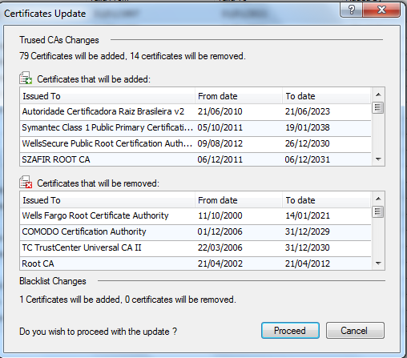
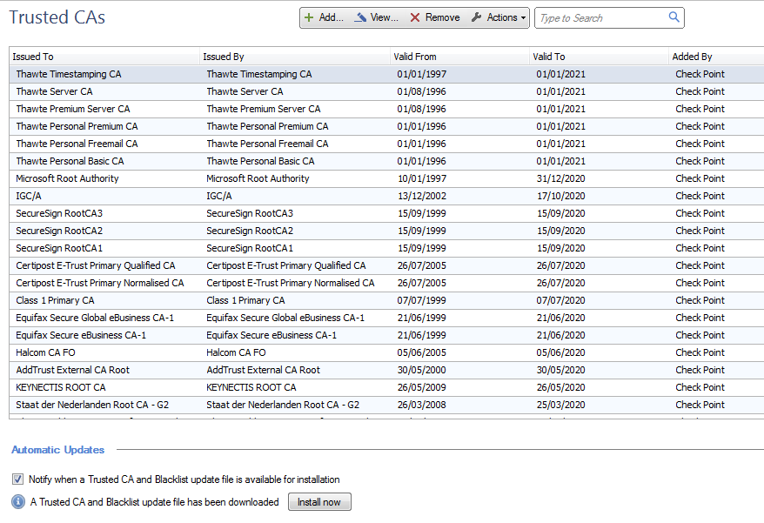
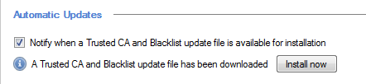
HTTPS Inspection Validation Settings
Trusted Certificate Authorities
The list of Trusted CAs is updated automatically but must be installed manually.
Notes:
Once you finish the install process you need to close the SmartDashboard.

Slide 28
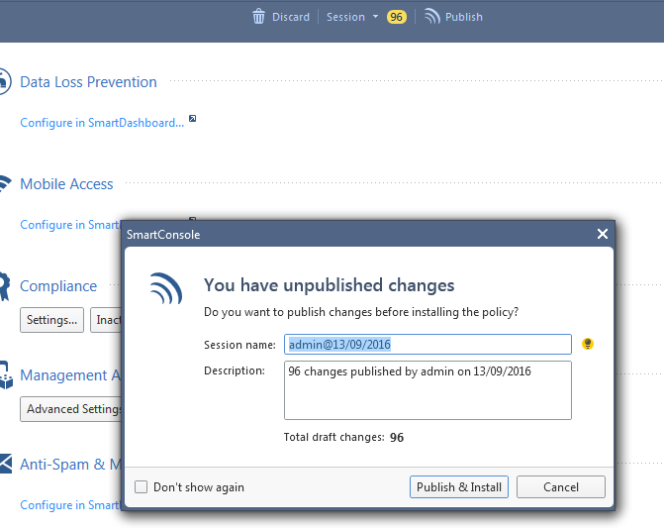
HTTPS Inspection Validation Settings
Trusted Certificate Authorities
Install the new list of Trusted CA Certificates
  Once you have closed the SmartDashboard you see in SmartConsole that there are changes to be published
Notes:
Publish the changes and install the policy.

Slide 29
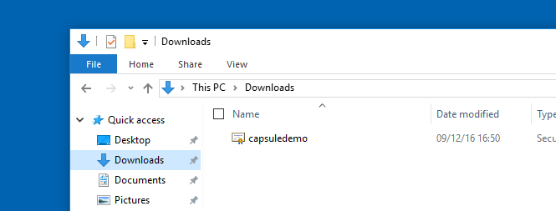
Import the Gateway CA Root Certificate
Windows Computers
Copy the Gateway Root CA Certificate to the computer
Notes:
Copy the root CA certificate to the Windows computer

Slide 30
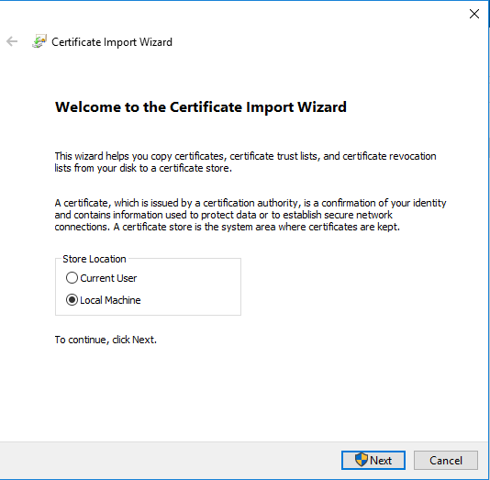
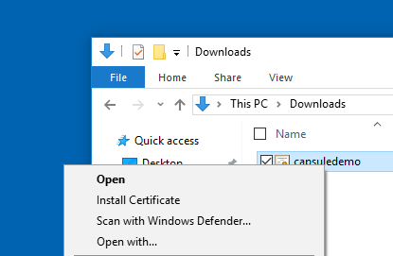
Import the Gateway CA Root Certificate
Windows Computers
Import the certificate into the certificate store
  Right click on the file
  Select “Local Machine” in the “Import Wizard”

Slide 31
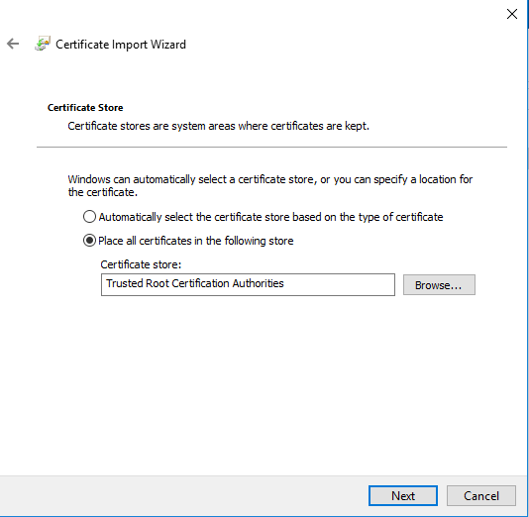
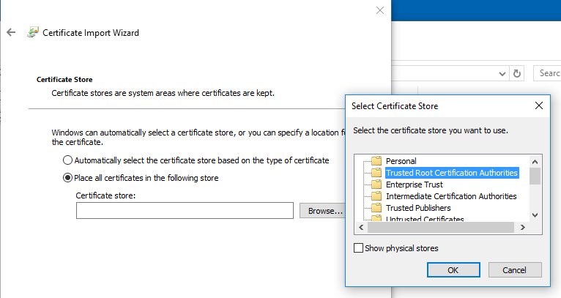
Import the Gateway CA Root Certificate
Windows Computers
Select “Place all certificates in the following store” and select “Trusted Root Certificate Authorities”

Slide 32
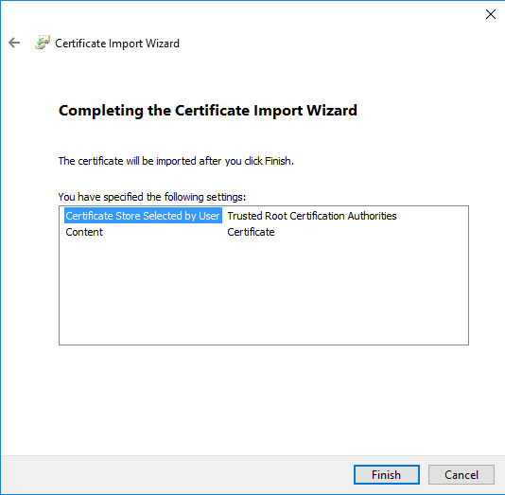
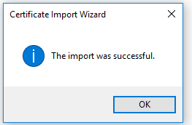
Import the Gateway CA Root Certificate
Windows Computers
Complete the wizard

Slide 33
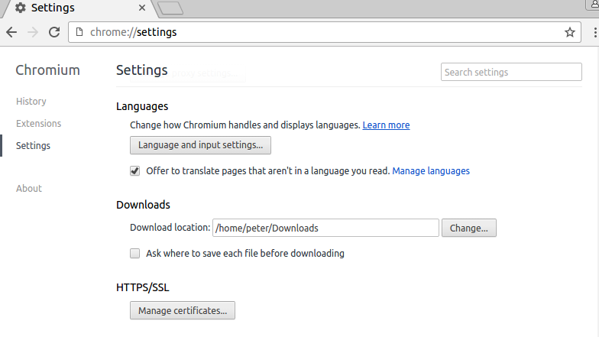
Import the Gateway CA Root Certificate
Linux Computers
When using Chrome on Ubuntu you need to import the certificate using the “advanced settings” dialog

Slide 34
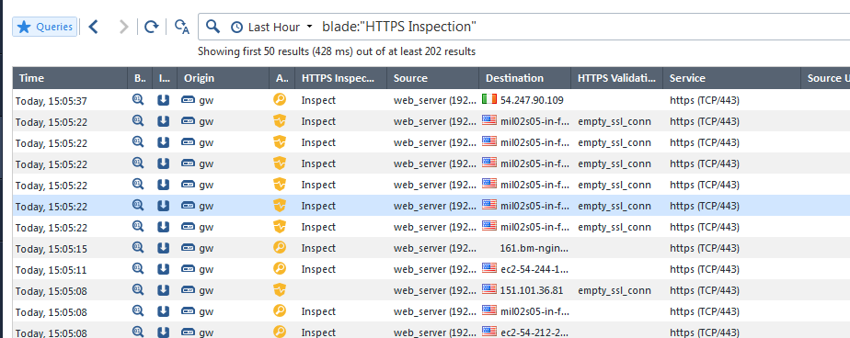
HTTPS Inspection Logs
Once You are accessing HTTPS sites on the Internet you will see the traffic is getting inspected.

Slide 35
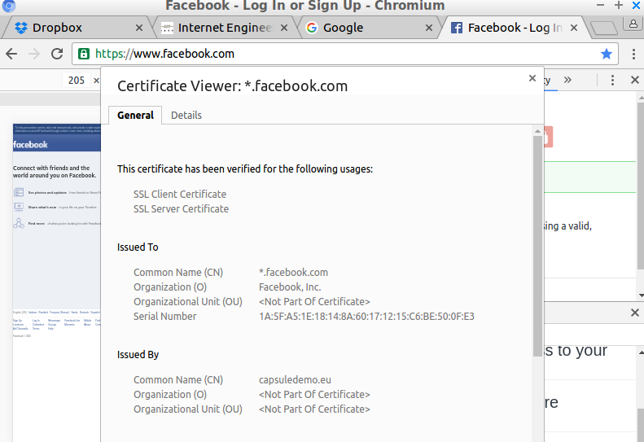
HTTPS Inspection – User Experience
The user will not notice that HTTPS Inspection is active unless she will verify the certificate in the browser

Slide 36
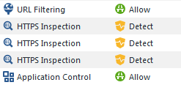
Monitoring Outbound HTTPS Inspection
APCL and URLF Blades are active
A client does access to https://www.duckduckgo.com
  The Root Certificate of the Gateways CA has been imported to the client
We see four log messages related to this action.
Lets look at the details
URL Filtering Blade
HTTPS Inspection Blade
Application Control Blade

Slide 37
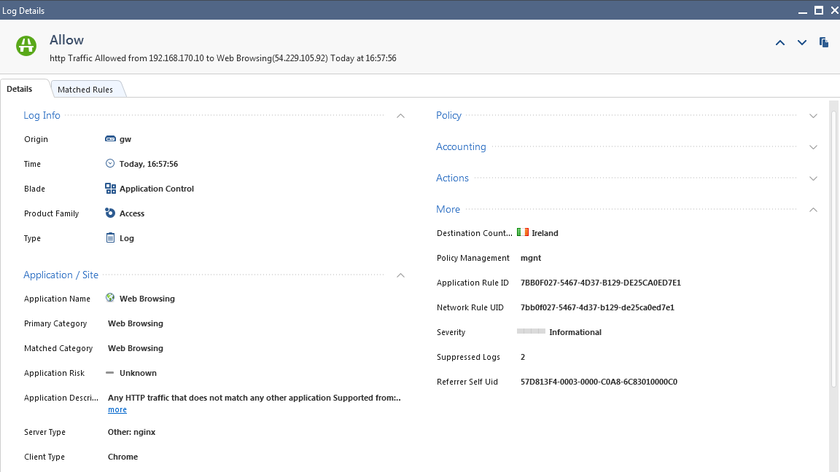
Monitoring Outbound HTTPS Inspection
APCL and URLF Blades are active
First the Application Control Blade does detect a “Web Browsing activity”

Slide 38
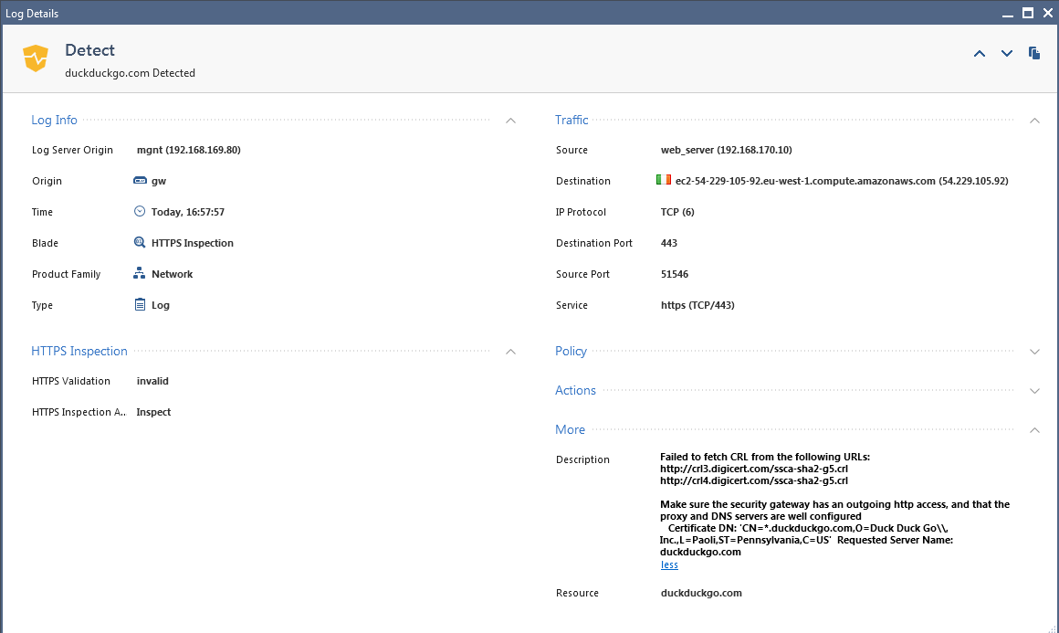
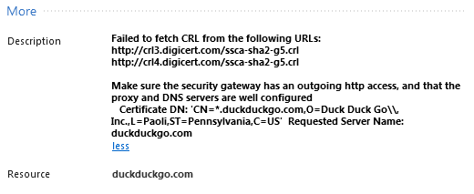
Monitoring Outbound HTTPS Inspection
APCL and URLF Blades are active
Then we see three log messages about the CRL related to the www.duckduckgo.com that could not be verified.

Slide 39
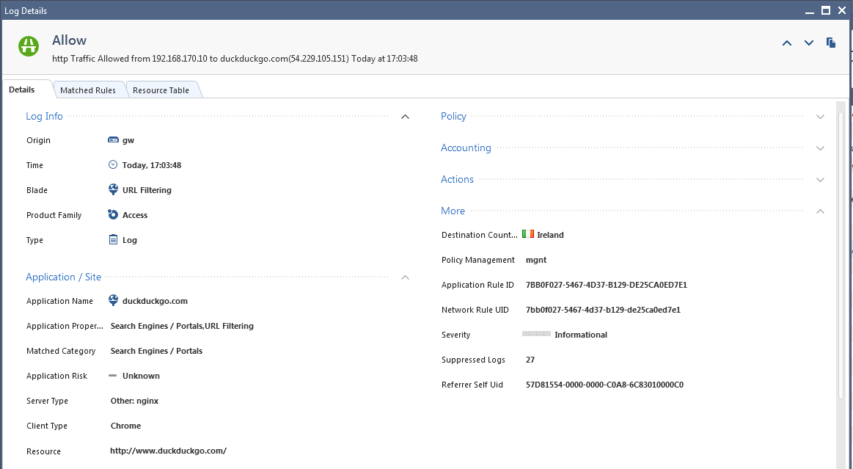
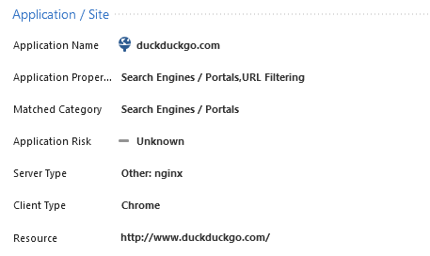
Monitoring Outbound HTTPS Inspection
APCL and URLF Blades are active
Then we see that the site has been categorized by the URL Filtering Blade.
Notes:
The "Categorize HTTPS websites" feature (in combination with URL Filtering) lets you categorize HTTPS sites without having to enable HTTPS Inspection.
When HTTPS Inspection is enabled, it also allows categorization for connections that are bypassed according the HTTPS Inspection rule base.
This feature does not perform inspection on the traffic and is only used to categorize sites so that URL Filtering rules can be enforced correctly.
Policies based on feature should consider that the confidence level in categorization is lower than that of HTTPS Inspection.
Similarly to HTTPS Inspection, the site’s category is resolved according to the SAN (Subject Alternative Name) or CN (Common Name) fields of server's certificate, and the SNI (Server Name Indication) TLS extension sent by the client.
Note: Just like with HTTPS Inspection, make sure the Security Gateway is connected to the Internet, either directly or through a proxy.
A proxy server can be defined in the Security Gateway properties, or in the Global Properties.

Slide 40
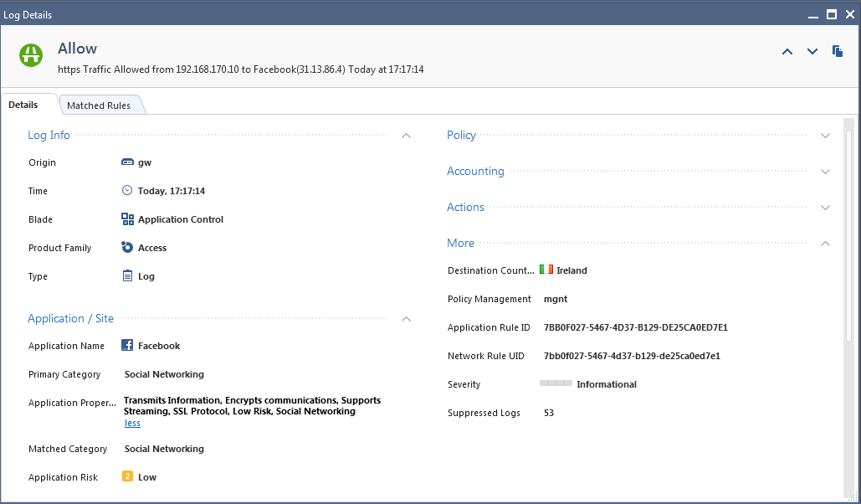
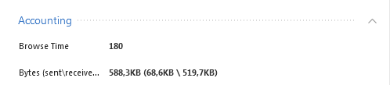
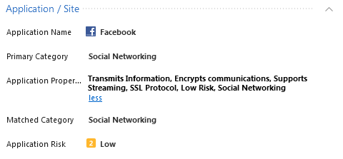
Monitoring Outbound HTTPS Inspection
APCL and URLF Blades are active
Access to Facebook is controlled by the Application Control Blade.
The time spent using the application and the amount of data transferred are logged.
These information are available for reporting.
Notes:
The “Browse Time” is given in seconds.

Slide 41
Inbound TLS Inspection

Slide 42
Inbound TLS Inspection – How It Works
Inbound HTTPS Inspection protects internal servers from malicious attacks coming from the Internet.
The Security Gateway doesn’t create a new certificate
The Security Gateway uses the server's original certificate and private key to initiate an TLS connection with the client.

Slide 43
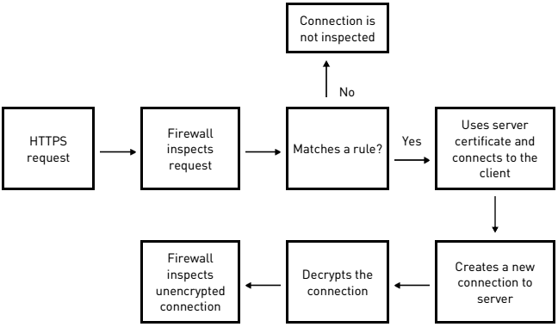
Inbound TLS Inspection – How It Works
Notes:
Inbound HTTPS Inspection protects internal servers (for example, data centers and web servers) from malicious attacks coming from the Internet.
Inbound connections are HTTPS connections that start from an external client and connect to an internal server in the DMZ or the network.
The Security Gateway compares the HTTPS request to the HTTPS Inspection Rule Base.
If the request does not match a rule, the packet is not decrypted.
If the request matches an inspection rule, the Security Gateway uses the certificate for the internal server to create a HTTPS connection with the external client.
The Security Gateway creates a new HTTPS connection with the internal server.
Since the Security Gateway has a secure connection with the external client, it can decrypt the HTTPS traffic.
The decrypted traffic is inspected according to the policy.
Flow on Security Gateway:
Intercept the request.
Use the server's original certificate and private key to initiate a TLS connection with the client.
Create and establishes a new TLS connection with the web server.
Using the two TLS connections:
Decrypt the encrypted data from the client.
Inspect the clear text content for all blades set in the policy.
Encrypt the data again to keep client privacy as the data travels to the destination server behind the Security Gateway.

Slide 44

Decrypt
Inspect
Re-encrypt
TLS Server
TLS Client
Security Gateway
Data
Center
Internet
HTTPS Interception: Inbound

Slide 45
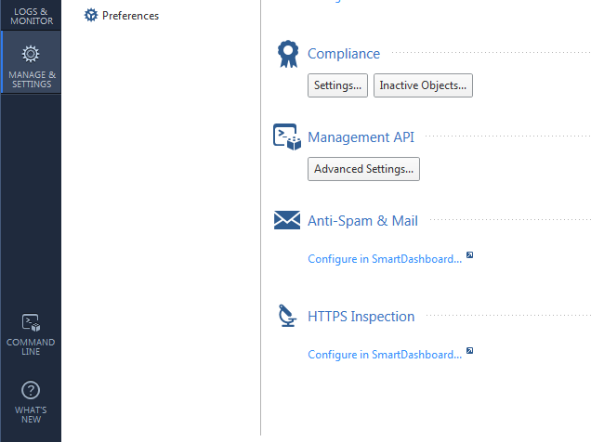
Configuring the HTTPS Inspection Policy
Configure HTTPS Inspection
You will be redirected to SmartDashboard.

Slide 46
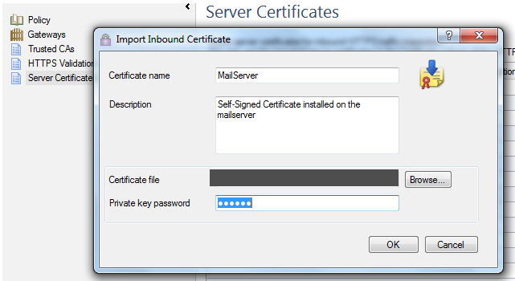
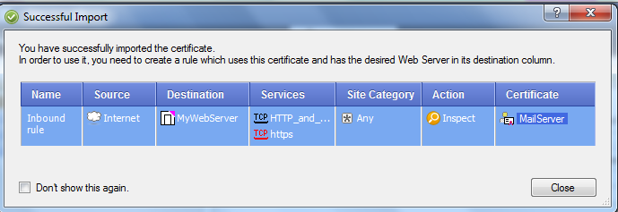
Import the Server Certificate
The Certificate and the related private key must be wrapped inside a PKCS#12 container.
Notes:
Using the entire certificate chain for configuring inspection of incoming traffic
When importing an internal server's certificate for incoming traffic inspection, it is necessary to include all the intermediate CAs of the chain in the *.p12 file.
Inclusion of only the server certificate may cause some browsers to warn about untrusted sites, since some browsers are unable to fetch and validate the complete certificate chain.
CA creation/import - Using a CA certificate for HTTPS Inspection of outgoing traffic
When importing an external certificate in SmartDashboard on the - "Advanced" - "HTTPS Inspection" - "Gateways" - "Import Certificate from file...", it is imperative to use a CA certificate, so that this certificate can be used to sign certificates generated by Security Gateway for outgoing traffic inspection.
Importing a non-CA certificate will result in client browsers refusing the connection.
For best security, the order should be:
3) Make the Security Gateway's internal CA a subordinate CA of an existing CA of the organization.
1) Deploy this certificate on the entire organization (usually through GPO for Windows domain).
2) Export a CA certificate from an existing CA of the organization.

Slide 47
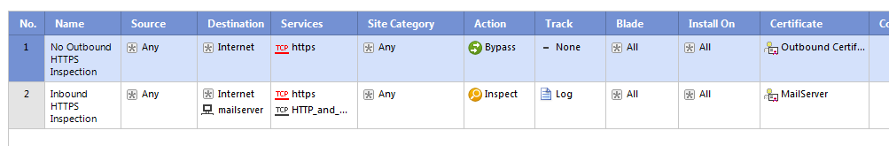
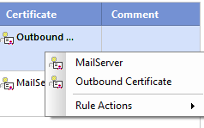
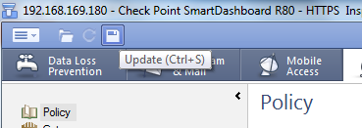
Configuring the HTTPS Inspection Policy
Create an outbound rule to bypass traffic
Create an inbound rule to inspect traffic using the servers certificate you have imported before.
  The Certificate does appear when You right-click on the Certificate column.
Save / Update Your settings before closing the SmartDasbhoard

Slide 48


Log example when using Inbound HTTPS Inspection

Slide 49
CONSTRAINTS AND best practices
Notes:
https://support.checkpoint.com/results/sk/sk108202

Slide 50
HTTPS Inspection Best Practices – General Guidance
Inbound, Outbound or both?
Gradual approach:
  Clearly defined limited case
  From a single GW to multiple
  From a single subnet to more
Always follow documentation!
  sk108757 httpsi performance impact
  sk108202 httpsi best practices
  sk112214 apps using cert pinning, etc.
  sk65123 httpsi FAQ
  sk167052 User Space Firewall (USFW) support in R80.30 3.10 and higher
  Threat Prevention Guide
Notes:
Categorize HTTPS traffic based on the FQDN does not work when there is a proxy between the gateway and the Internet or when the gateway itself is working as a proxy.
https://sc1.checkpoint.com/documents/R81/WebAdminGuides/EN/CP_R81_ThreatPrevention_AdminGuide/Search.htm?q=TLS
Sk108757 How to estimate the performance impact of HTTPS Inspection using the Appliance Sizing Tool
https://supportcenter.checkpoint.com/supportcenter/portal?eventSubmit_doGoviewsolutiondetails=&solutionid=sk108757
https://support.checkpoint.com/results/sk/sk108202
https://support.checkpoint.com/results/sk/sk112214
https://supportcenter.checkpoint.com/supportcenter/portal?eventSubmit_doGoviewsolutiondetails=&solutionid=sk167052

Slide 51
HTTPS Inspection Best Practices - Certificates
Inbound Inspection
  Some browser do full chain validation
  Include all intermediate CAs of the chain in *p12 file
Outbound Inspection
  GW should sign certificates as a CA
  When importing an external certificate in SmartDashboard, use a CA certificate
Make sure all intermediate certificates are signed SHA-256 or higher to avoid “The connection is not secure enough” warning in a browser
Notes:
Making sure all intermediate certificates in the chain are signed with SHA-256 to avoid browser warnings
For both incoming and outgoing inspection, validate that all intermediate certificates in the chain are signed with SHA-256 (or higher) algorithm.
Otherwise, browsers may warn (either by icon next to the URL, or in other ways) that the connection is not secure enough.
This limitation applies only to intermediate certificates in the chain, and not to root CAs.

Slide 52
HTTPS Inspection Constraints
Inspecting traffic over QUIC or HTTP/3 is not supported yet.
It is recommended to configure clients to use TLS instead, or reject such traffic to force them to use TLS.
See sk111754
Notes:
Categorize HTTPS traffic based on the FQDN does not work when there is a proxy between the gateway and the Internet or when the gateway itself is working as a proxy.
Sk108757 How to estimate the performance impact of HTTPS Inspection using the Appliance Sizing Tool
https://supportcenter.checkpoint.com/supportcenter/portal?eventSubmit_doGoviewsolutiondetails=&solutionid=sk108757
https://supportcenter.checkpoint.com/supportcenter/portal?eventSubmit_doGoviewsolutiondetails=&solutionid=sk111754

Slide 53
Building the Rulebase
Recommended – HTTPS traffic from desktop browsers
Bypass rules?
  Comply with regulations and laws
  Mobile applications that may not be forced to trust GW CA
  Certificate pinning and chain pinning (discussed later on)
  Non-browser based and/or non-standard TLS might be problematic
Multi-Category certificates (Google, etc)
Need FQDN or SNI (discussed later) for bypass/inspect decision
Update services (such as Microsoft updates) are implicitly bypassed in the HTTPS Inspection rulebase.

Slide 54
Internet connectivity
Gateway must be connected to Internet directly or through proxy
Without Internet connectivity:
  CRL fetch and intermediate CA fetch fails
  Although decryption works, URL-based categorization fails
Inspecting on a Bridge interface? Connect to Internet for CRL validation
Notes:
Note: Checking the box "Log connections of clients that have not installed the CA certificate" will log connections of clients that have not installed the CA certificate, however it will also log other cases of dropped connections. It is recommended to clear this box.

Slide 55
Certificate Pinning
Applications like Dropbox use Certificate Pinning
sk112214 Applications like Dropbox (Windows and Android), OneDrive (Android), LogMeIn (Android) or GoToMeeting (Android) do no longer work, when you enable HTTPS Inspection on the Security Gateway.
These applications use Certificate Pinning (link to Wikipedia):
  “The HTTPS web server serves a list of public key hashes, and on subsequent connections clients expect that server to use one or more of those public keys in its certificate chain.”
The sk112214 is constantly updated
Notes:
You enable HTTPS Inspection on the Security Gateway and OneDrive will work from Your Windows computer but no longer from Your Android device. This is not the fault of Check Point: it is a result of the Security Mechanics implemented in the applications (read for example about Dropbox Certificate Pinning here). To allow the use of the applications listed in the sk112214 You need to create HTTPS Inspection bypass rules as documented in the sk. You may want to monitor the sk112214 for changes as the list of applications will be updated over time.

Slide 56
TLS Inspection – Performance
HTTPS Inspection creates additional load on Security Gateway's CPU due to these reasons:
  TLS termination, encrypt/decrypt and active TCP termination that consume CPU resources
  Additional traffic is inspected by the security blades.
When enabling HTTPS Inspection in an existing configuration, the CPU utilization on Security Gateway (R77.30/R80.10) is expected to increase
  by factor of 1.6 for NGTP configuration
  by factor of 2 for NGFW configuration
Better performance figures with R80.20 and up

Slide 57
TLS Inspection Features R80.30+
SNI Support – NG Bypass
New Ciphers and Curves
Ciphers Configuration Tool
Fail Open/Close
TLS Inspection Acceleration
Hardware Security Module (HSM)
Mirror and Decrypt
LIGHT TLS - Categorize HTTPS sites

Slide 58

SNI Support – Background & Terminology
Server Name Indication (SNI) is an extension to the TLS Protocol
The Client indicates which hostname it is attempting to connect to at the start of the handshaking process

Slide 59

SNI Support – Background & Terminology
This allows a server to present multiple certificates on the same IP address and TCP port number
This allows multiple secure (HTTPS) websites to be served by the same IP address

Slide 60

SNI Support – Background & Terminology
Subject Alternative Name (SAN) - is an extension to certificates that allows various values to be associated with a security certificate using a subjectAltName field

Slide 61
SNI Support – Background & Terminology
SAN Certificates can secure multiple domains with a single certificate
SAN Certificates allow you to secure a primary domain and then add additional domains to the subject alternative name field of the certificate

Slide 62
SNI Support – NGBypass
Bypass - In some cases HTTPS inspection should be avoided and certain sites have to be bypassed by the blade
  Privacy considerations: Finance data, Medical data, etc.
  Technical reasons: Key pinning, Client certificate usage, etc.
Notes:
To allow bypass without impact on user experience or privacy, it is necessary to determine the site's category without performing TLS decryption.
To accomplish this, the site’s category is resolved according to the SAN (Subject Alternative Name) or CN (Common Name) fields of server's certificate, and the SNI (Server Name Indication) TLS extension sent by the client.
When the SNI extension isn’t provided by the client, users should take into account that connections to servers that present the same server certificate may be matched to the same category.

Slide 63

SNI Support – Wrong Matching Example
  Connection to https://www.youtube.com is categorized by CN (*.google.com) and Inspected by rule #2
  Since YouTube and Google Search present the same certificate - the connections to both sites will be matched as if they are both categorized as "Search Engines" - the bypass rule of YouTube(Media Sharing) will be ignored.

Slide 64
SNI Support – Wrong Matching Example
  Connections to YouTube Must be bypassed by rule #1 (Media Sharing Category)
  Could be bypassed if we used SNI (www.youtube.com) instead of CN (*.google.com)

Slide 65
SNI Support
NGBypass project adds support to Verified SNI matching
Adds support for Multiple services per IP
  Since we pass SNI to the server it would provide us the relevant certificate
Adds support for multiple services per certificate
  We would be able to verify that the SNI is matching the certificate. Within same certificate we can distinguish between services by SNI.

Slide 66

SNI Support
SNI is validated, i.e. must match at least one option from Subject Alternative Name
Some security products use the SNI extension for the categorization without Validation
  The Decrypt/Bypass decision is done according to this categorization.
  This method is not secure since an attacker can use a fake SNI in order to connect to a webserver. The attacker will be able to Bypass the connection to the sever.
  The Rule-Base decision will be made based on the fake SNI
Notes:
Competitors video
https://www.youtube.com/watch?v=yXv-svU72nM&index=2&list=PLwVbDDblU9bdPfgpldt89DZUFZi_q7t-S&t=0s

Slide 67

Validate SNI vs certificate
SNI
TLS probing
Client
Hello
TLS Server
TLS Client
Security Gateway
Offices
Internet
SNI Verification

Slide 68
Ciphers and Curves
We added support for all TLS 1.2 important ciphers and curves
    TLS_RSA_WITH_AES_256_GCM_SHA384
    TLS_RSA_WITH_AES_256_CBC_SHA256
    TLS_ECDHE_RSA_WITH_CHACHA20_POLY1305_SHA256
    TLS_ECDHE_ECDSA_WITH_CHACHA20_POLY1305_SHA256
    TLS_ECDHE_RSA_WITH_AES_256_CBC_SHA384
    TLS_ECDHE_RSA_WITH_AES_128_CBC_SHA256
    TLS_ECDHE_ECDSA_WITH_AES_256_CBC_SHA384
    TLS_ECDHE_ECDSA_WITH_AES_128_CBC_SHA256
x25519 , P-256, P-384, P-521 Elliptic Curves
TLS 1.3 see sk167052
Notes:
From R81, Check Point Security Gateway can inspect the Transport Layer Security (TLS) v1.3 traffic (see RFC 8446).
Make sure gateway supports TLS 1.3 supports the User-space Firewall (USFW) mode. https://supportcenter.checkpoint.com/supportcenter/portal?eventSubmit_doGoviewsolutiondetails=&solutionid=sk167052

Slide 69

Cipher Util
Easy cipher suite configuration with interactive UI on Security Gateway.
Supported in TLS-Inspection & Multi-Portal for portals on port 443, such as:
  TLSVPN
  DLPSenderPortal
  SecurePlatform(Gaia Portal)
  UserCheck
  NAC
Prioritizing active ciphers and disabling unsafe ciphers for each blade.
Run by entering : cipher_util

Slide 70

Cipher Util
Printing configured cipher-suites on each blade
Enabling disabled ciphers
Disabling unsafe ciphers
Reordering ciphers for prioritization in each connection
Further information can be found in SK126613.

Slide 71

Fail Open/Close
In R80.10 a Fail Open/Close configuration was added.
    Fail Open - HTTPS traffic is Bypassed in case of failures
    Fail Close - HTTPS traffic is blocked in case of failures
The functionality of this feature has improved significantly in R80.30

Slide 72


Hardware Security Module (HSM)
Hardware Security Module (HSM) is a device that is used to store cryptographic keys
HSM is designed to provide dedicated cryptographic functionality.
HSM adds an extra layer of security to the network

Slide 73
Hardware Security Module (HSM)
When Check Point Security Gateway uses an HSM, the HSM holds these objects for outbound HTTPS Inspection:
The Certificate Authority (CA) certificate (certificate buffer + key pair).The administrator creates the CA certificate and key pair before configuring the Security Gateway to work with an HSM.
Two to three key pairs for fake certificates.These keys are created during the initialization of the HTTPS Inspection daemon on the Security Gateway with 1024-bit, 2048-bit, or 4096-bit length.

Slide 74
Mirror and Decrypt
The Mirror and Decrypt feature on your Security Gateway performs these actions:
  Mirror only of all traffic - Clones all traffic (including HTTPS without decryption) that passes through, and sends it out of the designated physical interface.
  Mirror and Decrypt of HTTPS traffic - Clones all HTTPS traffic that passes through, decrypts it, and sends it in clear-text out of the designated physical interface.
    HTTPSi must be enabled on the Security Gateway

Slide 75


Mirror and Decrypt

Slide 76

HTTPSI Lite - Categorize HTTPS sites
This feature lets Application and URL Filtering assign categories to HTTPS sites without activating HTTPS inspection
It allows the administrator to create access rules(Accept/Drop) For specific applications and categories
It assigns a site category based on CN (or verified SNI)
Does not require HTTPSi enablement in R80.40

Slide 77
R80.40+ HTTPS Inspection?
HTTPS Inspection Layer in Smart Console, with API support
Dynamic, Domain and Updatable objects in HTTPSi Policy Layer
Updatable objects for Update Services and Optional Bypass
HTTP/2 support

Slide 78


R80.40+ HTTPS Inspection Policy In SmartConsole
HTTPS Inspection Policy shown in policy package
Notes:
By integrating the HTTPS inspection policy into the SmartConsole we take way burden from the customer to work with the legathy SmartDashboard for the most frequent HTTPS management tasks.

Slide 79

R80.40+ Updatable Objects with HTTPS Inspection
Updatable Objects and Domain Objects in FQDN mode are now supported
  This eases the description of cloud hosted services
Configure a ‘catch all’ rule allowing the matching process to end correctly
Notes:
One of the most important improvements in R80.40 release is having the HTTPS Inspection Policy inside the SmartConsole. Now customers can see the policy in the context of their Access Control and Threat Prevention Policies.
Another important improvement is the support of updatable and FQDN objects making it easy to describe services hosted in the cloud.

Slide 80

R80.40+ Updatable Objects with HTTPS Inspection
Refer to sk112214 for examples of sites impacted by certificate pinning
Notes:
Ease configuration for traffic directed to cloud hosted services
Updatable Objects are resolved on GW
New objects can be added to the tree
without updating tSmartConsole
Updatable Objects describing sites using Certificate Pinning

Slide 81
The Value Of HTTP/2 - Loading web pages faster
HTTP/1 opens a separate TCP session for each element of the web page
HTTP/2 is loading more than four times faster
HTTP/2 is protected by TLS 1.2
  In very rare cases you may find HTTP/2 over TCP
HTTP/2 works in streams (RFC 7540)
Notes:
Add stats about current distribution of HTTP/2

Slide 82

Demo https://http2.akamai.com/demo
HTTP/1.1
Load time 9,36s
HTTP/2
Load time 2,11s
Notes:
Add stats about current distribution of HTTP/2

Slide 83

The Value Of HTTP/2 - Loading web pages faster
42,6% of the Web supports HTTP/2 (Jan 2020)
  Source 6-Jan-2020:
  https://w3techs.com/technologies/details/ce-http2/all/all
Notes:
Add stats about current distribution of HTTP/2

Slide 84



Support of HTTP/2 over TLS in R80.40
A new protocol parser for HTTP/2 has been added and enabled by default
HTTP/2 Protocol Parser requires HTTPS Inspection being enabled
HTTP/2 Web Sites
Data Center
Users/Computers
Management
No special configuration for HTTP/2 support is required
Notes:
A new protocol parser for HTTP/2 has been added and enabled by default
No special configuration for HTTP/2 support is required
HTTP/2 Protocol Parser requires HTTPS inspection being enabled
Remember R80.20 introduced a new TLS Protocol Parser and moving CPAS to medium path is saving up to 60% CPU cycles
Remember R80.30 introduced SNI support improving HTTPS inspection policy matching

Slide 85

Logs for HTTP/2
The Protocol field displays relevant protocol found inside the TLS connection
Possible values are:
  HTTP:
    Clear text HTTP/1.1
  HTTPS
    HTTP/1.1 over TLS
  H2C
    Clear text HTTP/2.0
  HTTP2
    HTTP/2.0 over TLS

Slide 86

Monitoring HTTP/2 using CPVIEW
Find HTTP/2 protocol monitor:
Advanced > HTTP-Parser > HTTP2-Information
‘HTTP2-Information’ tab contains additional data on HTTP/2 connections such as:
  Total open connections
  Number of current streams
  Connection types (HTTP/2 over TLS: H2)
  Errors
  Fame types

Slide 87
TLS1.3 Support
TLS 1.3 protocol
  All handshake messages after the ServerHello are encrypted.
  The handshake state machine has been restructured to be more consistent and remove superfluous messages.
  New message types
  A zero-RTT (0-RTT) mode - zero round trip time - significant improvement in performance by reducing latency
  New Session resumption mechanism – single PSK exchange

Slide 88
Adding support for additional protocols
Adding support for more protocols besides HTTPS :
  Other protocols over TLS :IMAPS, FTPS, SMTPS, POP3S, MQTTS
  Other protocols over other cryptographic protocols :
    SSH – SFTP, SCP

Slide 89
Thank you
Micki Boland
Cybersecurity Architect and Evangelist
1 JUN 2023

