Slide 1
Public cloud security blueprint
Maya Levine | Technical Marketing Engineer

Slide 2
Agenda
Challenges
Cloud Security Architectural Principals
Blueprint: Architectures & Solutions

Slide 3
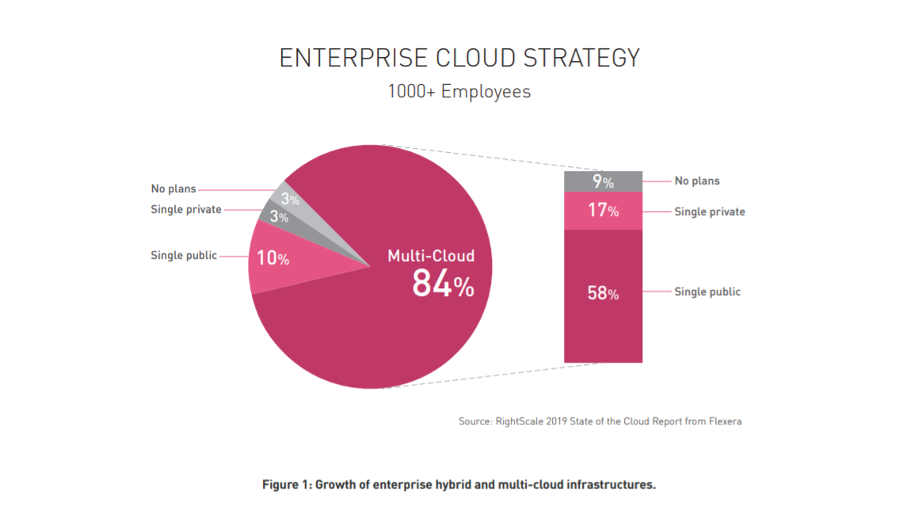
Notes:
cloud computing adoption is close to universal across organizations of all sizes: 94% of survey respondents reported that their organization uses the public cloud. We also see that enterprises continue to embrace hybrid and multi-cloud strategies (see Figure 1). Hybrid cloud adoption has grown from 51% to 58%, and multi-cloud adoption increased from 81% to 84% over the previous year.

Slide 4
Challenges
Increased attack surface
Lack of Visibility and Tracking
Ever-Changing Workloads
DevOps, DevSecOps, and Automation
Granular Privilege and Key Management
Multi-Cloud Environment
Compliance and Regulations
Notes:
Increased attack surface - The public cloud environment has become a large and highly attractive attack surface for hackers who seek to exploit poorly secured cloud ingress ports in order to access and disrupt workloads and data in the cloud.
Lack of visibility and training: cloud assets are difficult to identify/quantify. Visualizing cloud environments can be challenging leading to security enforcement gaps
Ever changing workloads: Cloud assets are provisioned and decommissioned dynamically—at scale and at velocity. Traditional security tools are simply incapable of enforcing protection policies in such a flexible and dynamic environment. New tools and approaches are required to secure today’s ever-changing and ephemeral workloads.
DevOps: Need to embed security controls into the CICD processes of deelopers. Find issues in code or templates early in the development cycle
Granular Privilege and Key Management: It is not unusual for cloud user roles to be configured very loosely, granting extensive privileges beyond what is intended or required. One common example is giving database delete or write permissions to users who are untrained or simply have no business need to delete or add assets. The situation is similar at the application level, where improperly configured keys and privileges create security risks through key leakage or poorly protected sessions
Multi cloud Environment: Each cloud provider offers tools and services to help customers monitor & secure cloud resources….but these only apply to its own cloud services for most part. You need tools that work seamlessly across public cloud providers
Compliance: customers are responsible for ensuring that their workload and data processes are compliant. In addition, given the poor visibility and dynamics of the cloud environment, the compliance audit process can be painstaking unless customers use tools that perform real-time and continuous compliance checks for misconfigurations, including alerting and automatic remediation as required.

Slide 5





ZERO TRUST
Notes:
the basic principle of Zero Trust is not to trust anyone or anything—and verify everything. There are attackers both within and outside of the network and, by default, users and machines should never be automatically trusted. You need to assume that all traffic, regardless of location, is threat traffic until it is verified (i.e., authorized, inspected, and secured).
Zero Trust, for example, promotes a least privilege governance strategy whereby users are only given access to the resources they need to perform their duties. Furthermore, today’s modern applications often grant extensive privileges to the components that comprise the distributed architecture. Web-facing applications are particularly vulnerable. For example, if the developer has not blocked ports consistently or has not implemented permissions on an “as needed” basis, a hacker who takes over the application will have privileges to retrieve and modify data from the database.
In addition, Zero Trust networks utilize micro-segmentation—a method of creating secure zones in data centers and cloud deployments that segments workloads from each other, secures everything inside the zone, and applies policies to secure traffic between zones. This makes network security far more granular. It is also important to continuously inspect and log all internal and external traffic in order to monitor for malicious activity with real-time protection capabilities.
The idea of a trusted internal network and an untrusted external network needs to be discarded

Slide 6
Attack Vectors to Be Secured
IDENTITY
DATA
COMPUTE

Slide 7
Security by Design
Misconfigurations
Segmentation & Micro-Segmentation
Agility
Automation, Efficiency, Elasticity
Borderless
Compliance

Slide 8
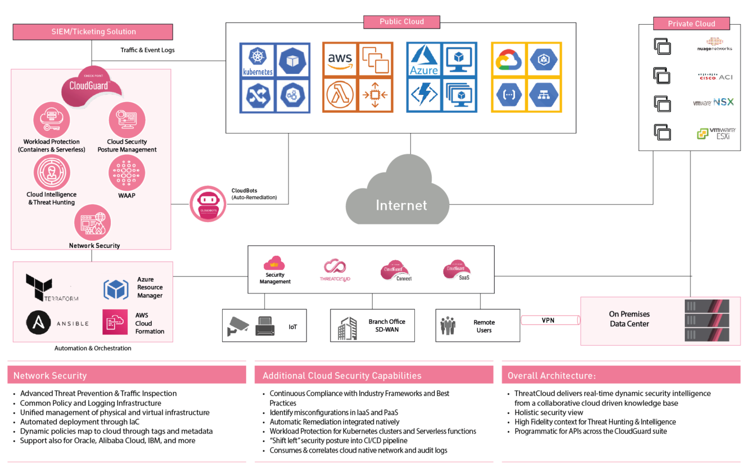

Slide 9
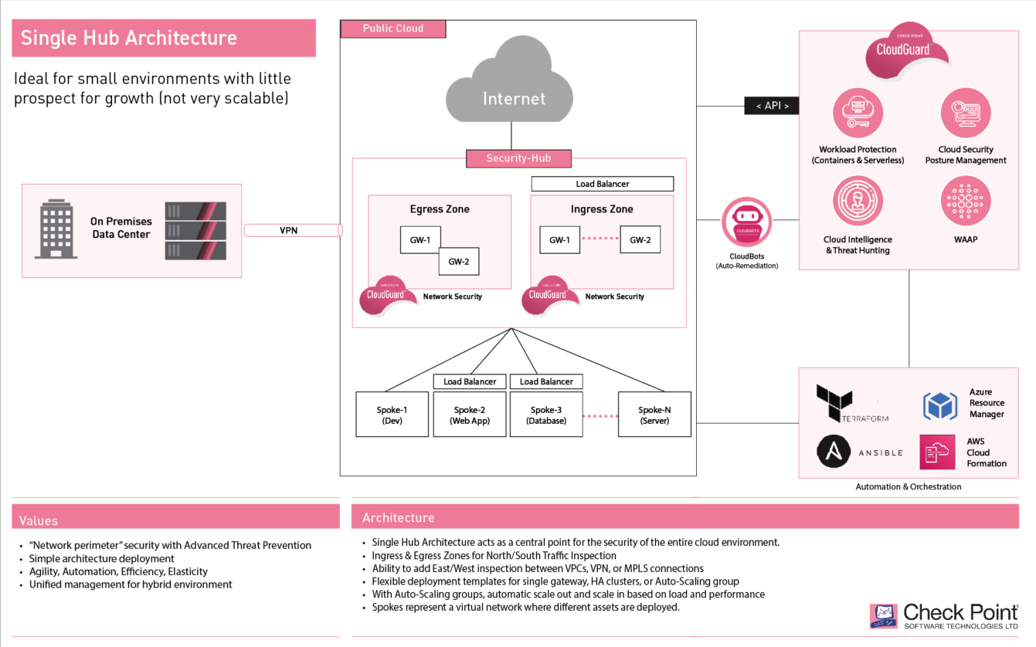

Slide 10
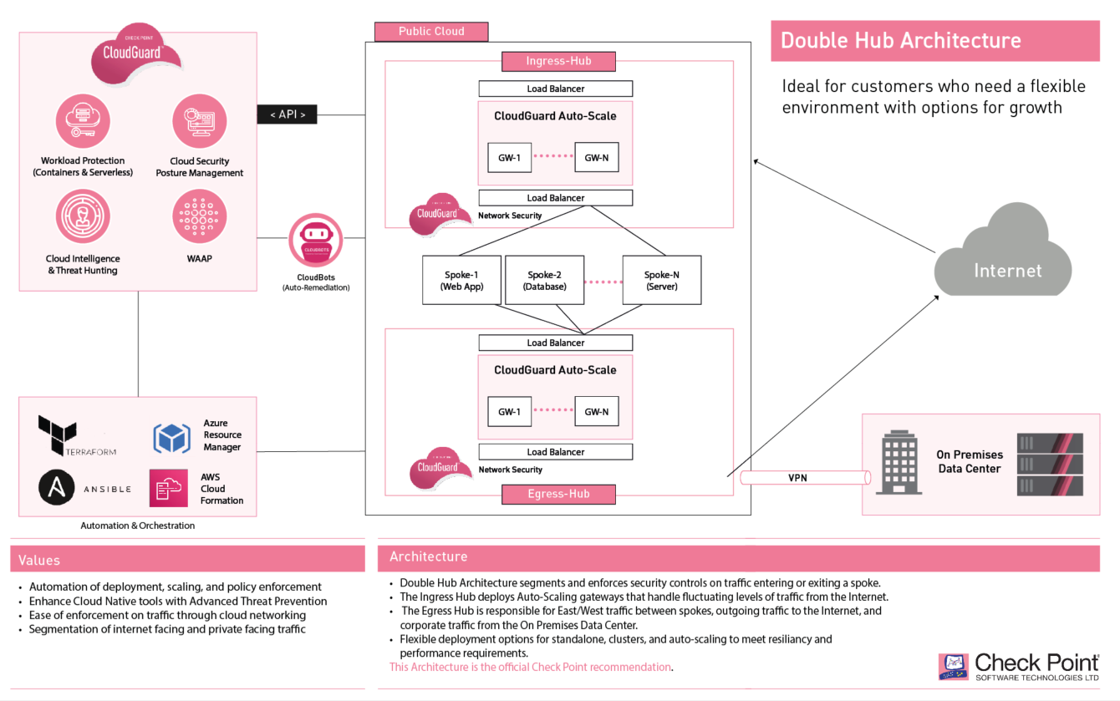

Slide 11
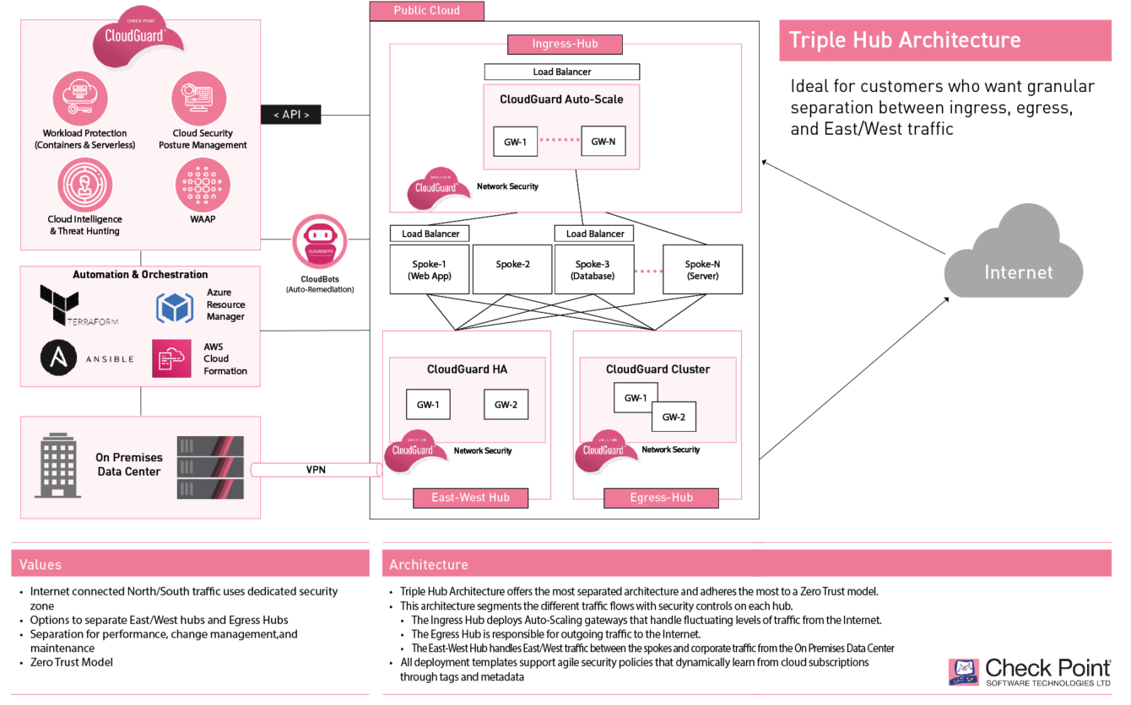

Slide 12


Slide 13
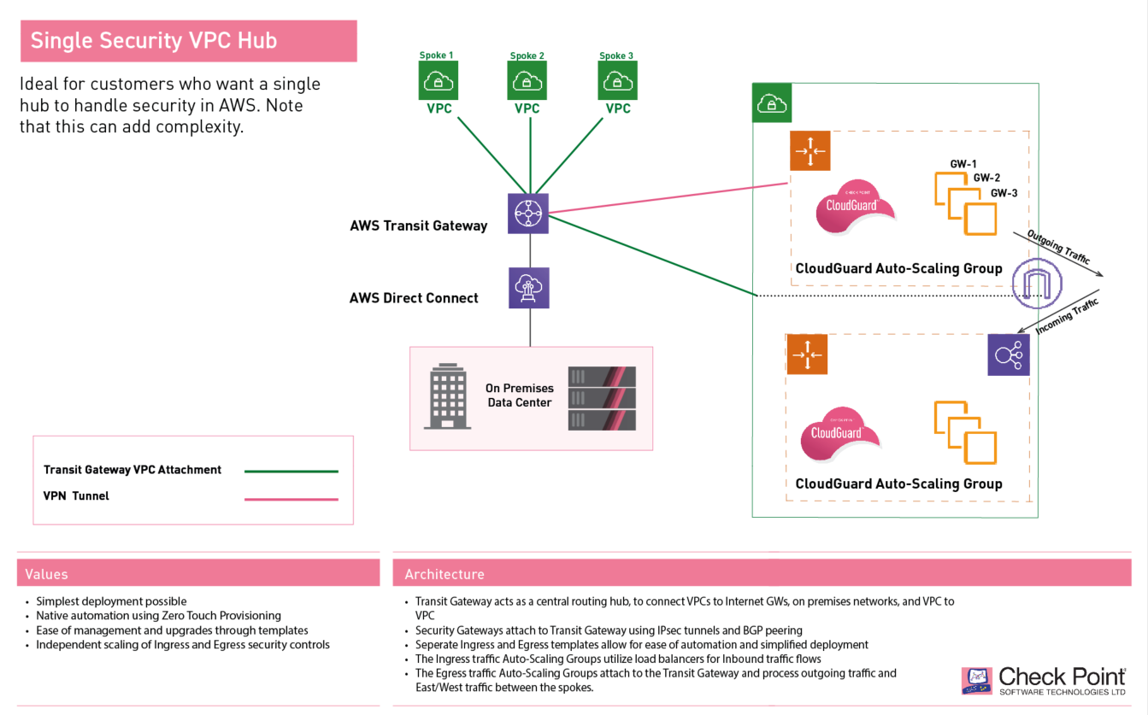

Slide 14
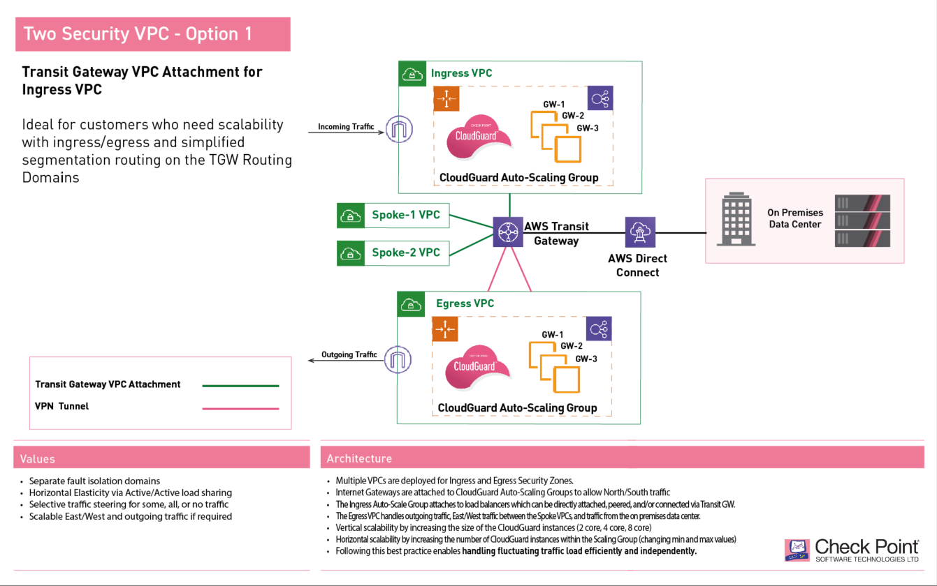

Slide 15
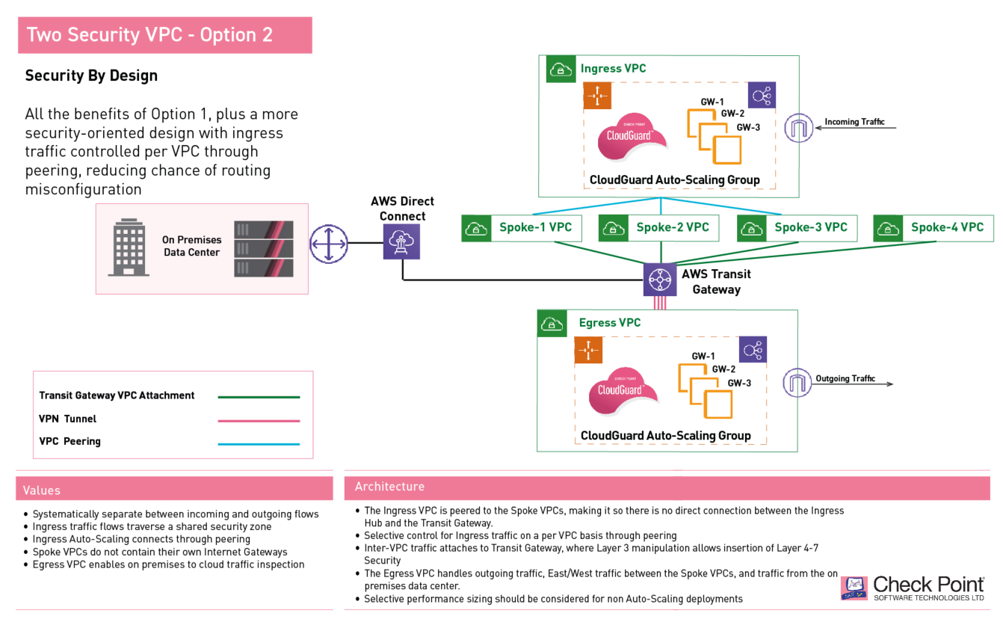

Slide 16
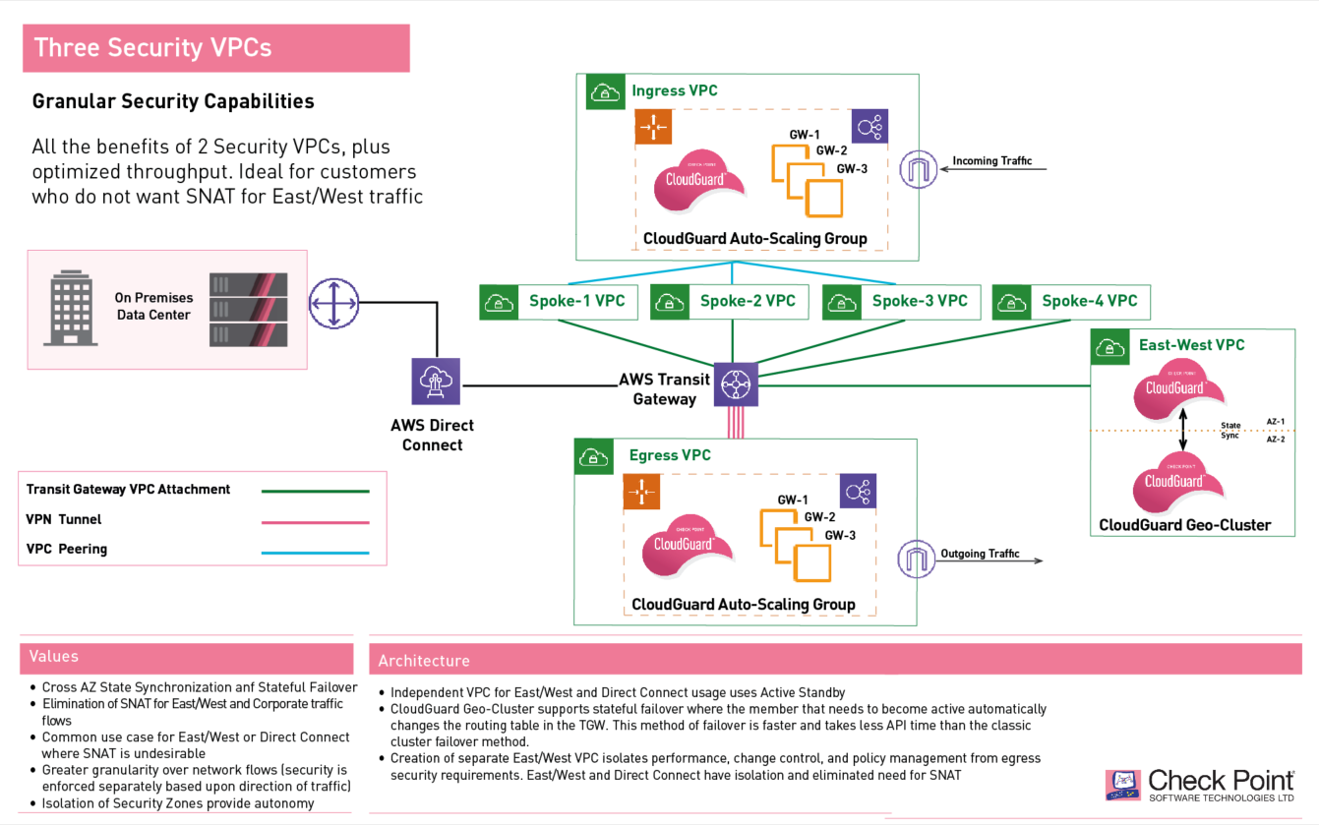

Slide 17


Slide 18
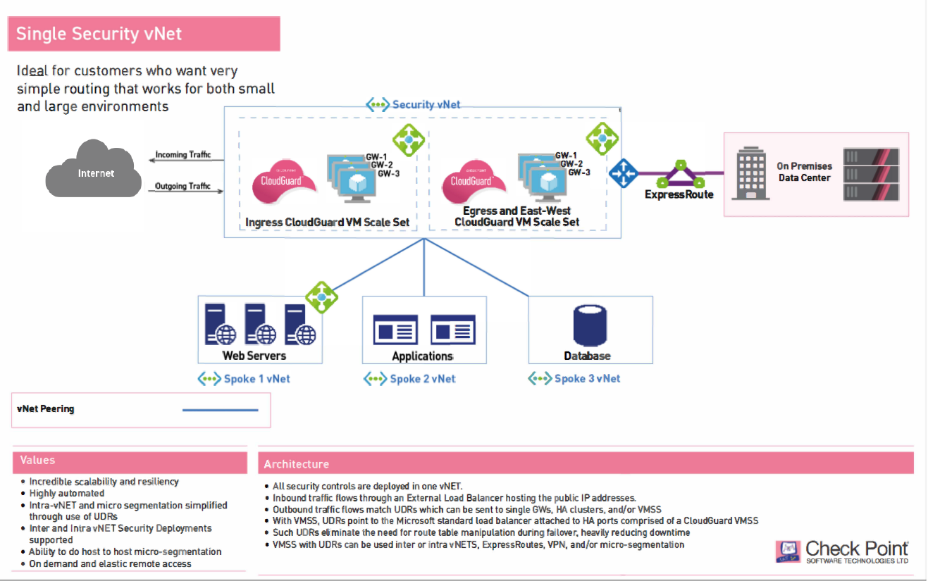

Slide 19
